Slide 1



On the Vulnerability of Large Graphs
Joint work by
Hanghang Tong, B. Aditya Prakash, Charalampos Tsourakakis
Tina Eliassi-Rad, Christos Faloutsos, Duen Horng (Polo) Chau

Slide 2

Motivation: Immunization
Given: a graph A, virus prop model and budget k;
Find: k ‘best’ nodes for immunization.
23
16
24
15
12
14
25
22
13
26
11
21
27
9
34
20
10
1
28
4
8
33
19
2
29
3
7
18
5
30
6
17
31
32
SARS costs 700+ lives; $40+ Bn; H1N1 costs Mexico $2.3bn

Slide 3

Motivation: Immunization
Given: a graph A, virus prop model and budget k;
Find: k ‘best’ nodes for immunization.
23
16
24
15
12
14
25
22
13
26
11
21
27
9
34
20
10
1
28
4
8
33
19
2
29
3
7
18
5
30
6
17
31
32
SARS costs 700+ lives; $40+ Bn; H1N1 costs Mexico $2.3bn

Slide 4
Challenges
Given a graph A, and budget k,
  Q1 (Measure): how to measure the `shield-value’ for a subset of nodes (S)?
  Q2 (Algorithm): how to find a subset of k nodes with highest ‘shield-value’?

Slide 5
Roadmap
Motivation
(Q1) ‘Shield-value’
(Q2) Netshield Algorithm
Experimental Results
Conclusion

Slide 6
Background: SIS Virus Model [Chakrabarti+ 2008]
‘Flu’ like: Susceptible-Infectious-Susceptible
If the virus ‘strength’ s < 1/ λ , an epidemic can not happen
Intuition
  s ≈ # of sneezes before heal
  Largest eigenvalue λ ≈ # of edges/paths
λ indicates the vulnerability of the whole graph A !

Slide 7
Eigen-Drop: an Ideal `shield-value’?
Eigen-Drop(S)=λ-λ_{s}
9
9
11
9
10
10
1
1
4
4
8
8
2
2
3
7
3
7
5
5
6
6
Original Graph: λ
Without {2, 6}: λ_{s}

Slide 8
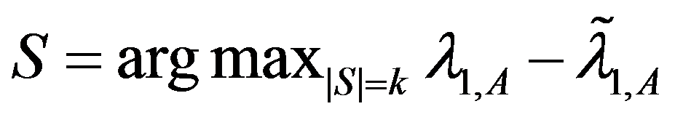
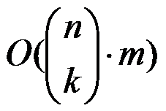
Why not Use Eigen-Drop as `Shield-Value’ ?
Select k nodes, whose absence creates the largest drop in λ
We need in time
  Example:
    1,000 nodes, with 10,000 edges
    It takes 0.01 seconds to compute λ
    It takes 2,615 years to find best-5 nodes !
λ-λ_{s}
Largest eigenvalue
w/o subset of nodes S

Slide 9
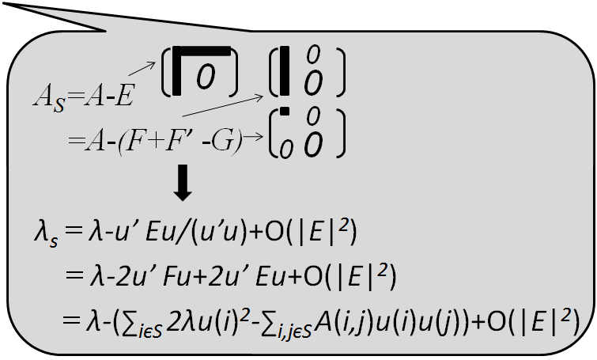
Our `Shield-Value’: Approx Eigen-Drop
Theorem:
(1) λ - λ_{s}≈Sv(S)= ∑_{iєS} 2λu(i)²-∑_{i,jєS} A(i,j)u(i)u(j)
A
u
u
= λ X
u(i): eigen-score
Footnote: u(i) ~ PageRank(i) ~ in-degree(i)

Slide 10
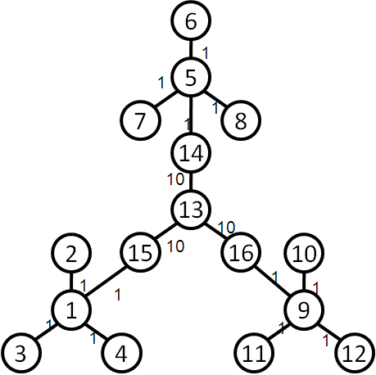
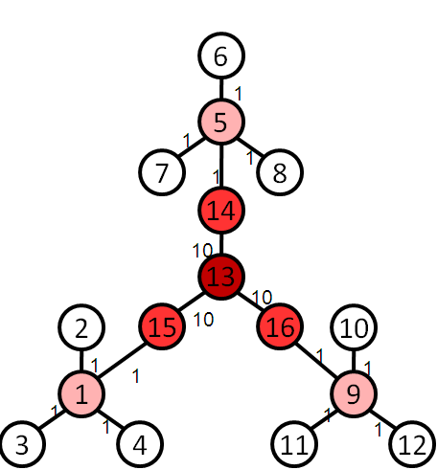
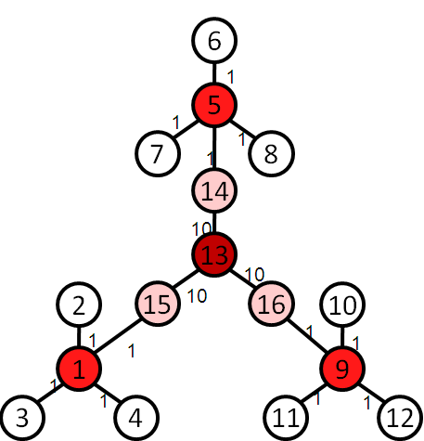
Intuition of the proposed `Shield-value’
Theorem: (Tong+ 2009)
(1) λ - λ_{s}≈Sv(S)= ∑_{iєS} 2λu(i)²-∑_{i,jєS} A(i,j)u(i)u(j)
find a set of nodes S (e.g. k=4), which
  (C1) each has high eigen-scores
  (C2) diverse among themselves
Original Graph
Select by C1
Select by C1+C2

Slide 11
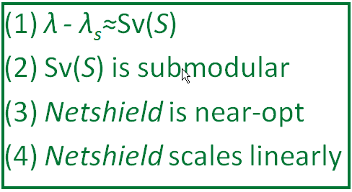
The Proposed Alg.: Netshield
Theorem:
(1) λ - λ_{s}≈Sv(S)= ∑_{iєS} 2λu(i)²-∑_{i,jєS} A(i,j)u(i)u(j)
(2) Sv(S) is sub-modular
Example: 1,000 nodes, with 10,000 edges
  Netshield takes < 0.1 seconds to find best-5 nodes !
  … as opposed to 2,615 years
Corollary:
(3) Netshield is near-optimal (wrt max Sv(S))
(4) Netshield is O(nk²+m)
Footnote: near-optimal means Sv(S ^{Netshield}) >= (1-1/e) Sv(S ^{Opt})

Slide 12

Why Netshield is Near-Optimal?
Marginal benefit of deleting {5,6}
Marginal benefit of deleting {5,6}
9
3
10
9
3
1
10
5
1
δ
5
2
6
8
7
2
6
8
7
4
4
Benefit of deleting {1,2}
Benefit of deleting {1,2, 3,4}
>=
Sub-Modular (i.e., Diminishing Returns)
δ

Slide 13
Why Netshield is Near-Optimal?
9
3
10
9
3
1
10
5
1
δ
5
2
6
8
7
2
6
8
7
4
4
>=
Sub-Modular (i.e., Diminishing Returns)
δ
Theorem: k-step greedy alg. to maximize a sub-modular function guarantees (1-1/e) optimal [Nemhauster+ 78]

Slide 14
T4: Why Sv(S) is sub-modular?
Newly deleted
9
3
10
1
5
2
6
8
7
4
Already deleted

Slide 15
T4: Why Sv(S) is sub-modular?
Newly deleted
Marginal Benefit of deleting {5,6}
=
9
3
Sv(S_{green} U S_{blue}) - Sv(S_{green})
∑_{iєSblue} 2λu(i)²-∑_{i,jєSblue} A(i,j)u(i)u(j)
(∑_{iєSblue, jєSgreen} A(i,j)u(i)u(j)+∑_{iєSgreen, jєSblue} A(i,j)u(i)u(j))
10
-
1
5
2
6
8
7
4
Already deleted
Pure benefit
from {5,6}
Interaction between
{5,6} and {1,2}
Only purple term depends on {1, 2}!

Slide 16
T4: Why Sv(S) is sub-modular?
9
3
9
3
10
10
1
1
5
5
2
6
2
6
8
7
8
7
4
4
Marginal Benefit = Blue –Purple
More Green
More Purple
Less Red
Marginal Benefit of Left >= Marginal Benefit of Right
Footnote: greens are nodes already deleted; blue {5,6} nodes are nodes to be deleted

Slide 17
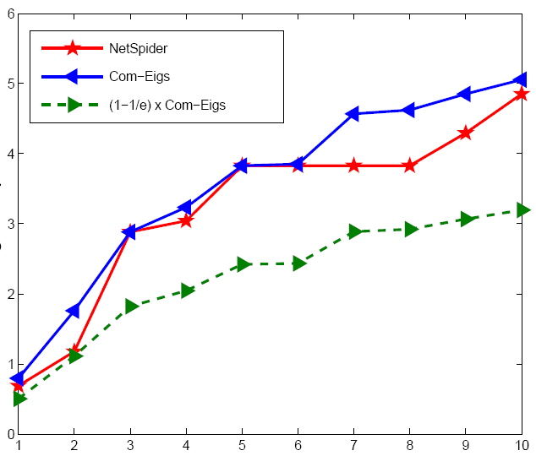
Experiment: Quality of Netshield
(better)
Optimal
Netshield
Eig-Drop
(1-1/e) x Optimal
# of vaccines

Slide 18
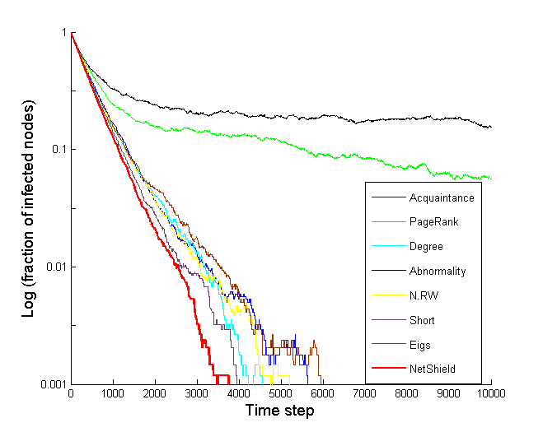
Experiment: Comparison of Immunization
Log(fraction of infected nodes)
(better)
Abnormality
PageRank
Between (short)
Degree
Between (RW)
Acquaintance
Netshield
Eigs (=HITS)
Time Epoch

Slide 19
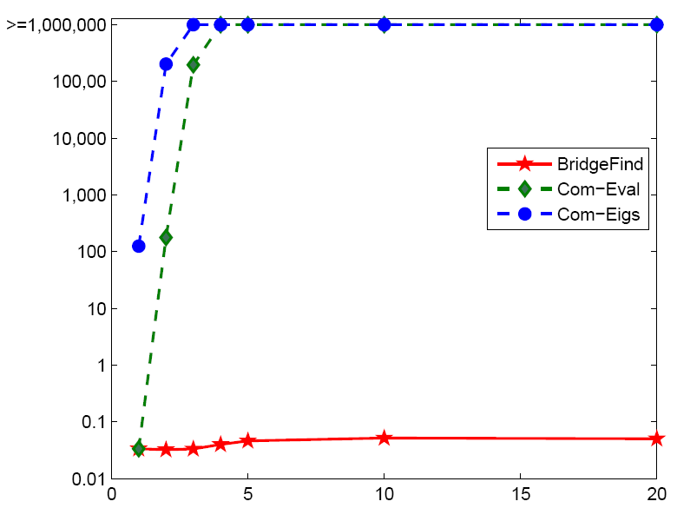
Experiment: Speed of Netshield
> 10 days
>=1,000,000
Com-Eigs
100,000
10,000
Com-Eval
Time
10,000,000x
1,000
(better)
100
10
Netshield
0.1 seconds
1
0.1
# of vaccines
0.01
NIPS co-authorship Network: 3K nodes, 15K edges

Slide 20
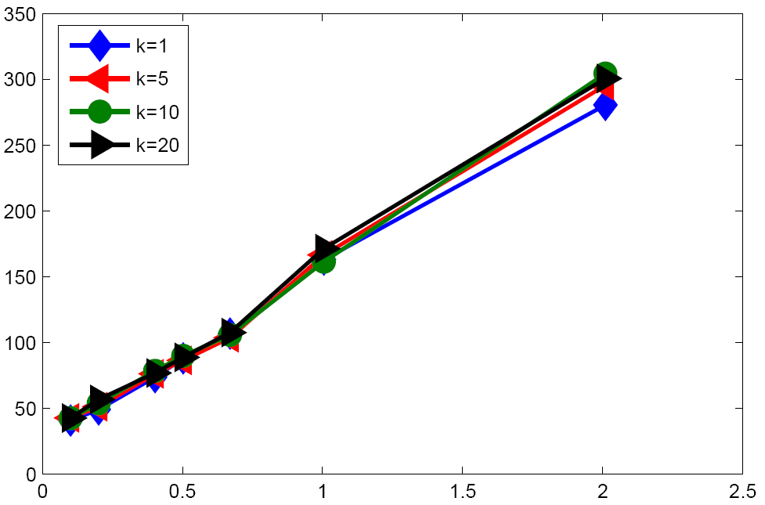
Experiment: Scalability of Netshield
Time
(better)
# of edges
X 10⁸

Slide 21
Conclusion
Prob. Dfn (Immunization)
  Given: a graph A, virus prop model and budget k;
  Find: k ‘best’ nodes for immunization.
Our Contributions
  Measure (‘shield-value’) : Approx Eigen-Drop
  Algorithm: Scalable & Near-optimal

