Slide 1

Networks-as-a-Context:
A New Frontier in Network Mining
Hanghang Tong
University of Illinois at Urbana-Champaign
htong@illinois.edu, http://tonghanghang.org

Slide 2
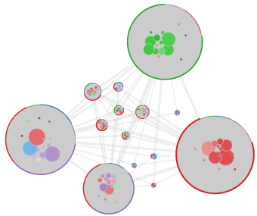
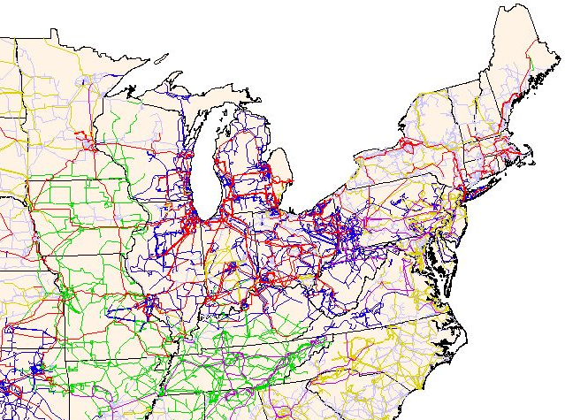
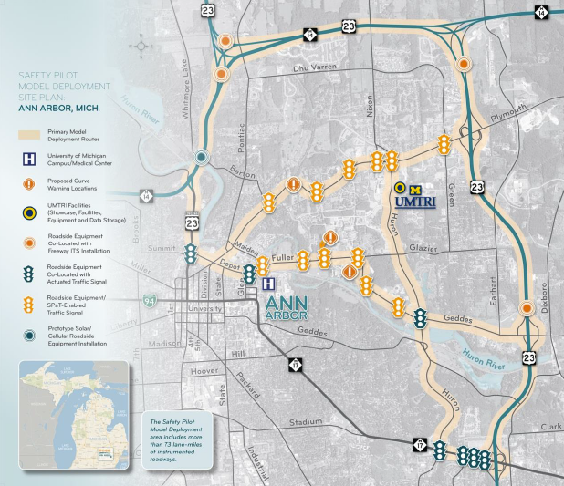
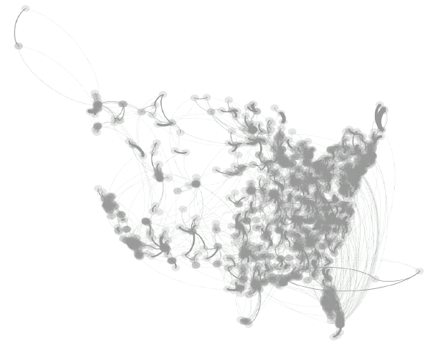
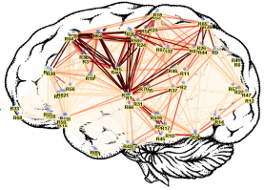
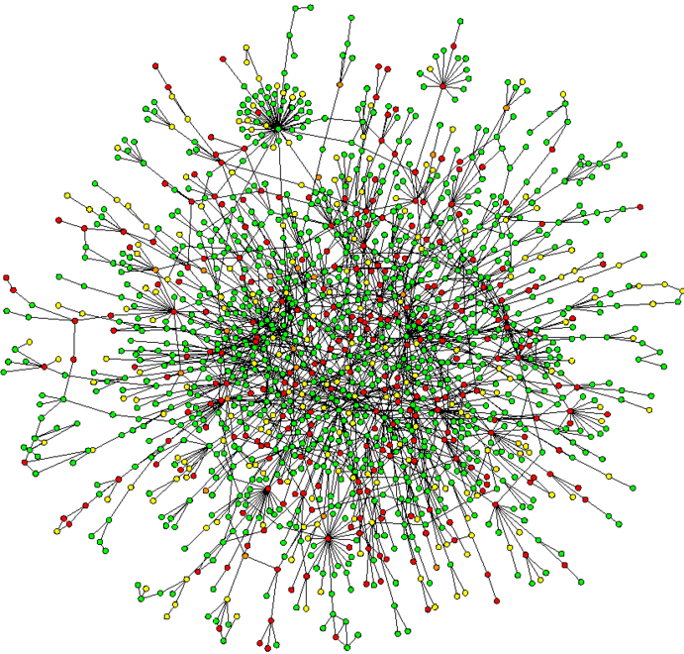
Observation: Networks & Graphs Are Everywhere!
Collaboration Networks
US Power Grid
Traffic Network
Brain Networks
Biological Networks
Hospital Networks
This Talk: Networks = Graphs

Slide 3
Research Theme: Understand and Utilize Networks
Applications
Systems
Social Networks
Bioinformatics
Neuroscience
Transportation
…
Commerce
Visualization
Algorithms
[TVCG17, CIKM17a]
[CHI15,17, IUI15]
[PacificViz14]
[ICDM14]
[ICDM13a]
[TKDE14]
[SDM13a]
[KDD12c]
[VLDB06]
Prediction
Inference
Control
Detection
Querying
[KDD19, 15c,17d]
[KDD15d,14b,08b]
[TKDE17a, CIKM18]
[SDM15b, 16]
[WWW13,14,17a]
[KDD12a,11a]
[PKDD12, ICDm10a]
[IJCAI19a-b]
[WWW19b, AAAI19a
KDD17c,KDD16a]
[TKDE17b, CIKM16]
[WWW15,CIKM14a]
[SDM14b,IJCAI15]
[ICDM13b, NIPS12]
[KDD09, 11b]
[WCRE’11, WSDM19]
[SAM’17, ICDM’15]
[KDD16c,18b,TKDD17]
[Bigdata18, SDM15a, d]
[SDM14a,13b]
[CIKM12a]
[ICDM10b]
[PKDD’10]
[Networking’10]
[WWW17b, 19a]
[KDD15b, 17b,d, 18a]
[SDM17,15c,12a-b]
[CIKM17b, 14b
[KDD12b,10,08b]
[TRB15, SAM12]
[CIKM12b,08]
[AAAI’11]
[KDD14a, WWW19a]
[KDD15a,16b,17a]
[BigData14]
[SDM13a,12b,11a]
[KDDa-c,07a-b,06]
[ICDM08,06]
[CIKM09,KAIS08]
[SDM08,SAM08]
This Talk: Networks-as-Context
Management
Theories
[SIGMOD17]
[AVI’16,ICDE’16]
[TKDE’15]
[J. VLDB12]
[P. IEEE12]
[KDD11c]
Hardness
Optimality
…
Complexity
Equivalence
[TKDE16,TKDD16,NIPS12,
ICDM15, KDD11b,PKDD08
KDD18a]
[NIPS19a, TKDE16,
ICDM10, CIKM12
KDD17d, 16a-b,08b, SDM08]
[TKDE17, KDD17a-d, 16a-c
ICDM15,KDD14a,CIKM12
CIKM09,SDM08,ICDM06]
[NIPS19b, TKDD17,
KDD16b,SAM17,
SDM15, KDD11c,J.VLDB12]
Results
&
Impacts
Publications
100+ papers
10,000+ citations
40+ h-index
20+ highly-cited
20+ patents
Awards
test-of-time (ICDM’15)
NSF CAREER (2017)
SDM/IBM award (2018)
Tao Li Award (2019)
4 best papers,7 finalists
Grants
$42M in total
$27M since ASU
$6M+ as PI
$4M+ personal share
7 agencies
Tech. Transfer
IBM (Gbase → System G. → Graphen.ai)
G-Ray/MAGE
MIT Lincoln Lab
Lawrence Livermore Natl Lab
DARPA SIGMA+

Slide 4
Networks-as-Context: Network of X
Observation: Each X being an Entity
  X = user: Social Network
  X = information: Information Network
  X = webpage: Web Graph
  X = device: Internet of Things
Question: What if Each X is
  A dataset (a set of entities, e.g., a network), or
  A data mining model?
“Learn how to see. Realize that everything is connected to everything else.” -- Leonardo da Vinci

Slide 5
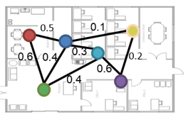
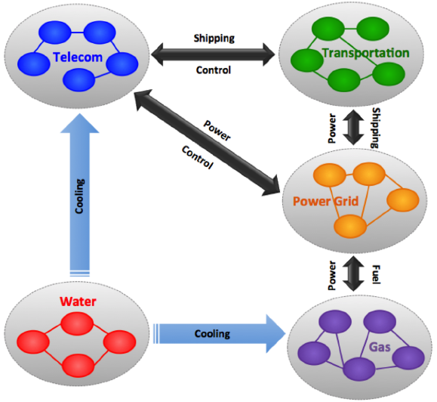
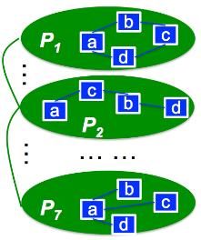
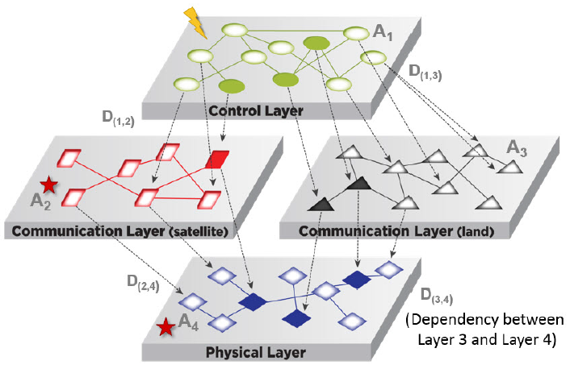
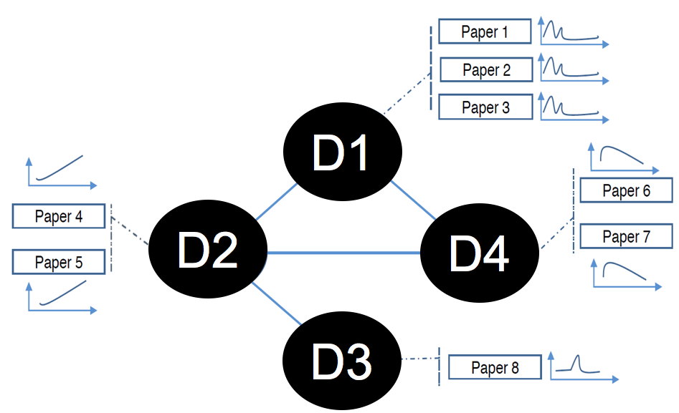
Network of X in This Talk
A Network of Time Series
NoT
A Network
of Inference
TimeSeries
A Network
of Networks
+
+
+
+Networks
Fascinate
Inference
Network
NoN
+
+
Control
Regression
A Network
of Control
A Network
of Regression
OPERAs
iBall

Slide 6
Network of X in This Talk
A Network of Time Series
(Focus of This Talk)
NoT
A Network
of Inference
TimeSeries
A Network
of Networks
+
+
+
+Networks
Fascinate
Inference
Network
NoN
Key Elements in NoN (a Network of Networks):
Set of networks
Context network
How to map (1) and (2)
+
+
Control
Regression
A Network
of Control
A Network
of Regression
OPERAs
iBall

Slide 7
Roadmap
Motivation
Network of Networks
  NoN Introduction
  NoN Model
  NoN Construction
  NoN Mining
Network of X: Other Scenarios
Vision for the Future

Slide 8
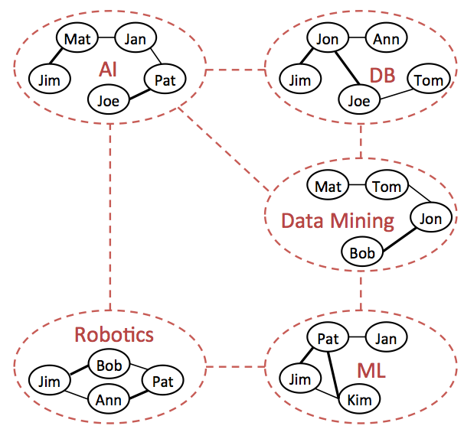
NoN: Scholarly Data Mining
NoN (Network of Networks) Application #1
Set of co-authorship networks, connected by a research domain network.
Santo Fortunato et al: Science of science. Science. Vol 359, Issue 6379, 2018
B. Börner, N. Contractor, et al: :A multi-level systems perspective for the science of team science. Science Translational Medicine, 2(49), 2010
Y. Lin, H. Tong, J. Tang, K.S. Candan: Guest Editorial: Big Scholar Data Discovery and Collaboration. IEEE Trans. Big Data 3(1): 2 (2017)

Slide 9
Bioinformatics
NoN (Network of Networks) Application #2
D
b
1
P₁
c
M
a
2
d
Blue: Tissue-specific PPI networks
Green: Disease similarity network
3
c
a
b
d
4
P₂
… …
… …
5
6
b
P₇
c
7
a
d
Set of tissue-specific protein-protein interaction (PPI) networks, connected by a disease similarity network.
O. Magger, Y. Y. Waldman, E. Ruppin, and R. Sharan. Enhancing the prioritization of disease-causing genes through tissue specific protein interaction networks. PLoS Computational Biology, 8(9), 2012.
Gross AM, Ideker T. Molecular networks in context. Nature biotechnology. 33(7), 2015

Slide 10
Critical Infrastructure Networks
NoN (Network of Networks) Application #3
Set of infrastructure networks, connected by a cross-infrastructure dependency network.
J. Gao, S.V. Buldyrev, H.E. Stanley, S. Havlin: Networks formed from interdependent networks. 8(1) 2012.
S.D. Reis, Y. Hu, A. Babino, J.S. Andrade, S. Canals, M. Sigman, and H.A. Makse: Avoiding catastrophic failure in correlated networks of networks. Nature Physics, 10(10), 762, 2014
NSF Critical Resilient Interdependent Infrastructure Systems and Processes (CRISP 2.0): https://www.nsf.gov/funding/pgm_summ.jsp?pims_id=505277

Slide 11
Network Science of Teams
NoN (Network of Networks) Application #4
Set of team networks, connected by a project dependency network.
G.S. McChrystal, C. Tantum, S. David, and F. Chris:. Team of teams: New rules of engagement for a complex world. Penguin, 2015.
N. Contractor, L.A. DeChurch, A. Sawant, and X. Li: My Dream Team Assembler, 2013.
W. Stefan, B. Jones, and B. Uzzi: The Increasing Dominance of Teams in the Production of Knowledge. Science, May 2007, 316:1036-1039.
Network Science of Teams Project Website: http://team-net-work.org
L. Li, and H. Tong: Network Science of Teams: Characterization, Prediction, and Optimization. WSDM 2018 tutorial

Slide 12
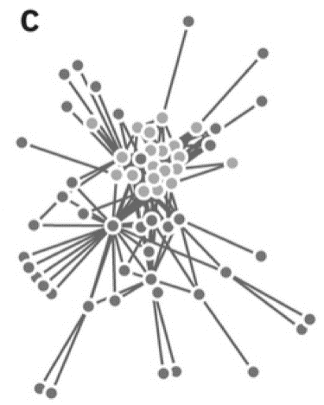
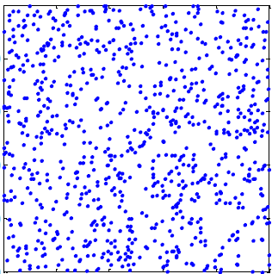
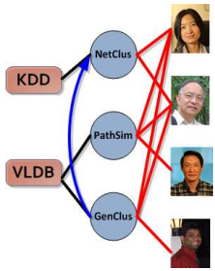

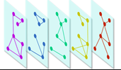
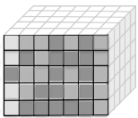
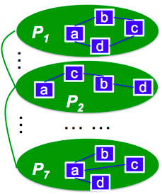
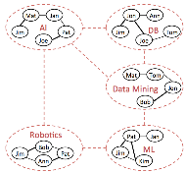
Network of Networks vs. Other Complex Networks
At Macro-Level: Input Networks
Existing Work
  Plain Networks
  Heterogeneous Information Networks [Sun & Han 2012-2017]
  Multi-Networks [Yu+ 2013-2018]
  Tensor [Faloutsos+ 2008-2017]
  Multiplex [Kanawati 2015, Porter 2014]
NoN: Set of Networks Connected by a Contextual Network
Key Advantages: Network Modeling
  Multi-Resolution, Hierarchical Modeling
  Towards Multi-Network Model Unification
    Including tensor, multiplex, hypergraph models as special cases

Slide 13
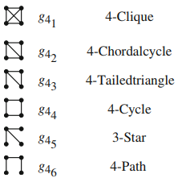
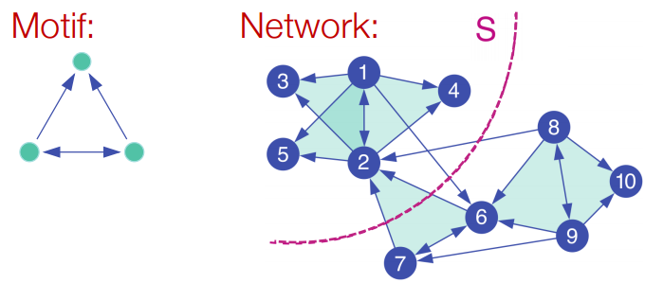
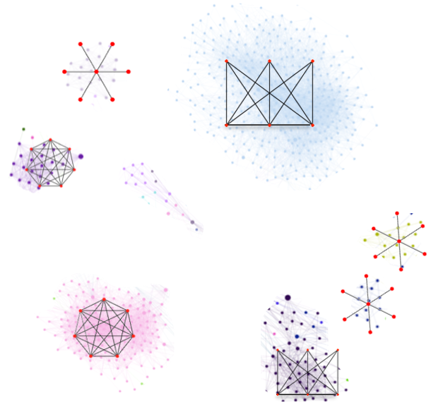
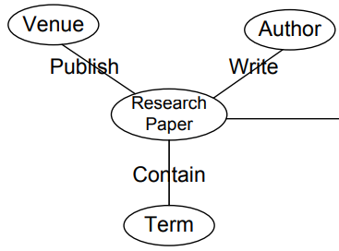
Network of Networks vs. High-order Structure
At Micro-Level: Basic Unit/Atom for Mining
Existing Work
  A Node or a Link
  Graphlet [Neville+ 2016]
  Motif [Benson+ 2016]
  Meta-Path or Meta-Structure [Sun & Han 2012-2017]
  Graph Vocabulary [Koutra & Faloutsos+ 2014]
NoN: Networks Inside a Node/Link
  Key Advantages: Structure Aggregation
  Collective Mining with Focused Knowledge Transfer
  New Principle for Mining Multiple Networks: Cross Network Consistency

Slide 14
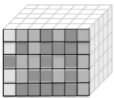
Network of Networks: Where Are We?
Network of Networks in the Global View
Basic Networks
Beyond a Single Adj. Matrix
At Macro-level: Nodes Linked by Edges (e.g., an Adjacency Matrix)
At Micro-level: Node/Link as Atom
HIN [Sun & Han 2012-2017]
Tensor [Faloutsos+ 2008-2017]
Multi-Network [Yu+ 2013-2018]
Multiplex [Kanawati 2015, Porter 2014]
1
2
3
4
1
2
3
4
High-order Structure
At Macro-level: Set of Networks Connected by Another Network
Key Advantages: Hierarchical Modeling, Towards Multi-Network Model Unification.
Graphlet [Neville+ 2016]
Meta-Path/Structure [Sun & Han 2012]
Motif/High-order Structure [Benson+ 2016]
Graph Vocabulary [Koutra, Faloutsos+ 2014]
1
2
3
NoN: Network of Networks
4
At Micro-level: Hidden Networks Deep Inside a Node/Link
Key Advantages: Collective Mining with Focused Knowledge Transfer
2
4
1
3

Slide 15
Roadmap
Motivation
Network of Networks
  NoN Introduction
  NoN Model
  NoN Construction
  NoN Mining
Network of X: Other Scenarios
Vision for the Future

Slide 16
Modeling NoN
Q: How to Represent a Set of Inter-connected Networks (e.g., Tissue-Specific PPI Networks)?
D
b
1
P₁
c
a
2
d
3
c
a
b
d
4
P₂
… …
… …
Blue: Tissue-specific PPI networks
Green: Disease similarity network
5
6
b
P₇
c
7
a
d

Slide 17
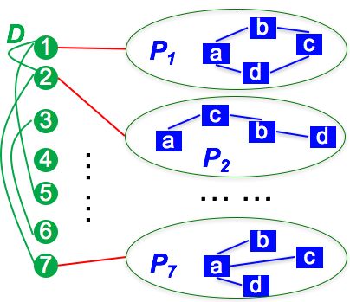
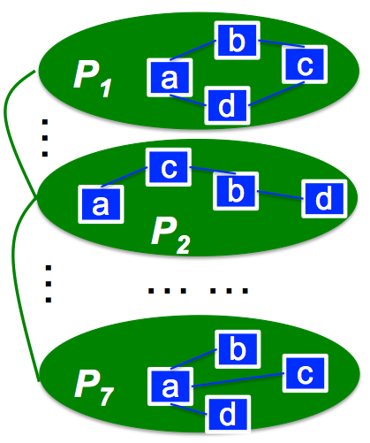
Introducing the NoN Model
A: Each Green Node (Disease) Itself is a Network.
Blue: Tissue-specific PPI networks
Green: Disease similarity network
NoN (A Network of Networks) := a triplet R = <G, A, θ>
  G: Main network (the green, disease to disease network)
  A: Domain networks (the blue, tissue-specific PPI networks)
  θ: Mapping function (each green, main node → a blue, domain network)
J. Ni, H. Tong, W. Fan, X. Zhang: Inside the atoms: ranking on a network of networks. KDD 2014
J. Ni, M. Koyuturk, H. Tong, J. Haines, R. Xu, X. Zhang: Disease gene prioritization by integrating tissue-specific molecular networks using a robust multi-network model. BMC bioinformatics 2016

Slide 18
NoN Models: Examples
Blue: Tissue-specific PPI networks
Green: Disease similarity network
NoN (A Network of Networks) := a triplet R = <G, A, θ>
  G: Main network (the green, disease to disease network)
  A: Domain networks (the blue, tissue-specific PPI networks)
  θ: Mapping function (each green, main node → a blue, domain network)
Applications | The Main Network (G) | Domain Networks (A)
Gene-Pheno Assoc. | Disease Similarity Network | Tissue-Specific PPI Nets
Location-Based Social Networks | Geo-Proximity Network | Social Networks
Brain Initiative | Person-Person Network | Brain Networks
Team of Teams | Project Dependence Net | Team Networks
Scholarly Data | Res. Area Similarity Network | Collaboration Networks
Infrastructure Nets | Net-Net Dependence | Gas/Water/Tele/Power Nets

Slide 19
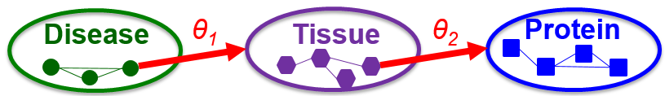
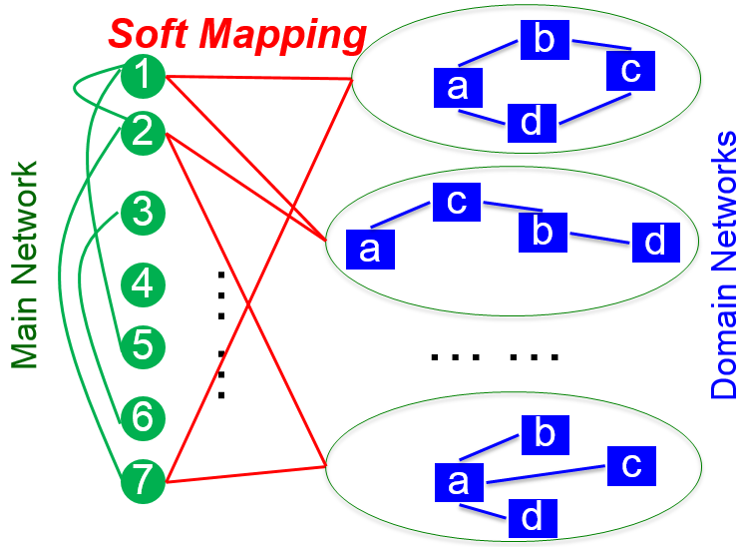
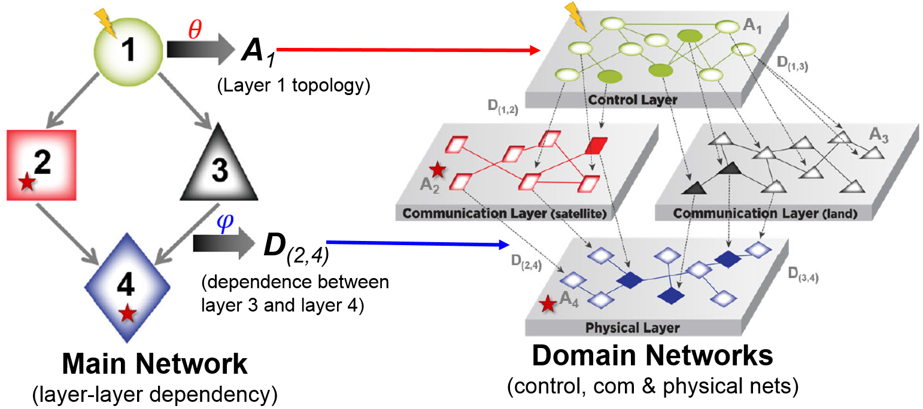


NoN Generalizations
G1: Multi-layered Hierarchical NoN
G2: Soft Mapping Function θ
  1-to-many or many-to-many
G3: Map Edges to Networks $φ$
    G: Main Network
    A: Domain Networks
    D: Cross-Layer Dep’
    $θ$: Function V_{G}$→$ A
    $φ$: Function E_{G}$→$ D
C. Chen, J. He, N. Bliss and H. Tong: “On the Connectivity of Multi-layered Networks: Models, Measures and Optimal Control” ICDM 2015.
C. Chen, J. He, N. Bliss and H. Tong: “Towards Optimal Connectivity on Multi-layered Networks”. IEEE Trans. Knowl. Data Eng., 29(10): 2332-2346 (2017)

Slide 20
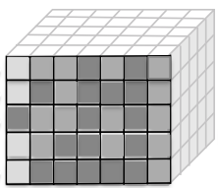
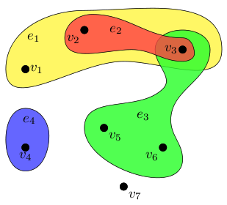
Towards Multi-Network Model Unification
Special Cases of NoN Model
  Tensor = NoN with
    A full clique main network (G)
    All domain networks (A) sharing the same node sets
  Hypergraph = NoN with
    All domain networks (A) being empty
  Multiplex = NoN with
    Two-layers
    All domain networks (A) sharing the same node sets

Slide 21
Roadmap
Motivation
Network of Networks
  NoN Introduction
  NoN Model
  NoN Construction
  NoN Mining
Network of X: Other Scenarios
Vision for the Future

Slide 22
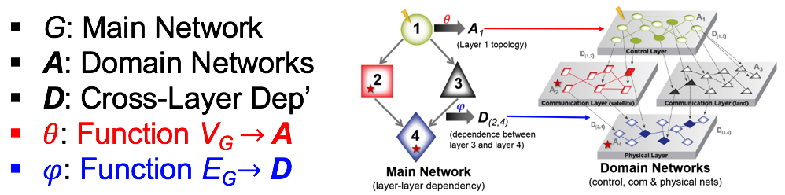
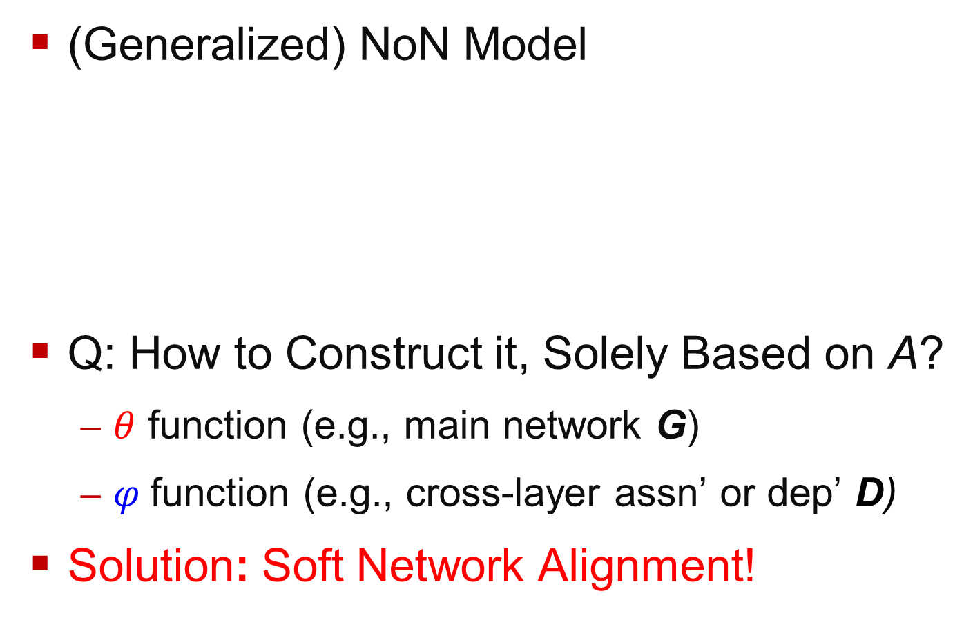
NoN Model Construction
(Generalized) NoN Model
Q: How to Construct it, Solely Based on A?
  $θ$ function (e.g., main network G)
  $φ$function (e.g., cross-layer assn’ or dep’ D)
Solution: Soft Network Alignment!

Slide 23
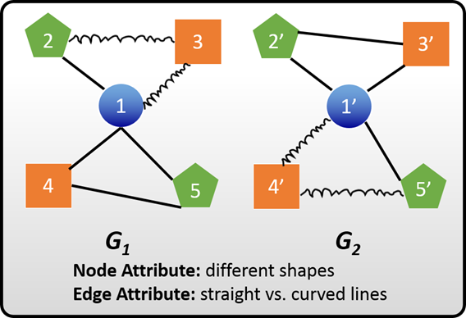
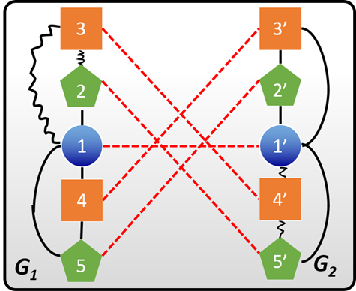
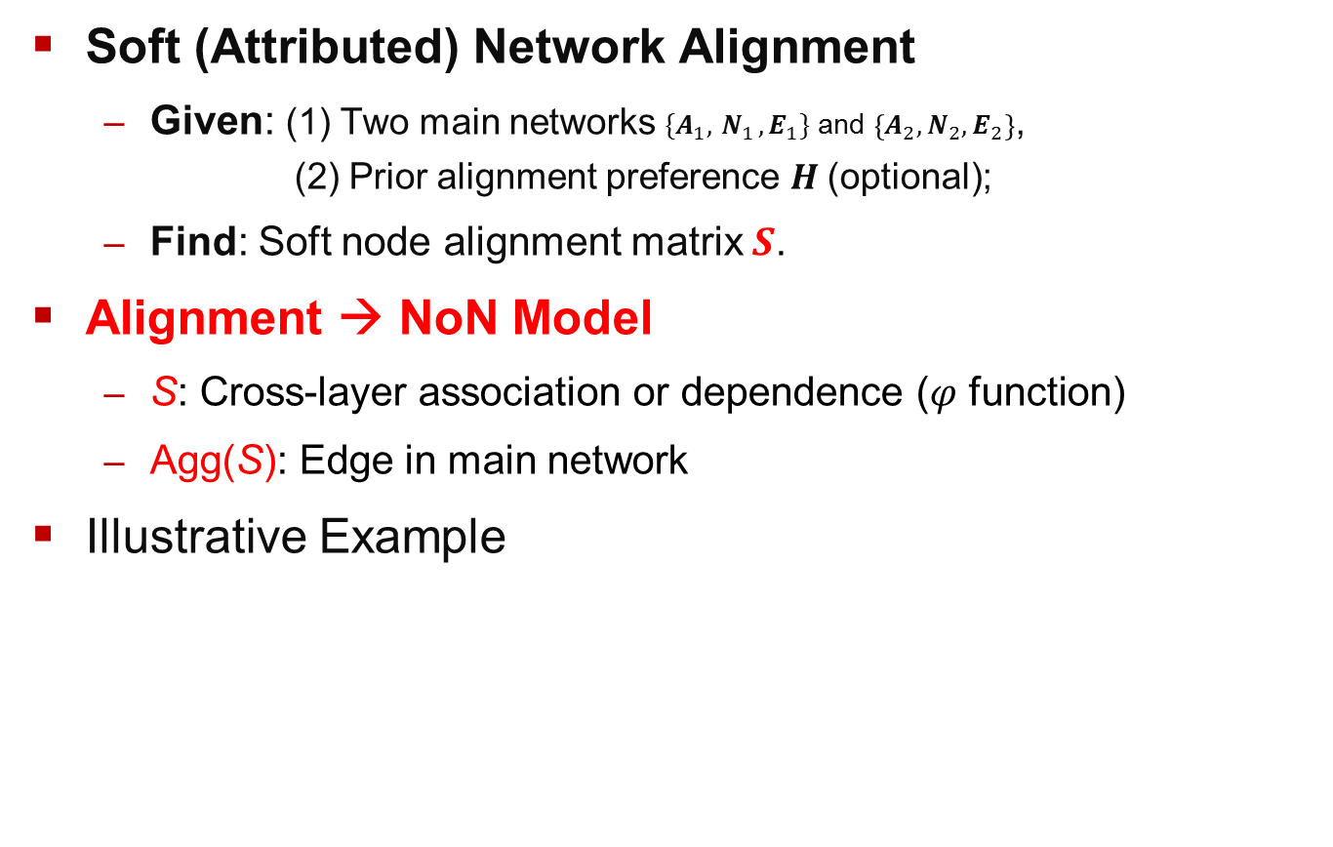

NoN Construction via Soft Network Alignment
Soft (Attributed) Network Alignment
  Given: (1) Two main networks $\{A_{1},{ N}_{1}, E_{1}\}$ and $\left\{A_{2}, N_{2}, E_{2}\right\}$, ( (2) Prior alignment preference $H$(optional);
  Find: Soft node alignment matrix $S$.
Alignment → NoN Model
  S: Cross-layer association or dependence (𝜑 function)
  Agg(S): Edge in main network
Illustrative Example
align
$$S$$
S. Zhang, and H. Tong: FINAL: Fast Attributed Network Alignment. KDD 2016: 1345-1354
S. Zhang, H. Tong. Attributed Network Alignment: Problem Definitions and Fast Solutions. IEEE TKDE 31(9): 1680-1692 (2019)

Slide 24
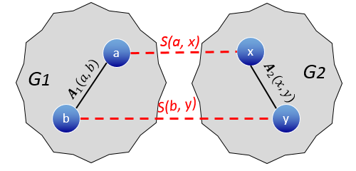


Formulation #1: Topological Consistency
Intuition: Similar node-pairs tend to have similar neighboring node-pairs.
Implication:
  Large $A_{1}(a,b)$ and $A_{2}(x,y)$
Mathematical Details: $\min_{S}{\left[S\left(a,x\right)−S\left(b,y\right)\right]}^{2}A_{1}\left(a,x\right)A_{2}(b,y)$
Example:
G₁: collaboration network in Google Scholar
G₂: collaboration network in DBLP
If (1) author-a and author-x are the same researcher, (2) author-a and author-b collaborate with each other heavily, and (3) author-x and author-y collaborate heavily;
It is likely that author-b and author-y are the same researcher or they are very similar w/ each other.
$$S\left(a,x\right)≈S\left(b,y\right)$$
S. Zhang, and H. Tong: FINAL: Fast Attributed Network Alignment. KDD 2016: 1345-1354
S. Zhang, H. Tong. Attributed Network Alignment: Problem Definitions and Fast Solutions. IEEE TKDE 31(9): 1680-1692 (2019)

Slide 25
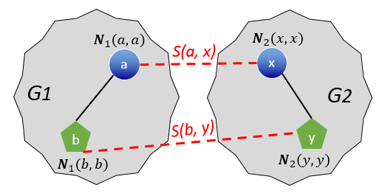
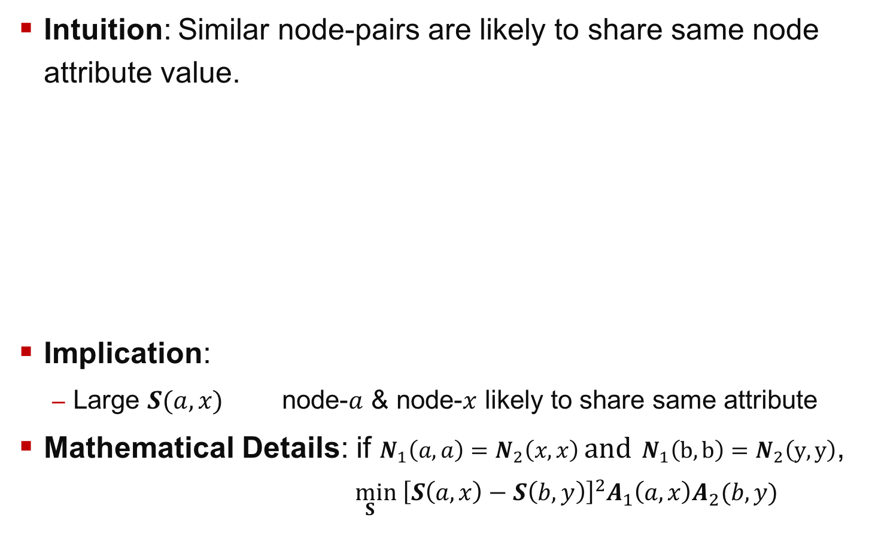
Formulation #2: Node Attribute Consistency
Intuition: Similar node-pairs are likely to share same node attribute value.
Implication:
  Large $S(a,x)$ node-$a$ & node-$x$ likely to share same attribute
Mathematical Details: if $N_{1}\left(a,a\right)=N_{2}\left(x,x\right)$ and $N_{1}\left(b,b\right)=N_{2}\left(y,y\right)$, $\min_{S}{\left[S\left(a,x\right)−S\left(b,y\right)\right]}^{2}A_{1}\left(a,x\right)A_{2}(b,y)$
Example:
G₁: collaboration network in Google Scholar
G₂: collaboration network in DBLP
Node attribute: research areas
If (1) author-a and author-x are the same researcher,
It is likely that author-a and author-x share the same research area(s).
S. Zhang, and H. Tong: FINAL: Fast Attributed Network Alignment. KDD 2016: 1345-1354
S. Zhang, H. Tong. Attributed Network Alignment: Problem Definitions and Fast Solutions. IEEE TKDE 31(9): 1680-1692 (2019)

Slide 26
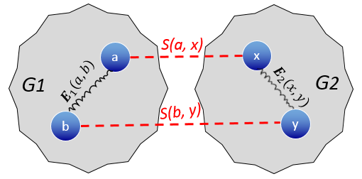

Formulation #3: Edge Attribute Consistency
Intuition: Similar node-pairs are likely to connect to their similar neighboring node-pairs via same edge attribute value.
Implication:
  Large $S(a,x)$
  Large $S(b,y)$
Mathematical Details: if $E_{1}\left(a,b\right)=E_{2}\left(x,y\right)$,
$\min_{S}{\left[S\left(a,x\right)−S\left(b,y\right)\right]}^{2}A_{1}\left(a,x\right)A_{2}(b,y)$
Example:
G₁: collaboration network in Google Scholar
G₂: collaboration network in DBLP
Edge attribute: citation patterns (e.g., who-cites-whom, highly-cited-by)
If (1) author-a and author-x are the same researcher, (2) author-b and author-y are the same researcher, and (3) author-a is highly cited by author-b;
It is likely that author-x is highly cited by and author-y.
edge $(a,b)$ & $(x,y)$ likely to share same attribute
S. Zhang, and H. Tong: FINAL: Fast Attributed Network Alignment. KDD 2016: 1345-1354
S. Zhang, H. Tong. Attributed Network Alignment: Problem Definitions and Fast Solutions. IEEE TKDE 31(9): 1680-1692 (2019)

Slide 27
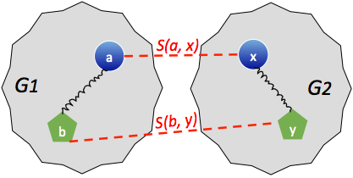

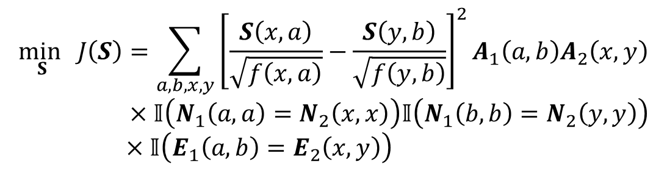
Putting Everything Together
Objective Function:
$f\left(x,a\right)$:
  Intuition: ‘Joint degree’ of node-$a$ and node-$x$
  Why: Normalization purpose
Generalization:
  Replacing $𝕀\left(∙\right)$ by an attribute similarity function
  Handle numerical attributes on nodes and/or edges
$$\min_{S} J\left(S\right)=\sum_{a,b,x,y}{{\left[\frac{S\left(x,a\right)}{\sqrt{f\left(x,a\right)}}−\frac{S\left(y,b\right)}{\sqrt{f\left(y,b\right)}}\right]}^{2}A_{1}\left(a,b\right)A_{2}\left(x,y\right)} \\ ×𝕀\left(N_{1}\left(a,a\right)=N_{2}\left(x,x\right)\right)𝕀\left(N_{1}\left(b,b\right)=N_{2}\left(y,y\right)\right)$$
$×𝕀\left(E_{1}\left(a,b\right)=E_{2}\left(x,y\right)\right)$
#1. Topology Consistency
#2. Node Attribute Consistency
#3. Edge Attribute Consistency
S. Zhang, and H. Tong: FINAL: Fast Attributed Network Alignment. KDD 2016: 1345-1354
S. Zhang, H. Tong. Attributed Network Alignment: Problem Definitions and Fast Solutions. IEEE TKDE 31(9): 1680-1692 (2019)

Slide 28
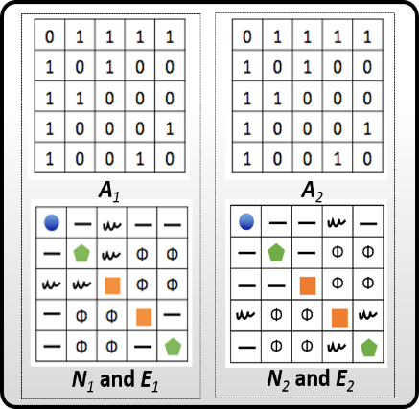
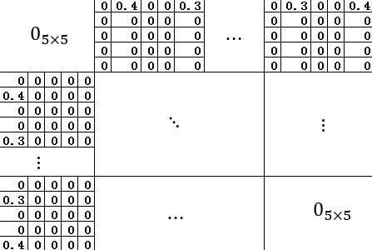




Formulation: Matrix Form
Matrix-Form Objective Function
  $W=N\left[E⊙\left(A_{1}⊗A_{2}\right)\right]N$: Attributed Kronecker product matrix
  $D$: $\text{D}\text{egree} \text{matrix} \text{of} W$
  $\tilde{W}=D^{−\frac{1}{2}}$W$D^{−\frac{1}{2}}$: Symmetric normalization of $W$
  $h=\text{vec}\text{(}\text{H}\text{)}\text{: }$Encoding prior and avoiding trivial solutions
$$\min_{S}{J\left(S\right)=\min_{s}{ \begin{aligned}\begin{aligned}\begin{aligned}\sum_{v,w}{{\left[\frac{s\left(v\right)}{\sqrt{D\left(v,v\right)}}−\frac{s\left(w\right)}{\sqrt{D\left(w,w\right)}}\right]}^{2}W\left(v,w\right)}\end{aligned}\end{aligned}\end{aligned}}}$$
$\underset{ s}{=min}{{α s}^{T}\left(I−\tilde{W}\right)s}$ + $\left(1−α\right){\left\|s−h\right\|}_{2}^{2}$
$$s=\text{vec}\left(S\right)$$
$$\tilde{W}$$
S. Zhang, and H. Tong: FINAL: Fast Attributed Network Alignment. KDD 2016: 1345-1354
S. Zhang, H. Tong. Attributed Network Alignment: Problem Definitions and Fast Solutions. IEEE TKDE 31(9): 1680-1692 (2019)

Slide 29


Alignment Algorithm
Observation: Convex optimization problem
Benefits: Fixed-point algorithm converging to the global optimal solution
Intuition: Similarity propagation to neighboring node-pairs, further filtered by node/edge attributes
Challenges: Computationally VERY expensive
  Iterative solution: $O\left(mnt_{\text{max}}\right) \text{or} O\left(m^{2}t_{\text{max}}\right)$
  Closed form solution: $O\left(n^{6}\right)$ (due to matrix inversion)
Q: How to scale up and speed up?
$$\min_{s}{αs^{T}\left(I−\tilde{W}\right)s+\left(1−α\right){\left\|s−h\right\|}_{2}^{2}}$$
$s=a\tilde{W}s+\left(1−α\right)h \underset{⇒}{ } s=\left(1−α\right){\left(I−α\tilde{W}\right)}^{−1}h$ (closed form)
S. Zhang, and H. Tong: FINAL: Fast Attributed Network Alignment. KDD 2016: 1345-1354
S. Zhang, H. Tong. Attributed Network Alignment: Problem Definitions and Fast Solutions. IEEE TKDE 31(9): 1680-1692 (2019)

Slide 30




Speed-up Alignment
If we only consider node attributes
Goal: Approximate a huge (n² x n²) matrix inverse
Key Idea: Low rank approximation of $A_{1}$ and $A_{2}$
Complexity: $O\left(n^{6}\right) or O(mnt_{\text{max}})$ $O\left(n^{2}r^{4}\right)$
Both Node & Edge Attributes: Similar idea with same big-O
$$s=\left(1−α\right){\left(I−αD_{N}^{−\frac{1}{2}}N\left(A_{1}⊗A_{2}\right)ND_{N}^{−\frac{1}{2}}\right)}^{−1}h$$
$$s≈\left(1−α\right)\left(I+αD_{N}^{−\frac{1}{2}}NUΛU^{T}ND_{N}^{−\frac{1}{2}}\right)h$$
where $U=U_{1}⊗U_{2}$
$$Λ={\left[{\left(Λ_{1}⊗Λ_{2}\right)}^{−1}−αU^{T}ND_{N}^{−1}NU\right]}^{−1}$$
$$A_{1}≈U_{1}Λ_{1}U_{1}^{T} \\ A_{2}≈U_{2}Λ_{2}U_{2}^{T}$$
Sherman-Morrison Lemma
Si Zhang, Hanghang Tong: FINAL: Fast Attributed Network Alignment. KDD 2016: 1345-1354
U. Kang, Hanghang Tong, Jimeng Sun: Fast Random Walk Graph Kernel. SDM 2012: 828-838

Slide 31




More on NoN Model Construction
Further Speed-up: From O(n²) to O(m)
  Key Idea: Indirect representation of S
  Theorem: Low-rank of A₁ and A₂ implies low-rank of S
Alignment Quality: Linear Complexity w/o Approximation
  Multi-level alignment (Perfect Interpolation Thm.)
  Implicit Krylov subspace methods
NoN Model Update
  $∆A_{i}:$Sparse & low-rank → Incrementally update low-rank of A_{i}
B. Du and H. Tong: FASTEN: Fast Sylvester Equation Solver for Graph Mining. KDD 2018
S. Zhang, H. Tong, J. Tang, J. Xu, W. Fan: iNEAT: Incomplete Network Alignment. ICDM 2017: 1189-1194
R. Liu, W. Cheng, H. Tong, W. Wang, X. Zhang: Robust Multi-Network Clustering via Joint Cross-Domain Cluster Alignment. ICDM 2015: 291-300 [Best of ICDM’15]
L. Li, H. Tong, Y. Xiao, W. Fan: Cheetah: Fast Graph Kernel Tracking on Dynamic Graphs. SDM 2015: 280-288

Slide 32
Roadmap
Motivation
Network of Networks
  NoN Introduction
  NoN Model
  NoN Construction
  NoN Mining
Network of X: Other Scenarios
Vision for the Future

Slide 33
NoN Mining: Ranking
A1: Given a disease (e.g. P₁), what are the most relevant proteins (blue nodes)?
A2: Who is most influential, considering both the within- and cross-area influence?

Slide 34
Ranking on Single Network: Intuition
Background
0.03
0.04
 | Node 4
Node 1 Node 2 Node 3 Node 4 Node 5 Node 6 Node 7 Node 8 Node 9 Node 10 Node 11 Node 12 | 0.13 0.10 0.13 0.22 0.13 0.05 0.05 0.08 0.04 0.03 0.04 0.02
10
0.10
9
12
0.13
2
0.08
0.02
1
8
0.13
11
3
0.04
4
0.05
6
Query
5
0.13
7
0.05
Assumption: Homophily (Guilt-by-association)
Example: Two researchers are close if
  sharing many common co-authors,
  working on similar topics, and
  publishing at same venue(s).
Ranking vector
H. Tong, C. Faloutsos, J.-Y. Pan: Fast Random Walk with Restart and Its Applications. ICDM 2006
[best paper ICDM 2006, 10-Year Highest Impact Paper Award ICDM 2015]

Slide 35
Ranking on Single Network: Formulation
Background
0.03
0.04
 | Node 4
Node 1 Node 2 Node 3 Node 4 Node 5 Node 6 Node 7 Node 8 Node 9 Node 10 Node 11 Node 12 | 0.13 0.10 0.13 0.22 0.13 0.05 0.05 0.08 0.04 0.03 0.04 0.02
10
0.10
9
12
0.13
2
0.08
0.02
1
8
0.13
11
3
0.04
4
0.05
6
Query
5
0.13
7
0.05
Nearby nodes, Higher scores
Ranking vector
More red, More relevant
r_{i} = c x A x r_{i} + (1-c) x e_{i}
“Maxwell Equation” for Web -- Soumen Chakrabarti

Slide 36

Ranking on Single Network: Optimization
Background
Query
r_{i} = c x A x r_{i} + (1-c) x e_{i}
= argmin cr_{i}'(I – A)r_{i} + (1-c) x||r_{i} – e_{i}||²
Network Smoothness
Query Preference
An Optimization Viewpoint of “Maxwell Equation” for Web (Symmetric A)

Slide 37


NoN Ranking: Formulation
Optimization Formulation:
Intuition:
  Similar ranking scores for an overlapped domain node, if their G(i,j) is high.
    Example: If (1) a protein is highly relevant to disease-i, (2) disease-i is very similar to disease-j; then it is likely that the same protein is also highly relevant to disease-j.
  A set of correlated g random walks
#1: within-network smoothness
#2: query preference
#2: query preference
G(i,j): similarity between disease i and disease j
$Ι$_{ij:} overlapped proteins between disease i and disease j
#3: cross-network consistency
J. Ni, H. Tong, W. Fan, X. Zhang: Inside the atoms: ranking on a network of networks. KDD 2014
J. Ni, M. Koyuturk, H. Tong, J. Haines, R. Xu, X. Zhang: Disease gene prioritization by integrating tissue-specific molecular networks using a robust multi-network model. BMC bioinformatics 2016

Slide 38

NoN Ranking: Equivalence
Optimization Formulation:
Equivalence: J(r) = J(r₁,…,r_{g})
  Intuition: Single R.W. on the integrated network W
#1: within-network smoothness
#2: query preference
#3: cross-network consistency
~
~
A: Diagonal block matrix; Each block is a domain network
$Y$: Off-diagonal block matrix, Weighted indicator matrix for overlapped node pairs
W: Integrated network, Weighted linear combination of A and Y.
~
~
~
~

Slide 39





NoN Ranking: Algorithms
Property: J(r) is positive-definite!
Proof (key ideas)
  Normalized Graph Laplacian:
  Hessian Matrix:
  Weyl’s Inequality:
Algorithms:
  #1: Linear, fixed-point algorithm → optimal solution
  #2: Equivalence → any existing fast solution on single network
  #3: Structure of NoN → further speedup O(T(m+ng)) → O(T(g log(g) + z))
    g << n; and z << m (key idea: using main network for pruning)

Slide 40


NoN Ranking: Results
A1: Candidate Protein Prioritization
Which proteins are most relevant w.r.t. disease a?
A2: Collaboration Prediction
Which data mining authors are likely to collaborate with a given medical author?
Ours
ROC Curve Comparison
AUC and Accuracy
Solely based on homogeneous networks
Tailored for cross-area prediction

Slide 41


NoN Mining: Clustering
Results:
Obj. Function:
Algorithm:
Same assumption,
Similar intuition!
Linear, multiplicative algorithm
converges to KKT point.
P-value vs. (biologically meaningful) clusters
J. Ni, H. Tong, W. Fan, X. Zhang: Flexible and Robust Multi-Network Clustering. KDD 2015

Slide 42
Roadmap
Motivation
Network of Networks
Network of X: Other Scenarios
  NoT: A Network of Co-evolving Time Series
  iBall: A Network of Regression Models
  Fascinate: A Network of Inference Problems
  Mulan: A Network of Control Problems
Vision for the Future

Slide 43




NoT: A Network of Time Series
Problem Definition
Results
Models &
Algorithms
Y. Cai, H. Tong, W. Fan and P. Ji: Fast Mining of a Network of Coevolving Time Series. SDM 2015.
Y. Cai, H. Tong, W. Fan, P. Ji, Q. He: Facets: Fast Comprehensive Mining of Coevolving High-order Time Series. KDD 2015
F. Hairi, H. Tong, and L. Ying, NetDyna: Mining Networked Coevolving Time Series with Missing Values. BigData 2019

Slide 44





iBall: A Network of Regression Models
Problem Definition
Models & Algorithms
D1
D2
D4
D3
Results
L. Li, H. Tong and H. Liu: Towards Explainable Networked Prediction. CIKM 2018
Y. Yao, H. Tong, F. Xu, J. Lu: Scalable Algorithms for CQA Post Voting Prediction. TKDE 2017
L. Li, H. Tong, Y. Wang, C. Shi, N. Cao and N. Buchler: Is the Whole Greater Than the Sum of Its Parts? KDD 2017
L. Li, H. Tong: The Child is Father of the Man: Foresee the Success at the Early Stage. KDD 2015
Y. Yao, H. Tong, F. Xu, J. Lu: Predicting long-term impact of CQA posts: a comprehensive viewpoint. KDD 2014
“Data Mining Reveals the Secret to Getting Good Answers”, MIT Technology Review, 2013

Slide 45



OPERAs: Optimal Connectivity Control
(on Multi-Layered Networks)
Problem Definition
Connectivity Unification
Find optimal node set in control layer
→ w/ maximal impact in target layers
Key Idea: Subgraph aggregation
Examples: Path capacity, Robustness, Triangle counts, etc.
Methods
Impact score: Diminishing returns
Greedy algorithm → near-optimal
Results
C. Chen, J. He, N. Bliss and H. Tong: On the Connectivity of Multi-layered Networks: Models, Measures and Optimal Control ICDM15.
C. Chen, J. He, N. Bliss, H. Tong: Towards Optimal Connectivity on Multi-Layered Networks. IEEE TKDE 2017

Slide 46




Fascinate: Cross-Layer Dependence Inference
Problem Definition
Methods
Infer Unobserved Cross-Layer Links
Cross-Layer Inference = Collective CF
Results
Effectiveness
Efficiency
C. Chen, H. Tong, L. Xie, L. Ying and Q. He: “FASCINATE: Fast Cross-Layer Dependence Inference on Multi-layered Networks”, KDD16, ‘Bests of KDD 2016’
C. Chen, H. Tong, L. Xie, L. Ying and Q. He: Cross-Dependency Inference in Multi-layered Networks: A Collaborative Filtering Perspective. ACM TKDD 2017

Slide 47
Summary: Network of X
A Network of Time Series
NoT
A Network
of Inference
TimeSeries
A Network
of Networks
+
+
+
+Networks
Fascinate
Inference
Network
NoN
+
+
Control
Regression
A Network
of Control
A Network
of Regression
OPERAs
iBall

Slide 48


Conclusion: Network of X
Modeling: `No’ (i.e., Network of X)
  Networks as data → Networks as context
Algorithms: Networks as Contextual Regularizer
  e.g.,
Computations: Network for Pruning
  e.g., O(T(m+ng)) → O(T(g log(g) + z), (g<<n; z<<m)

Slide 49
Roadmap
Motivation
Network of Networks
Network of X: Other Scenarios
Vision for the Future
  Next Steps for Network Mining
  Beneficial Application Domains
  Networks for AI & Big Data

Slide 50
Task-Specific Network Construction
Typical Network Mining Paradigm
State-of-the-art: Step 2>>Step 1; Step 1 ┴ Step 2
Proposed Work
  Construct an optimal network for a specific mining task
Key Challenges: HUGE Parameter Space (O(n²) or more)
Step 1
Step 2
Raw Data
(e.g., text, time series,
image, subgraph, etc.)
Network
(e.g., A)
Patterns: y = f(A)
f(A, θ)

Slide 51



Task-Specific Network Construction
(A Pilot Study)
Goal: Optimal Networks
  Query-Specific
  Optimal Topology + Weights
  On-line Learning
Results
Accuracy (MAP)
Methods: VERY Efficient Way to Estimate
Scalability
L. Li, Y. Yao, J. Tang, W. Fan, H. Tong: QUINT: On Query-Specific Optimal Networks. KDD 2016.

Slide 52

Interventionary Network Mining
From Observation to Intervention
Task-specific network construction
Interventionary network mining
  Explainable mining
  Adversarial mining
Step 1
Step 2
Raw Data
(e.g., text, time series,
image, subgraph, etc.)
Network
f(A, θ)
Patterns: y = f(A)
$$\frac{∂L(f\left(A,θ\right), y)}{∂A}$$
Implications
  Stability analysis
  Learning w/ side info.
  Active data collection
J. Kang, M. Wang, N. Cao, Y. Xia, W. Fan, H. Tong: Graph Ranking Auditing: Problem Definition and Fast Solutions. TKDE 2020 (accepted)
J. Kang and H. Tong: N2N: Network Derivative Mining. CIKM 2019
Q. Zhou, L. Li, N. Cao, L. Ying and H. Tong: Admiring: Adversarial Multi-Network Mining. ICDM 2019
J. Kang, M. Wang, N. Cao, Y. Xia, W. Fan, H. Tong: AURORA: Auditing PageRank on Large Graphs. BigData 2018: 713-722

Slide 53

Towards Network Mining Unification
State-of-the-art: MANY Mining Algorithms
Task-specific network construction
Interventionary network mining
Core Primitives
Core primitives
Raw Data
(e.g., text, time series,
image, subgraph, etc.)
Network
f(A, θ)
Patterns: y = f(A)
Alg.: f
$$\frac{∂L(f\left(A,θ\right), y)}{∂A}$$
  Promising Candidates
    Generalized Matrix-Vector Multiplication
      k-core, induced subgraph, pageRank, egonet, connected components, radius, etc.
    (Generalized) Sylvester Equation
      graph kernel, alignment, matching, node similarity.
    Eigen-Function Optimization
      various network connectivity problems
C. Chen, R. Peng, L. Ying and H. Tong: Network Connectivity Optimization: Fundamental Limits and Effective Algorithms. KDD 2018
C. Chen, H. Tong: On the eigen-functions of dynamic graphs: Fast tracking and attribution algorithms. SADM 2017: 121-135 [Best of SDM’15]
S. Zhang, H. Tong: FINAL: Fast Attributed Network Alignment. KDD 2016: 1345-1354
U. Kang, H. Tong, J. Sun, C. Lin, C. Faloutsos: GBASE: a scalable and general graph management system. KDD 2011: 1091-1099

Slide 54
Roadmap
Motivation
Network of Networks
Network of X: Other Scenarios
Vision for the Future
  Next Steps for Network Mining
  Beneficial Application Domains
  Networks for AI & Big Data

Slide 55





Proactive Team Optimization
…
Network Science of Teams
  Team performance = f(users, tasks, networks)
Our Current Work
Next Step: Optimization before Struggling
?
Team Performance Prediction
Team Composition Optimization
Proactive Team Optimization
Key Element: Explanation
L. Li, H. Tong and H. Liu: Towards Explainable Networked Prediction. CIKM 2018
L. Li, H. Tong, Y. Wang, C. Shi, N. Cao, N. Buchler: Is the Whole Greater Than the Sum of Its Parts? KDD 2017
L. Li, H. Tong, N. Cao, K. Ehrlich, Y.-R. Lin and N. Buchler: Replacing the Irreplaceable: Fast Algorithms for Team Member Recommendation, WWW 2015
L. Li, and H. Tong: The Child is Father of the Man: Foresee the Success at the Early Stage. KDD 2015
Teamwork in Networks Project Website: http://team-net-work.org

Slide 56






Closed-loop Robustness Control
(Critical Infrastructure Networks)
Existing Network Robustness
  Primarily on the design of robust net structures,
  Consider the worst-case performance,
  Based on the network topology before attacks.
Yet, An Attack (e.g., natural disaster) Could
  Disrupt networks in short time,
  Cause a massive loss of network state information.
Closed-loop Robustness Control
“Resiliency: The Electric Grid’s Only Hope” -- William Sanders
  : the dynamic network
  : the imperfect rep’ of
  : : the robustness of
  : : the control action at t
  m(t): the external attack
  f(.): the temporal evolution of network under attacks (m(t)) and real-time control (u)
Maximizing network robustness during & after external disruption
Network Robustification Project Site: http://tonghanghang.org/netrin.htm

Slide 57
Roadmap
Motivation
Network of Networks
Network of X: Other Scenarios
Vision for the Future
  Next Steps for Network Mining
  Beneficial Application Domains
  Networks for AI & Big Data

Slide 58

Networks for AI & Big Data
Learning
Trinity
Learning Methods
  Data-Driven
  Knowledge Driven
  (Domain) Theory-Driven
Goal: Integrate Them All!
Possible & Promising Solution:
  Multilayered Networks
Example:
  Service-demand Fulfillment in
  the Aftermath of Disaster Relief
Explanability
Knowledge
-Driven
Multilayered
Networks
Theory-
Driven
Data-Driven
(e.g., Deep Learning)
Traditional Learning
Learning Performance
Theories
Knowledge
H. Tong: Towards the Next Generation of AI Framework based on Cognitive Graph Computing (A Futurewei gift, 8/1/2017-7/31/2018)
AI-trinity Project site: https://ai-trinity.herokuapp.com/
Raw Data

Slide 59




















This Talk
Networks for AI & Big Data
(Network of X)
AB
BD
Towards Learning-Trinity: Data, Knowledge and Theories
G1
Inside the atom is
a whole new world!
G3
G2
Next Frontier of Network Mining
…
…
A1
A2
A3
… …
Applications
A4
A5
A6
Res Theme: Understand & Utilize Networks
Supported by
“A whole new world
Every turn a surprise
With new horizons to pursue
Every moment red-letter ……”

