Slide 1

Optimal Dissemination on Graphs: Theory and Algorithms
Hanghang Tong
City College, CUNY
Hanghang.tong@gmail.com
http://www-cs.ccny.cuny.edu/~tong/

Slide 2
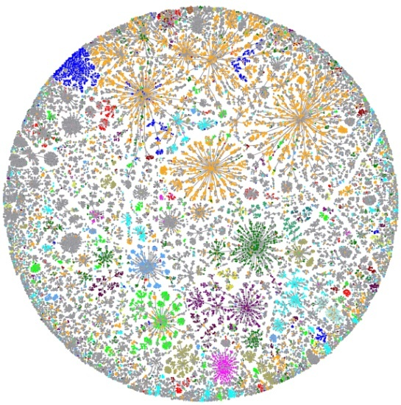
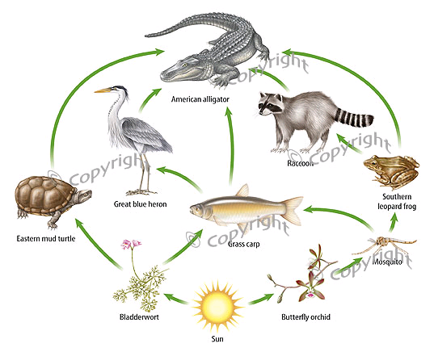
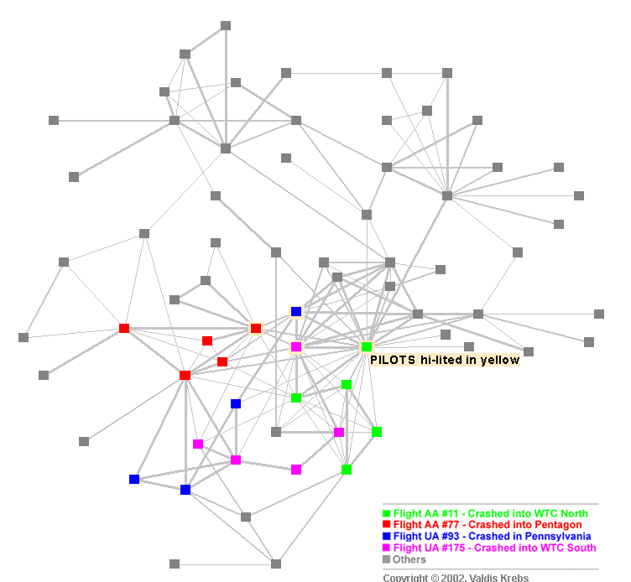
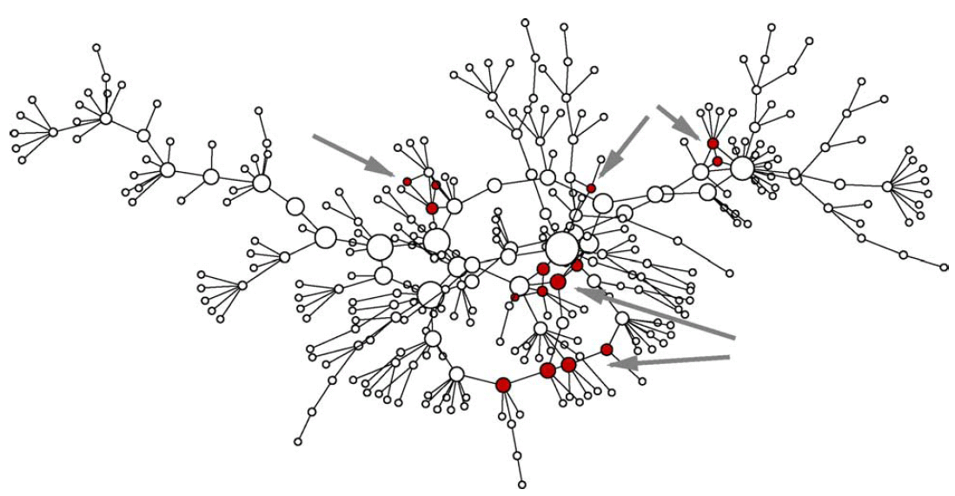
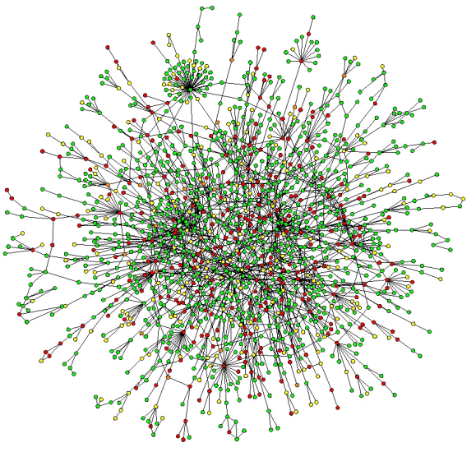
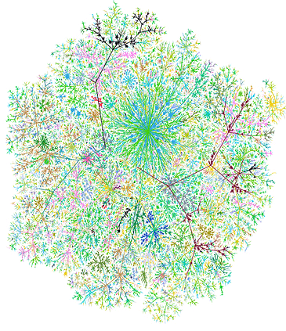
Observation: Graphs are everywhere!
-----
Internet Map [Koren 2009]
Food Web [2007]
Terrorist Network
[Krebs 2002]
Goal: understand and utilize graph data
Challenges: real graphs are often BIG!
Social Network
[Newman 2005]
Protein Network
[Salthe 2004]
Web Graph

Slide 3
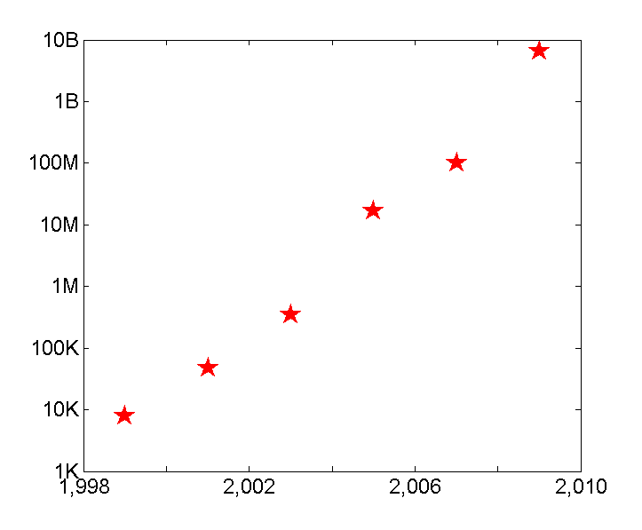
BIG Graphs #1: The Size of Graphs is Growing!
10B
Web Link
[Kang 2009]
100M
NetFlix Rating [Koren 2007]
Patent Citation [Leskovec 2005]
# of edges
(Log Scale)
Paper Citation [Chakrabarti 2003]
100K
Co-authorship [Newman 2001]
Internet Routing [Faloutsos 1999]
Year
1000
1,000
Q: How to Speed-up & Scale-up?
3
Notes:
3

Slide 4
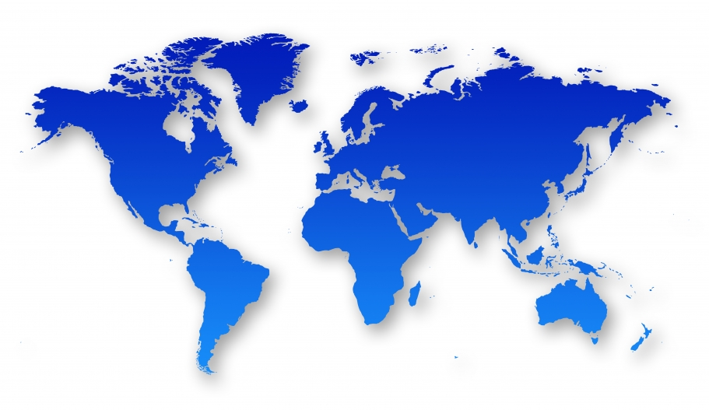
BIG Graphs #2: Data Complexity
(Rich graphs, e.g., geo-coded, attributed)
Node Attr.
Teenager
Adult
Phone
telemarketer
MSN
Edge Attr.
Q: What is difference between North America and Asia?; How to find patterns? (e.g., anomalies, communities, etc)
4
Notes:
4

Slide 5
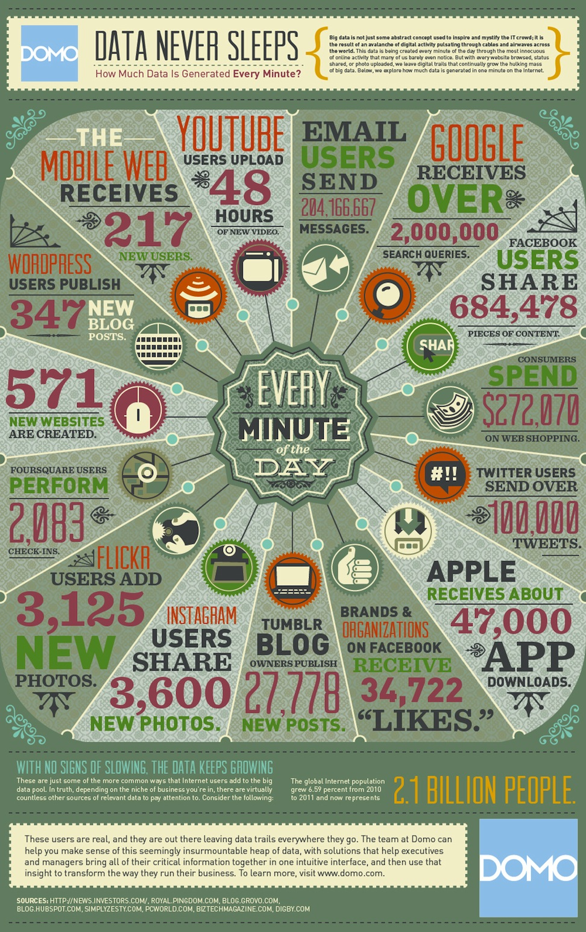
BIG Graphs #3: High Volatility
The amount of the data that is created every one minute
Q: How to respond in real-time or near-real time?
Notes:
How much data is created every one minute?
June 22, 2012, www.marshable.com
Nearly 300,000 status updates are posted to Facebook every minute
Twitter users average over 100,000 tweets per minute
Average day search on google: http://www.statisticbrain.com/google-searches/

Slide 6
Overall Research Theme (since 2005):
Understand and Utilize BIG Graphs
Applications
Systems
Social Networks
Healthcare
…
Cyber-security
Commence
Visualize
Algorithms
[PacificViz14]
[ICDM13a]
[TKDE13]
[SDM13a]
[KDD12c]
[VLDB06]
P
R
A
D
Q
Prediction
Recom’d
Affecting
Detection
Querying
[WWW13,14]
[KDD12a,11a]
[PKDD12]
[ICDM10a]
[KDD08b]
[SDM14b]
[ICDM13b]
[NIPS12]
[KDD09, 11b]
[WCRE’11]
[SDM14a,13b]
[CIKM12a]
[ICDM10b]
[PKDD’10]
[Networking’10]
[SDM12a-b]
[KDD12b,10,08b]
[SAM12]
[CIKM12b,08]
[AAAI’11]
[SDM13a,12b,11a]
[KDDa-c,07a-b,06]
[ICDM08,06]
[CIKM09,KAIS08]
[SDM08,SAM08]
Manage
This Talk: Optimal Dissemination
[J. VLDB12]
[P. IEEE12]
[KDD11c]
[NIPS12, CIKM12a, WWW11, KDD11b,08b] Theory[SDM13a-b,12a-b,08, ICDM10b,06, PKDD10]
Hardness
Optimality
…
Complexity
Equivalence
6
BIG = Large + Complex + Volatile

Slide 7

Dissemination: Think of it as Wine Spill
Background
Spill a drop of wine on cloth
Spread/disseminate to the neighborhood

Slide 8

Dissemination: Wine Spill on a Graph
Background
9
10
2
12
1
8
3
11
4
5
6
Initial Node
7
wine spill on cloth
Dissemination on a graph
Same Diffusion Eq.

Slide 9


An Example: Virus Propagation/Dissemination
Sick
Healthy
Contact
9

Slide 10

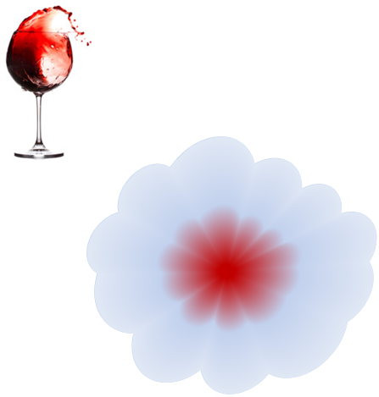
An Example: Virus Propagation/Dissemination
Sick
Healthy
Contact
1: Sneeze to neighbors
2: Some neighbors → Sick
3: Try to recover
Similar Diffusion Eq.
10

Slide 11
An Example: Virus Propagation/Dissemination
Sick
Healthy
Contact
1: Sneeze to neighbors
2: Some neighbors → Sick
3: Try to recover
Q: How to minimize infected population?
11

Slide 12
An Example: Virus Propagation/Dissemination
Sick
Healthy
Contact
1: Sneeze to neighbors
2: Some neighbors → Sick
3: Try to recover
Q: How to minimize infected population?
- Q1: Understand tipping point
- Q2: Affecting algorithms
12

Slide 13
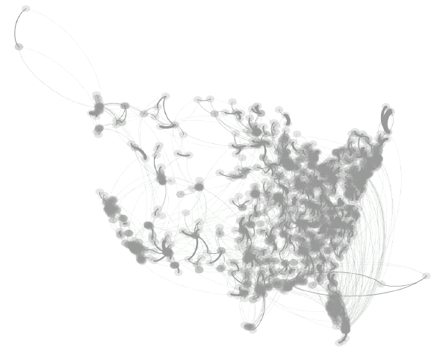
Why Do We Care? – Healthcare
[SDM’13b]
US-Medicare Network
Critical Patient transferring
Move patients → specialized care
→ highly resistant micro-organism → Infection controlling → costly & limited
Q: How to allocate resource to minimize overall spreading?
SARS costs 700+ lives; $40+ Bn; H1N1 costs Mexico $2.3bn; Flu 2013: one of the worst in a decade, 105 children in US.

Slide 14
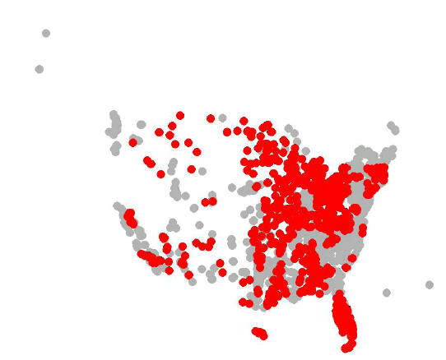
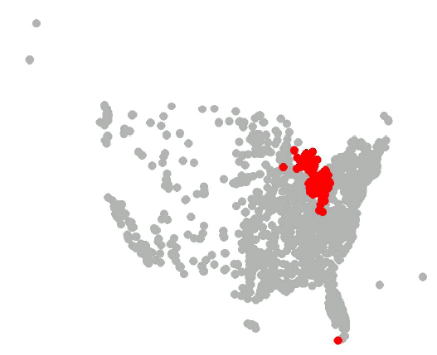
Why Do We Care? – Healthcare
[SDM’13b]
Current Method
Our Method
Red: Infected Hospitals after 365 days
SARS costs 700+ lives; $40+ Bn; H1N1 costs Mexico $2.3bn; Flu 2013: one of the worst in a decade, 105 children in US.

Slide 15
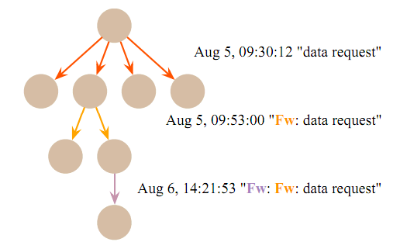
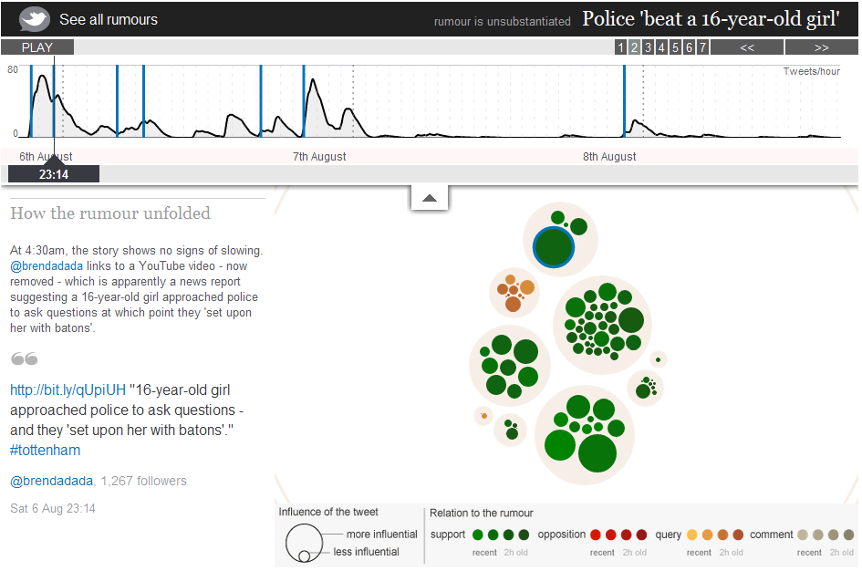
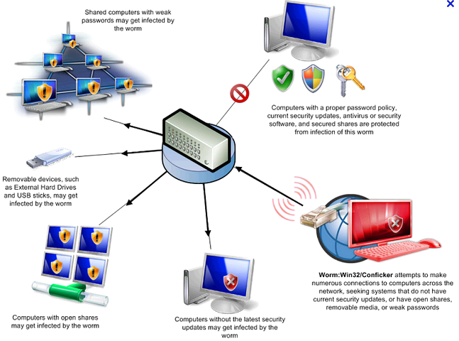
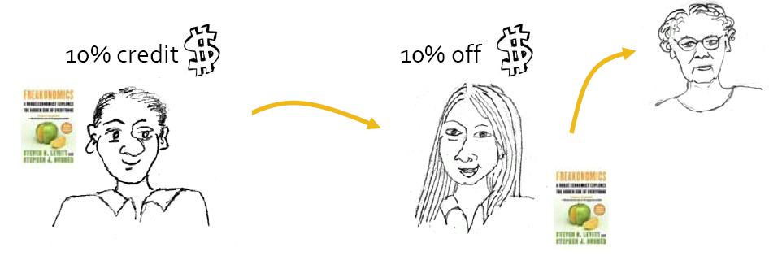
Why Do We Care? (More)
Email Fwd in Organization
Rumor Propagation
Viral Marketing
Malware Infection
15
Notes:
http://www.guardian.co.uk/uk/interactive/2011/dec/07/london-riots-twitter

Slide 16
Roadmap
Motivations
Q1: Theory – Tipping Point
Q2: Algorithms
Some of My Other Work
Future Plans

Slide 17







SIS Model (e.g., Flu)
(Susceptible-Infected-Susceptible)
Each Node Has Two Status:
β: Infection Rate (Prob ( | || ))
δ: Recovery Rate (Prob ( | | ))
Sick
Healthy
t = 1
t = 2
t = 3
17

Slide 18
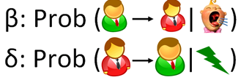
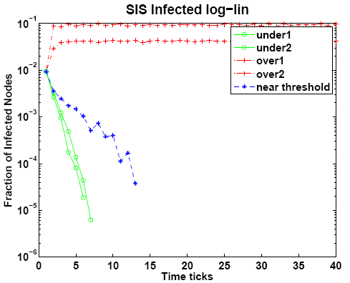
SIS Model (e.g., Flu)
p_{t+1} = H (p_{t})
Infection Ratio
Theorem [Chakrabarti+ 2003, 2007]:
If λ x (β/δ) ≤ 1; no epidemic
for any initial conditions of the graph)
, δ : virus par
Time Ticks
λ: largest eigenvalue of the graph (~ connectivity of the graph)
β, δ : virus parameters (~strength of the virus)

Slide 19

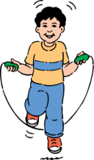






Beyond Static Graphs: Alternating Behavior [PKDD 2010, Networking 2011]
DAY
(e.g., work, school)
A₁: adjacency matrix
8
8
19

Slide 20
Beyond Static Graphs: Alternating Behavior [PKDD 2010, Networking 2011]
NIGHT
(e.g., home)
A₂: adjacency matrix
8
8
20

Slide 21



Formal Model Description
[PKDD 2010, Networking 2011]
Healthy
SIS model
  recovery rate δ
  infection rate β
Set of T arbitrary graphs
Prob. δ
N2
Prob. β
N1
X
Prob. β
Prob. δ
Infected
N3
day
night
N
N
, weekend…..
N
N
21

Slide 22
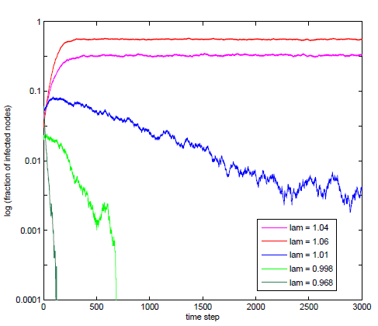
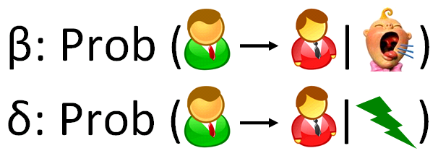
Epidemic Threshold for Alternating Behavior
[PKDD 2010, Networking 2011]
Theorem [PKDD 2010, Networking 2011]:
No epidemic If λ(S) ≤ 1.
Log (Infection Ratio)
Above
System matrix S = Π_{i} S_{i}
S_{i} = (1-δ)I + β A_{i}
At Threshold
Below
day
night
A_{i}
N
N
……
Time Ticks
Also generalize to other 25
virus propagation models
N
N
22

Slide 23
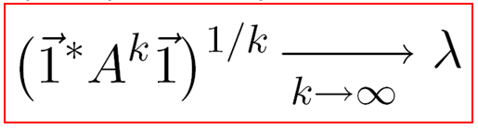
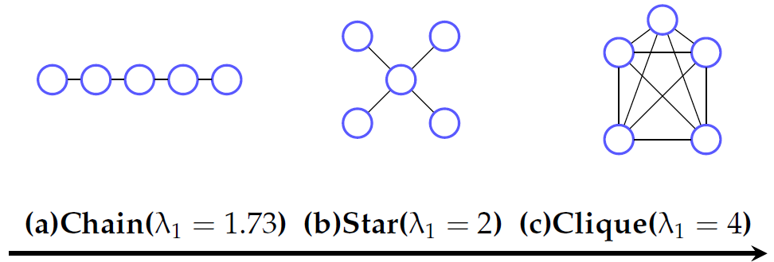
Why is λ So Important?
Intuitions
λ → Capacity of a Graph:
1
1
2
1
2
2
Larger λ → better connected
23

Slide 24
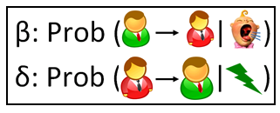
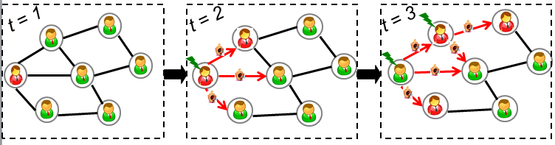
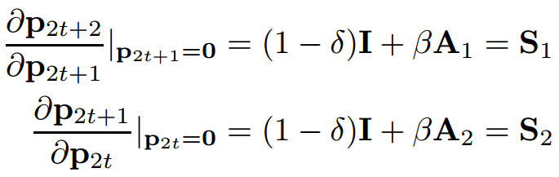
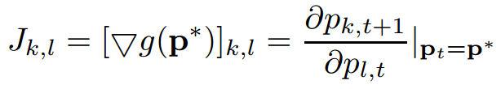
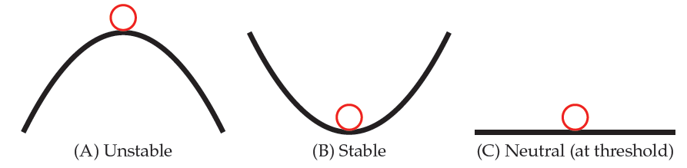
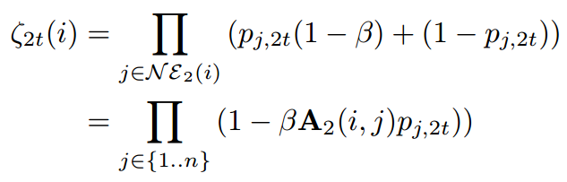
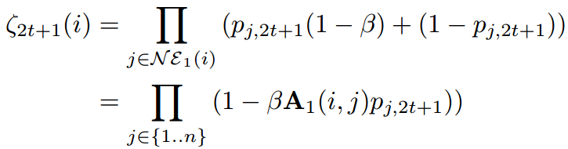
Why is λ So Important?
Details
Key 1: Model Dissemination as an NLDS:
Key 2: Asymptotic Stability of NLDS [Tong+ 2010]:
p = p* = 0 is asymptotic stable if | λ (J)|<1, where
p_{t+1} = g (p_{t})
p_{t} : Prob. vector: nodes being sick at t
g : Non-linear function (graph + virus parameters)
24
Notes:
\e_t(i): probability of node I does not receive any infection from neighborhood at time t

Slide 25
Roadmap
25
Motivations
Q1: Theory – Tipping Point
Q2: Algorithms
  Minimize Dissemination
  Maximize Dissemination
Some of My Other Work
Future Plans

Slide 26

Minimizing Dissemination: Immunization
Given: a graph A, virus prop model and budget k;
Find: k ‘best’ nodes for immunization.
23
16
24
15
12
14
25
22
13
26
11
21
27
9
34
20
10
1
28
4
8
33
19
2
29
3
7
18
5
30
6
17
31
32
26
SARS costs 700+ lives; $40+ Bn; H1N1 costs Mexico $2.3bn
Notes:
26

Slide 27

Minimizing Dissemination: Immunization
Given: a graph A, virus prop model and budget k;
Find: k ‘best’ nodes for immunization.
23
16
24
15
12
14
25
22
13
26
11
21
27
9
34
20
10
1
28
4
8
33
19
2
29
3
7
18
5
30
6
17
31
32
27
SARS costs 700+ lives; $40+ Bn; H1N1 costs Mexico $2.3bn
Notes:
27

Slide 28
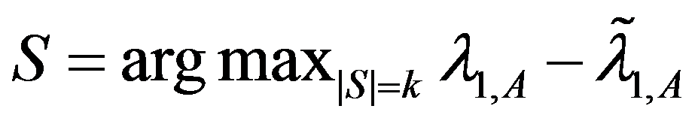
Optimal Method
Select k nodes, whose absence creates the largest drop in λ
λ-λ_{s}
9
9
11
9
10
10
1
1
4
4
8
8
2
2
3
7
3
7
5
5
6
6
Original Graph: λ
28
Without {2, 6}: λ_{s}

Slide 29
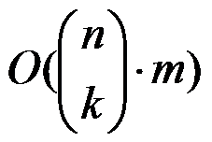
Optimal Method
Select k nodes, whose absence creates the largest drop in λ
But, we need in time
  Example: 1,000 nodes, with 10,000 edges
    It takes 0.01 seconds to compute λ
    It takes 2,615 years to find best-5 nodes !
λ-λ_{s}
Largest eigenvalue
w/o subset of nodes S
Theorem: (Tong+ CIKM12 best paper)
Find Optimal k-node Immunization is NP-Hard
29

Slide 30
Details
Optimal k-node immunization is NP-Hard
Basic Idea: Reduction from P1 (known NP-hard)
Proof #1: If YES to P1(G,k)→ YES to P2(G, n-k)
  YES to P1 S_{kxk} = 0 λ(A) = λ(0) = 0 YES to P2
Proof #2: If NO to P1(G,k)→ NO to P2(G, n-k)
Suppose YES to P2 λ(A) = λ(0) ≤ 0
S_{kxk} = 0 Nodes in S being ind. set contradict
Given an undirected/unweighted graph G, and k
P1 (k-independent set problem): is there k nodes, no two of which are adjacent?
P2 (k-node immunization problem): is there k nodes, the deletions of which makes the leading eigenvalues ≤ 0
S_{kxk}
X_{(k)x(n-k)}
A =
X_{(k)x(n-k)}
T_{(n-k)x(n-k)}
Removing
Nodes in T
~
Removing
Nodes in T
~
S(i,j)≥0

Slide 31
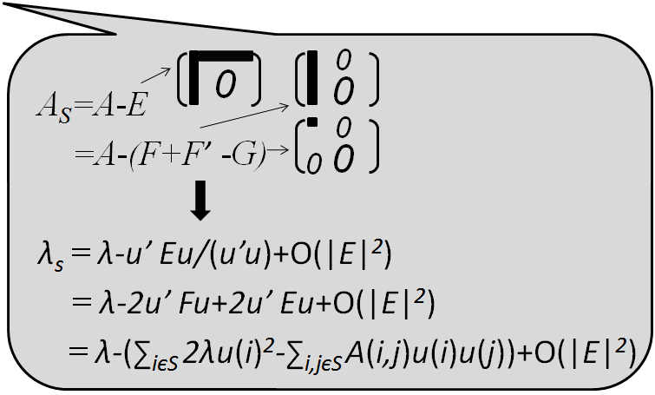
Netshield to the Rescue
Theorem: (ICDM 2010b, TKDE14)
(1) λ - λ_{s}≈Sv(S)= ∑_{iєS} 2λu(i)²-∑_{i,jєS} A(i,j)u(i)u(j)
A
u
u
=λ X
u(i): eigen-score
Footnote: u(i) ~ PageRank(i) ~ in-degree(i)

Slide 32
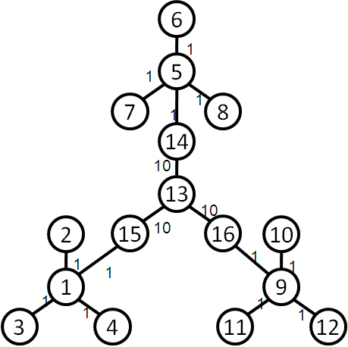
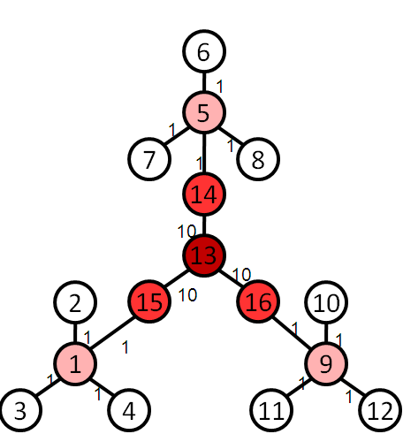
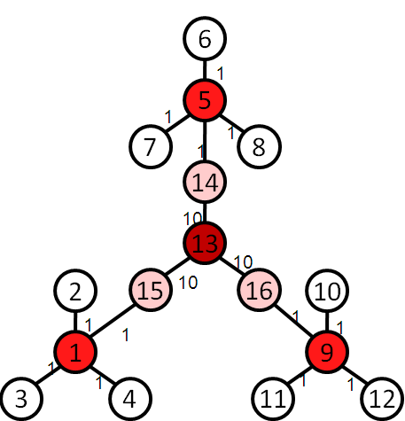
Netshield to the Rescue
Intuition
Theorem: (ICDM 2010b, TKDE14)
(1) λ - λ_{s}≈Sv(S)= ∑_{iєS} 2λu(i)²-∑_{i,jєS} A(i,j)u(i)u(j)
find a set of nodes S (e.g. k=4), which
  (C1) each has a high eigen-score
  (C2) diverse among themselves
Original Graph
Select by C1
Select by C1+C2

Slide 33
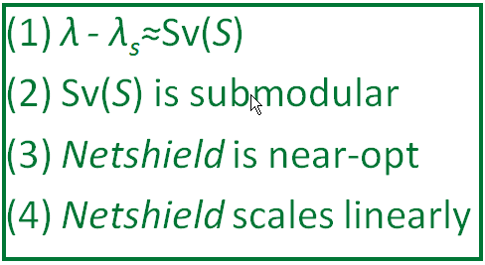
Netshield to the Rescue
Theorem: (ICDM 2010b, TKDE14)
(1) λ - λ_{s}≈Sv(S)= ∑_{iєS} 2λu(i)²-∑_{i,jєS} A(i,j)u(i)u(j)
(2) Sv(S) is sub-modular (+monotonically non-decreasing)
Example: 1,000 nodes, with 10,000 edges
  Netshield takes < 0.1 seconds to find best-5 nodes !
  … as opposed to 2,615 years
Corollary: (ICDM 2010b, TKDE14)
(3) Netshield is near-optimal (wrt max Sv(S))
(4) Netshield is O(nk²+m)
33
Footnote: near-optimal means Sv(S ^{Netshield}) >= (1-1/e) Sv(S ^{Opt})

Slide 34

Why Netshield is Near-Optimal?
Marginal benefit of deleting {5,6}
Marginal benefit of deleting {5,6}
9
3
10
9
3
1
10
5
1
δ
5
2
6
8
7
2
6
8
7
4
4
Benefit of deleting {1,2}
Benefit of deleting {1,2, 3,4}
>=
Sub-Modular (i.e., Diminishing Returns)
δ
34
Notes:
34

Slide 35
Why Netshield is Near-Optimal?
9
3
10
9
3
1
10
5
1
δ
5
2
6
8
7
2
6
8
7
4
4
>=
Sub-Modular (i.e., Diminishing Returns)
δ
Theorem: k-step greedy alg. to maximize a sub-modular function guarantees (1-1/e) optimal [Nemhauster+ 78]
35
Notes:
35

Slide 36
Why Sv(S) is sub-modular?
Newly deleted
9
3
10
1
5
2
6
8
7
4
Already deleted
36
Notes:
36

Slide 37
Why Sv(S) is sub-modular?
Newly deleted
Marginal Benefit of deleting {5,6}
=
9
3
Sv(S_{green} U S_{blue}) - Sv(S_{green})
∑_{iєSblue} 2λu(i)²-∑_{i,jєSblue} A(i,j)u(i)u(j)
(∑_{iєSblue, jєSgreen} A(i,j)u(i)u(j)+∑_{iєSgreen, jєSblue} A(i,j)u(i)u(j))
10
-
1
5
2
6
8
7
4
Already deleted
Pure benefit
from {5,6}
Interaction between
{5,6} and {1,2}
Only purple term depends on {1, 2}!
37
Notes:
37

Slide 38
Why Sv(S) is sub-modular?
Marginal Benefit of Sv(S) = Blue – Purple
9
3
9
3
10
10
1
1
5
5
2
6
2
6
8
7
8
7
4
4
More Green
More Purple
Less Red
Marginal Benefit of Left >= Marginal Benefit of Right
Footnote: greens are nodes already deleted; blue {5,6} nodes are nodes to be deleted
38
Notes:
38

Slide 39
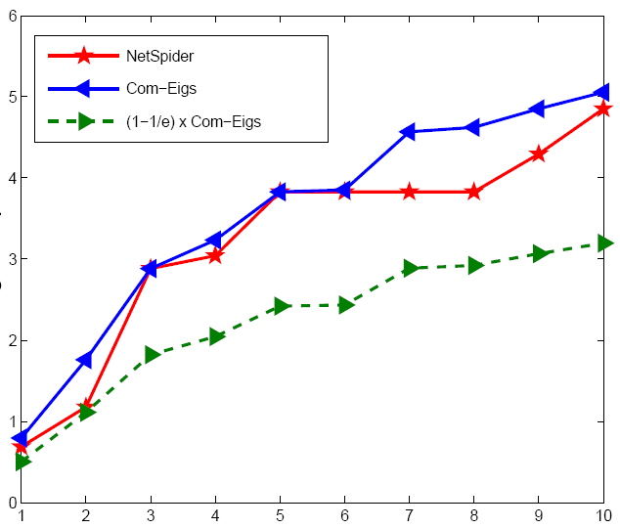
Quality of Netshield
(better)
Optimal
Netshield
Eig-Drop
(1-1/e) x Optimal
# of vaccines
39

Slide 40
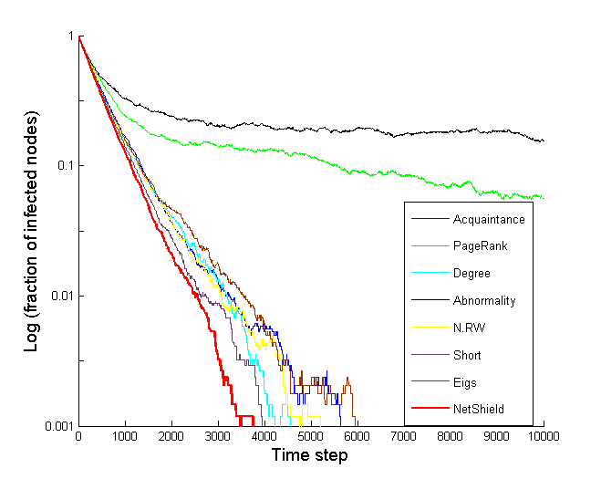
Comparison of Immunization
Log(infection ratio)
(better)
Abnormality
PageRank
Between (short)
Degree
Between (RW)
Acquaintance
Netshield
Eigs (=HITS)
Time Ticks
40

Slide 41
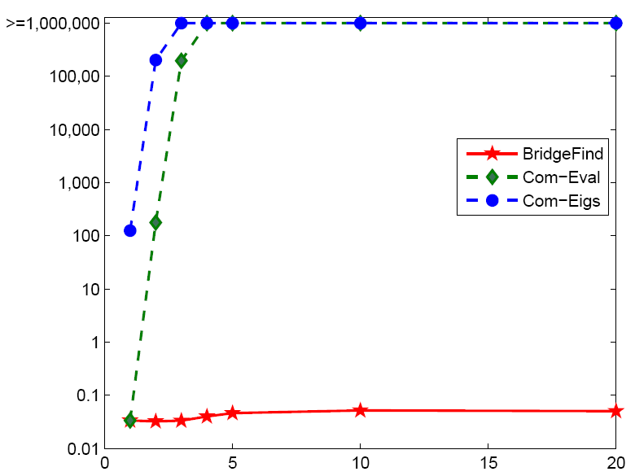
Speed of Netshield
> 10 days
>=1,000,000
Com-Eigs
100,000
10,000
Com-Eval
Time
10,000,000x
1,000
(better)
100
10
Netshield
0.1 seconds
1
0.1
# of vaccines
0.01
NIPS co-authorship Network: 3K nodes, 15K edges
41

Slide 42
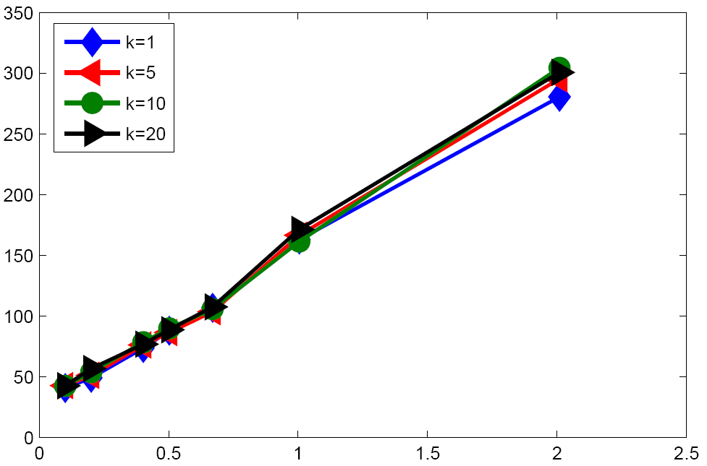
Scalability of Netshield
Time
(better)
# of edges
X 10⁸
42

Slide 43
Roadmap
43
Motivations
Q1: Theory – Tipping Point
Q2: Algorithms
  Minimize Dissemination
  Maximize Dissemination
Some of My Other Work
Future Plans

Slide 44
Maximizing Dissemination: Edge Addition
Best Paper CIKM12
Given: a graph A, virus prop model and budget k;
Find: add k ‘best’ new edges into A.
By 1st order perturbation, we have
  λ_{s} - λ ≈Gv(S)= c ∑_{eєS} u(i_{e})v(j_{e})
So, we are done. But…
Real graphs are sparse → O(n²-m) complexity
Low Gv
Left eigen-score
of source
Right eigen-score
of target
High Gv
44

Slide 45
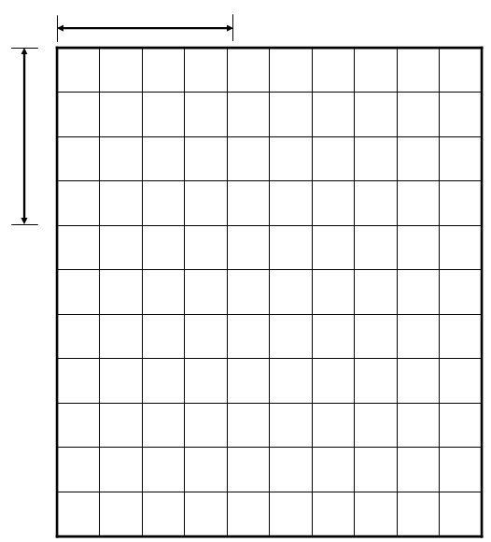
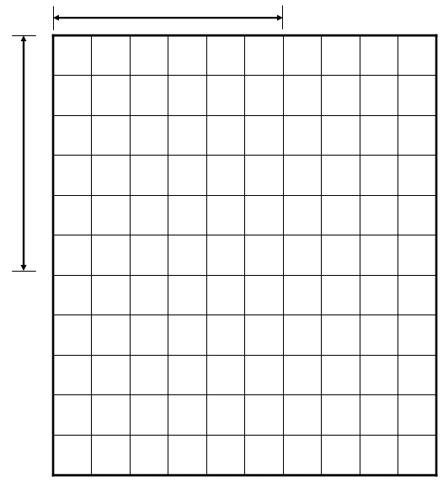
Maximizing Dissemination: Edge Addition
Best Paper CIKM12
λ_{s} - λ ≈Gv(S)= c ∑_{eєS} u(i_{e})v(j_{e})
Q: How to Find k new edges w/ highest Gv(S) ?
A: Modified Fagin’s algorithm
k
#2: Sorting
Targets by v
k+d
#3:
Search
space
Search
space
k
k+d
#1: Sorting
Sources by u
Time Complexity: O(m+nt+kt²), t = max(k,d)
:existing edge

Slide 46
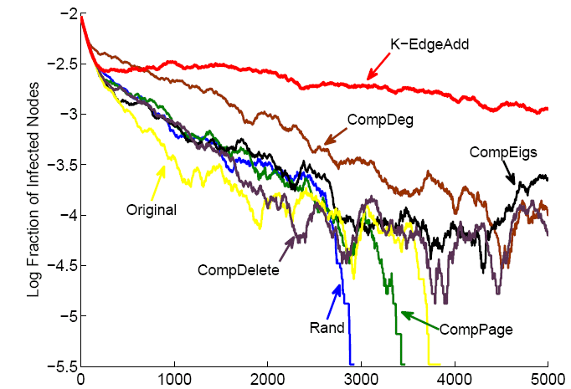
Maximizing Dissemination: Evaluation
Best Paper CIKM12
Log (Infection Ratio)
(better)
Time Ticks
46

Slide 47
Optimal Dissemination: Summary
Goal: Guild Dissemination by Opt. Link Structure
Theory: Opt. Dissemination = Opt. λ
Algorithms:
  Netshield to Minimize Dissemination
  NetGel to Maximize Dissemination
More on This Topic
  Beyond Link Structure (content, attribute) [WWW11]
  Beyond Full Immunity [SDM13b]
  Higher Order Variants [CIKM12a]
  Equivalence (node deletion vs. edge deletion) [CIKM12a]
  Immunization on Dynamic Graphs [PKDD10]

Slide 48
Roadmap
Motivations
Q1: Theory – Tipping Point
Q2: Algorithms – Minimize vs. Maximize
Some of My Other Work
Future Plans
– W1: Mining Clinical Notes
– W2: Graph Linkage
– W3: Graph Management & Mining System
– W4: Want a Good Answer on CQA?
– W5: Sense-Making on Large Graphs
48

Slide 49
Overall Research Theme (since 2005):
Understand and Utilize BIG Graphs
Applications
Systems
Social Networks
Healthcare
…
Cyber-security
Commence
Visualize
Algorithms
[PacificViz14]
[ICDM13a]
[TKDE13]
[SDM13a]
[KDD12c]
[VLDB06]
P
R
A
D
Q
Prediction
Recom’d
Affecting
Detection
Querying
[WWW13,14]
[KDD12a,11a]
[PKDD12]
[ICDM10a]
[KDD08b]
[SDM14b]
[ICDM13b]
[NIPS12]
[KDD09, 11b]
[WCRE’11]
[SDM14a,13b]
[CIKM12a]
[ICDM10b]
[PKDD’10]
[Networking’10]
[SDM12a-b]
[KDD12b,10,08b]
[SAM12]
[CIKM12b,08]
[AAAI’11]
[SDM13a,12b,11a]
[KDDa-c,07a-b,06]
[ICDM08,06]
[CIKM09,KAIS08]
[SDM08,SAM08]
Manage
This Talk: Optimal Dissemination
[J. VLDB12]
[P. IEEE12]
[KDD11c]
[NIPS12, CIKM12a, WWW11, KDD11b,08b] Theory[SDM13a-b,12a-b,08, ICDM10b,06, PKDD10]
Hardness
Optimality
…
Complexity
Equivalence
49
BIG = Large + Complex + Volatile

Slide 50
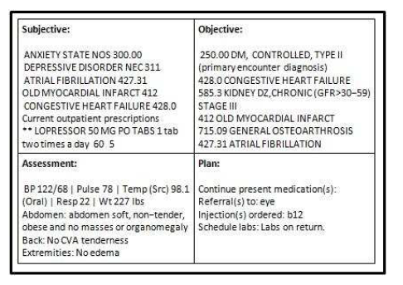
W1. Mining Clinical Notes [KDD 2012a]
Clinical Notes
Symptom Identification
Identified Symptoms
Input
Symptom Graphs
Graph Construction
RWR Symptom Expansion
Related symptoms
SOAP sections of a Clinical Note
Output
Initial symptoms
Input
50

Slide 51
W1. Mining Clinical Notes: Symptom Expansion [KDD 2012a]
Key Idea: Symptom Expansion → Graph Node Proximity
i.e., which symptoms are most relevant to initial symptoms?
Heart Attack
Expanded
Wheezing
Expanded
Cough
Fever
Ankle Edema
Expanded
Rales
Chest Pain
Initial
Initial
Graph Proximity Algorithms：best papers at ICDM06 & SDM08
Generalizations: comorbidity [KDD06, TKDE13a], negations [ICDM08, CIKM09]
51

Slide 52
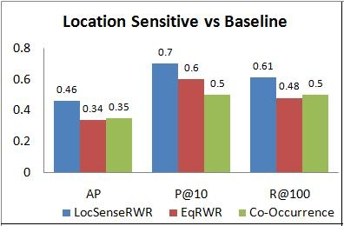
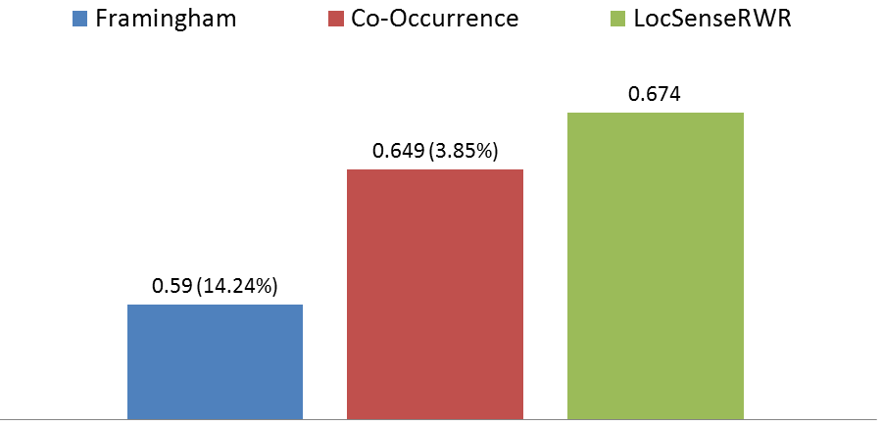
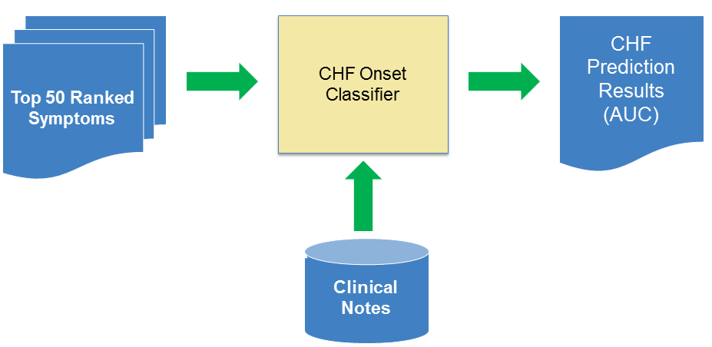
Framingham Symptom Expansion
W1. Evaluations
[KDD 2012a]
Evaluation Details:
Experts: 2; 175 symptoms judged
Relevant: 72 , Irrelevant: 103
Inter-annotator agreement : 81.8%
Symptoms labeled as related by both experts were considered as relevant.
CHF Prediction (AUC)
Evaluation Details:
CHF： affecting 1 out of 5 adults in US; _{most costly in CMS}
_{Framingham, 1971 → 50s, 60s}
52

Slide 53
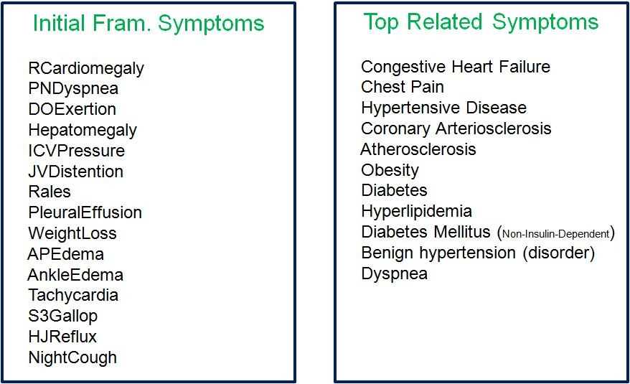
W1: Framingham Symptom Expansion [KDD 2012a]
We are able to identify related disease and symptom mentions, confirmed by clinical experts

Slide 54


  W2: Fast Bipartite Graph Alignment [ICDM13]

Slide 55




  W2: Fast Bipartite Graph Alignment [ICDM13]
(better)
Runtime (sec)
Accuracy vs. Noise
Runtime vs. Graph Size

Slide 56




W2. Beyond BIG-Align: Multi-Way Linkage
  ~
  S1: Dynamic Graph Linkage
  S2: Community-level Linkage
  ~
  ~
  S3: Hetero. Graph Linkage
  S4: Multi-relational DB Linkage
(1) All build upon BIG-Align [ICDM2013]
(2) Filed 7 patents, September 2013

Slide 57

W3. GBase: Large-Scale Graph
Management and Mining System [KDD’11 c, VLDB12]
57

Slide 58




W3. Efficiency Comparison & Scalability
_{Storage Savings}
_{Scalability (size of graph)}
_{Running Time Savings}
_{Scalability (# of Machine)}
Impact: Led to System G. (a world-wide software initiative at IBM)
58

Slide 59


W4: Want a Good Answer on CQA?
Observations:
  Positive Correlation
  r = 0.67, p-value<0.0001
Algorithms:
  Joint Prediction
  30% net increase
Precision
Better questions
Better Answers
MIT Technology Review, December 2013
“Data Mining Reveals the Secret to Getting Good Answers”

Slide 60



W5. Sense-Making of Marked Nodes [SDM 2013a, KDD 2011d]
(a) Too many connections?
(c) Our sol.: ‘right’ connections
→ better sense-making
+ ‘right’ connections = most succinct way to describe marked nodes
+ MDL-based formulation, NP-Hard
+ Effective Approximate Algorithms
(b) Too few connections?
60
60

Slide 61
Roadmap
Motivations
Q1: Theory – Tipping Point
Q2: Algorithms – Minimize vs. Maximize
Some of My Other Work
Future Plans
  F1: Task-aware Graph Construction
  F2: The Power of Scale
  F3: Complex Similarity
  F4: Social-Good Informatics
  F5: Big Data Analysis

Slide 62
F1: Task-Aware Graph Construction
Step 1
Step 2
Raw Data
(text, image, subgraph, etc)
Graphs
Patterns
Optimal Diss. (This Talk)
Q: How to construct an optimal graph for a specific task?
Observationｓ： #1： step 2 >> step 1; #2: step 1 ┴ step 2

Slide 63
F2: The Power of Scale
Opportunity: Approaching Asymptotic Properties of DM Algorithms!
Challenges: (C1) Scalability + (C2) Usability
    E1: O(m) or better on a single machine
    E2: Parallelism (implementation, decouple, analysis)
    E3: by interpretable algorithms
    E4: by summarization
C1
C2

Slide 64

F3: Beyond Graph Data: Complex Similarity
Observation #1: Many real-world objects are complex
  e.g., patients, video, teams, etc.→ mixture of spatial, temporal and relational data
Observation #2: Similarity → a core building block
Complex Similarity: New Models & Algorithms
Examples
  E1: Mining complex time-stamp
  events [Tong+ CIKM08]
  E2: Tissue-specific PPI Networks
AUC

Slide 65

F4: Social-Good Informatics
S1: Public Safety
  Q: How to deploy police officers by analyzing the co-arrest network proactively?
S2: Public Education
  Q: How does the usage of social networks impact students’ performance?
S3: Assistive Technology
  Q: How to provide step-by-step navigation for visually-impaired persons through crowd platform?
Network metrics | T-Statistic | P-value
Mean degree | 1.739 | 0.084
Max sociability | -2.165 | 0.031
Max tie skewness | 3.305 | 0.0001
A focused team w/ broad reachability
performs better [Tong+ 2012]

Slide 66

F5: Big Data Analysis Pipeline
Integration
(Representation)
Interpretation
(User)
Acquisition
(recording)
Cleaning
(Annotation)
Analysis
(Modeling)
_{Adopted} _{From:} ``Challenges and Opportunities with Big Data”

Slide 67
F5: Big Data Analysis - Comprehension
6
Integration
(Representation)
Interpretation
(User)
Acquisition
(recording)
Cleaning
(Annotation)
1
3
Analysis
(Modeling)
2
2
5
4
1. Graph enhancement (This talk)
2. Task-aware data integration (graph construction)
3. Visual analytics
4. User credibility/reputation vs. info. quality
5. active data acquisition
6. multi-source data quality cleaning
1. Optimal dissemination (This talk)
2. Task-aware data integration (graph construction)
3. Visual Analytics
4. User credibility/repuation vs. info. quality
5. active data acquisition
6. multi-source data quality cleaning
67

Slide 68


Thank you!
This Talk
Res. Theme: understand and utilize BIG graphs
current method
our method
My vision: Big data analysis is beyond one-way street !

