Slide 1

Fast Algorithms for
Querying and Mining Large Graphs
Hanghang Tong
Machine Learning Department
Carnegie Mellon University
htong@cs.cmu.edu
http://www.cs.cmu.edu/~htong

Slide 2
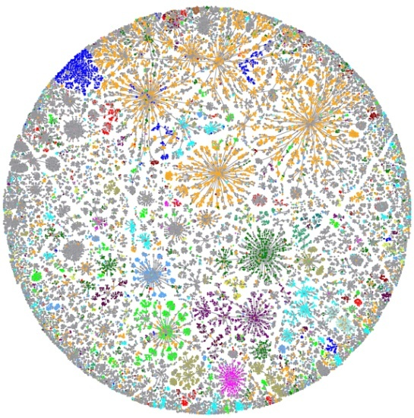
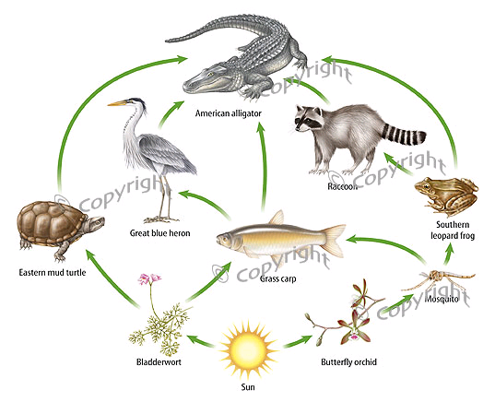
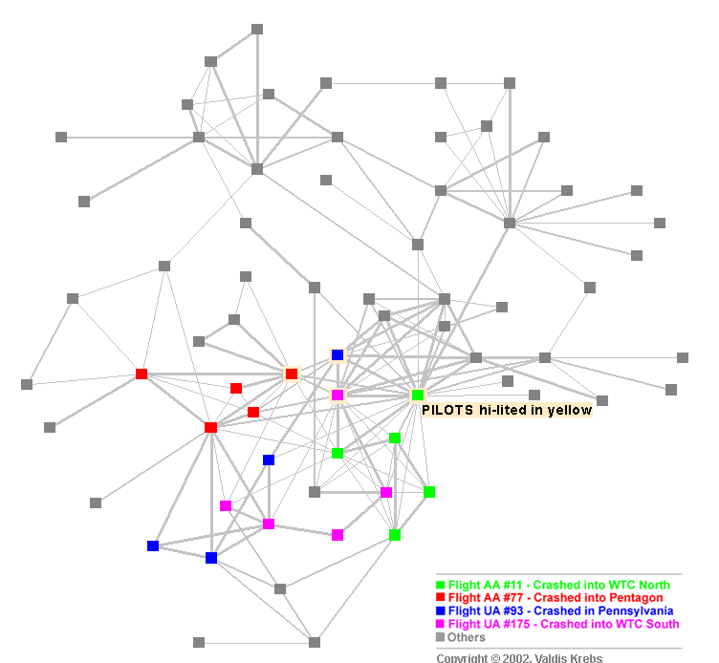
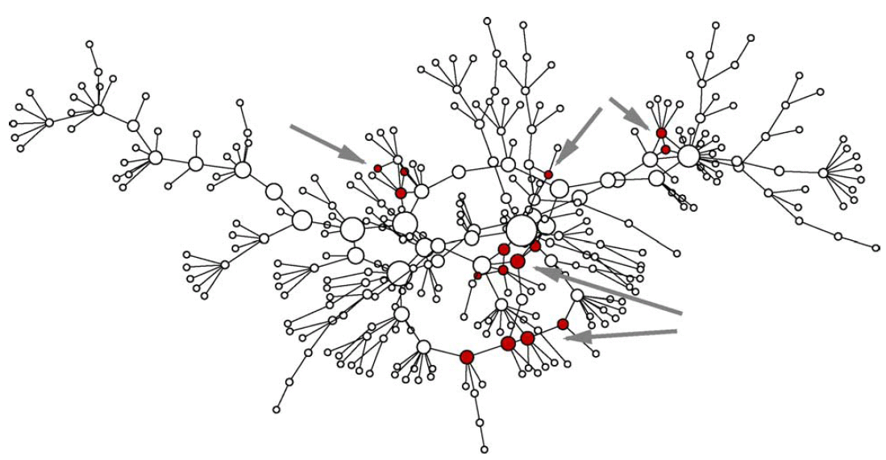
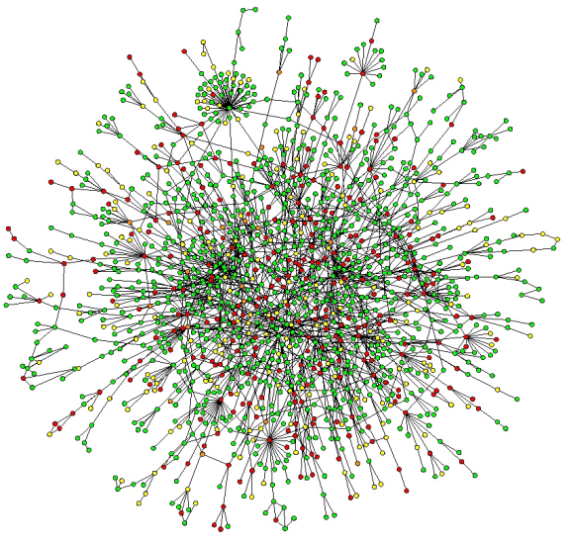
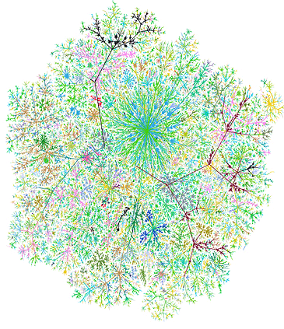
Graphs are everywhere!
-----
Internet Map [Koren 2009]
Food Web [2007]
Terrorist Network
[Krebs 2002]
Research Theme: Help users understand and utilize large graph-related data
Social Network
[Newman 2005]
Protein Network
[Salthe 2004]
Web Graph

Slide 3
Motivating Applications
A1: Social Networks
A2: Network Forensics
A3: Business Intelligence
A4: Financial Fraud Detection
A5: Immunization

Slide 4
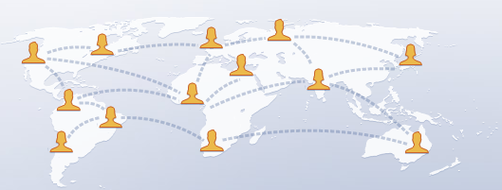





A1: Social Networks
Community
Facebook (300m+ users, 500mn revenue, 10bn values)
MSN ( (110m users); Twitter (18m users)
Msn (240m users) LinkedIn (50m users);
How to help users explore such networks?
(e.g., find strange persons, communities, etc)
Anomaly
Notes:
Facebook: 300m (largest social network); 500mn revenue in 2009, 10bn values
Myspace: 110m+ users
http://www.web-strategist.com/blog/2008/01/09/social-network-stats-facebook-myspace-reunion-jan-2008/
http://www.reuters.com/article/technologyNews/idUSTRE58E7ZK20090916?feedType=RSS&feedName=technologyNews
Twitter: 18million http://www.emarketer.com/Article.aspx?R=1007271

Slide 5
A2: Network Forensics [Sun+ 2007]
ibm.com
How to detect abnormal traffic?
Graph
cmu.edu
Port scanning
DDoS
Normal Traffic
IP Dst
IP Dst
IP Dst
IP Src
IP Src
IP Src
Adj. Matrix

Slide 6
A3: Business Intelligence
….
NY Times
Service
2007
Forbes
IBM
Reuters
Hardware
Proximity of ”IBM” wrt “Service”
(higher is better)
NY Times
Service
2006
Forbes
IBM
Reuters
Hardware
Year
NY Times
Service
2005
How close is “IBM” to
“service business” over years?
Forbes
IBM
Reuters
Hardware
….
nodes: business reviews & keywords; edges: ‘reporting’

Slide 7
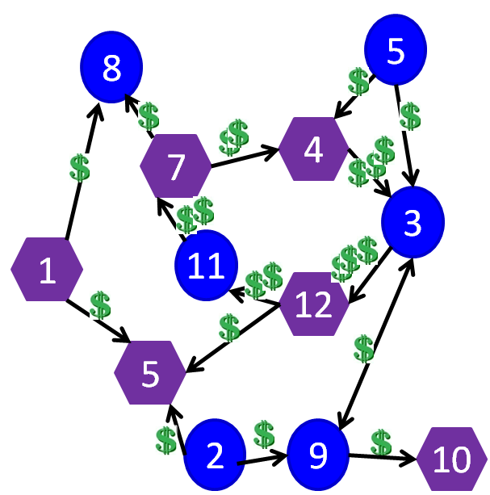
A4: Financial Fraud Detection [Tong+ 2007]
Legends:
: Anonymous accounts
: Anonymous banks
How to detect abnormal transaction patterns?
(e.g., money-laundering ring)
7.5% of U.S. adults lost money for financial fraud
50%+ US corporations lost >= $500,000
  e.g., Enron ($70bn) [Albrecht+ 2001]
Total cost of financial fraud: $1trillion [Ansari 2006]

Slide 8

A5: Immunization
23
16
24
15
How to select k `best’ nodes for immunization?
12
14
25
22
13
26
11
21
27
9
34
20
10
1
28
4
8
33
19
2
29
3
7
18
5
30
6
17
31
32
SARS costs 700+ lives; $40+ Bn; H1N1 costs Mexico $2.3bn

Slide 9

A5: Immunization
23
16
24
15
12
How to select k `best’ nodes for immunization?
14
25
22
13
26
11
21
27
9
34
20
10
1
28
4
8
33
19
2
29
3
7
18
5
30
6
17
31
32
SARS costs 700+ lives; $40+ Bn; H1N1 costs Mexico $2.3bn

Slide 10
Roadmap
Motivations
Selected Research Work
Future Plans

Slide 11
Selected Research Work
Querying [Goal: query complex relationship]
  T1. Find complex user-specific patterns;
  T2. Proximity tracking;
  T3. Answer all the above questions quickly.
Mining [Goal: find interesting patterns]
  T4. Immunization;
  T5. Spot anomalies.

Slide 12
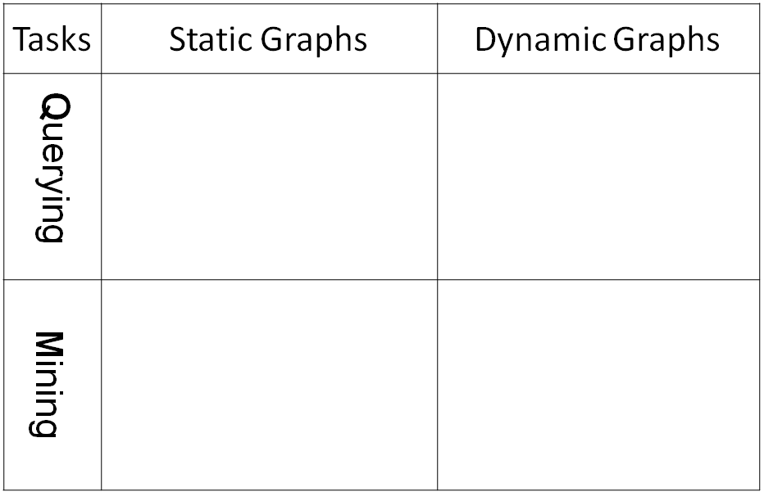
Overview
Tasks
Static Graphs
Dynamic Graphs
Querying
T1
T2
T3
T3
Mining
T4
T5
T5

Slide 13
Overview
Tasks
Static Graphs
Dynamic Graphs
Querying
CePS, iPoG
(KDD06, ICDM08, CIKM09)
pTrack/cTrack
(SDM08, SAM08)
T1
T2
FastProx (ICDM06,
KAIS07, KDD07 b, ICDM08)
FastProx
(SDM08, SAM08)
T3
T3
Mining
NetShield
T4
Colibri-S
(KDD08)
Colibri-D
(KDD08)
T5
T5

Slide 14
Proximity Measurement
Background
A
B
a.k.a Relevance, Closeness, ‘Similarity’…
Q: How close is A to B?

Slide 15
Random Walk with Restart
[Tong+ ICDM 2006]
Background
0.03
0.04
 | Node 4
Node 1 Node 2 Node 3 Node 4 Node 5 Node 6 Node 7 Node 8 Node 9 Node 10 Node 11 Node 12 | 0.13 0.10 0.13 0.22 0.13 0.05 0.05 0.08 0.04 0.03 0.04 0.02
10
0.10
9
12
0.13
2
0.08
0.02
1
8
0.13
11
3
0.04
4
0.05
6
5
0.13
7
0.05
Nearby nodes, higher scores
Ranking vector
More red, more relevant

Slide 16

RWR: Think of it as Wine Spill
Background
Spill a drop of wine on cloth
Spread/diffuse to the neighborhood

Slide 17

RWR: Wine Spill on a Graph
Background
9
10
2
12
1
8
3
11
4
5
6
Query
7
wine spill on cloth
RWR on a graph
Same Diffusion Eq.

Slide 18
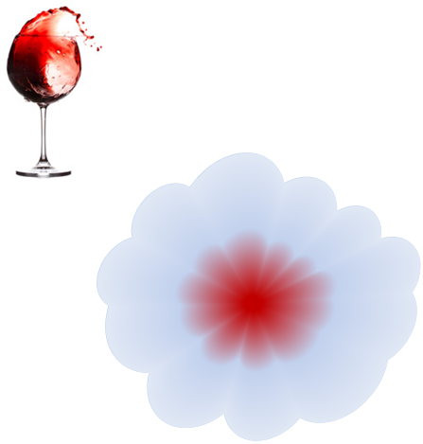
Random Walk with Restart
Background
10
9
12
2
1
8
3
11
4
6
5
7
Same Diffusion Eq.

Slide 19
Intuition: Why RWR is A Good Score?
Background
A
B
Prox (A, B) =
Score (Red Path) +
Score (Green Path) +
Score (Blue Path) +
Score (Purple Path) + …
…
High proximity many, short, heavy-weighted paths

Slide 20
Overview
Tasks
Static Graphs
Dynamic Graphs
Querying
CePS, iPoG
(KDD06, ICDM08, CIKM09)
pTrack/cTrack
(SDM08, SAM08)
T1
T2
FastProx (ICDM06,
KAIS07, KDD07 b, ICDM08)
FastProx
(SDM08, SAM08)
T3
T3
Mining
NetShield
T4
Colibri-S
(KDD08)
Colibri-D
(KDD08)
T5
T5

Slide 21
T1: Find Complex User-Specific Patterns
T1.1. Center-Piece Subgraph Discovery,
  e.g., master-mind criminal given some suspects X, Y and Z?
T1.2 Interactive Querying (e.g. Negation)
  e.g., find most similar conferences wrt KDD, but not like ICML?
Our algorithms for T1.1 and T1.2 Cyano
(a real system in IBM)

Slide 22
Overview
Tasks
Static Graphs
Dynamic Graphs
Querying
CePS, iPoG
(KDD06, ICDM08, CIKM09)
pTrack/cTrack
(SDM08, SAM08)
T1
T2
FastProx (ICDM06,
KAIS07, KDD07 b, ICDM08)
FastProx
(SDM08, SAM08)
T3
T3
Mining
NetShield
T4
Colibri-S
(KDD08)
Colibri-D
(KDD08)
T5
T5

Slide 23
T1.1 Center-Piece Subgraph Discovery [Tong+ KDD 06]
Given: a graph W, and a query set
Find: the most central node (wrt the query set)
A
Q: Who is the most central node wrt the black nodes?
(e.g., master-mind criminal, common advisor/collaborator, etc)
B
C

Slide 24
T1.1 Center-Piece Subgraph Discovery [Tong+ KDD 06]
Input: original graph
Output: CePS
A
A
CePS Node
B
C
B
C
Q: How to find hub for nodes A, B, C?
Our Solution: Max (Prox(A, Red) x Prox(B, Red) x Prox(C, Red))

Slide 25
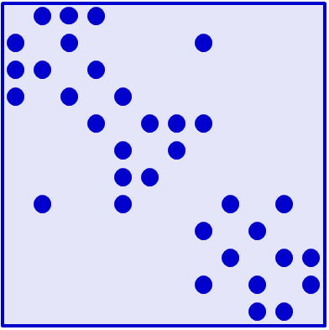
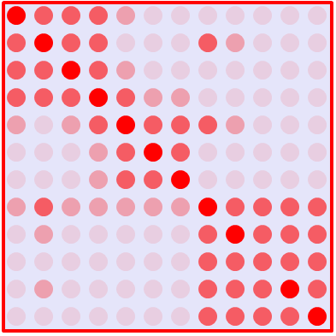
Computing CePS Score (AND)
details
r_{A}
r_{B}
r_{C}
= x x
Normalized adj.
matrix : W
Proximity matrix:
Q=(I-cW)⁻¹
CePS Score:
r_{ceps}= x x
r_{A}
r_{B}
r_{C}

Slide 26
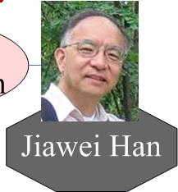
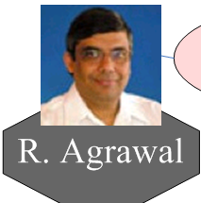


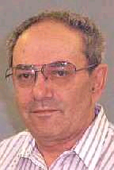
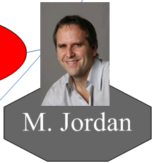
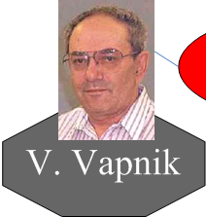

CePS: Example (AND Query)
?
DBLP co-authorship network:
  400,000 authors, 2,000,000 edges
Code at: http://www.cs.cmu.edu/~htong/soft.htm

Slide 27

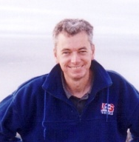

CePS: Example (AND Query)
10
10
1
1
2
1
1
1
4
6
DBLP co-authorship network:
  400,000 authors, 2,000,000 edges
Code at: http://www.cs.cmu.edu/~htong/soft.htm

Slide 28
Overview
Tasks
Static Graphs
Dynamic Graphs
Querying
CePS, iPoG
(KDD06, ICDM08, CIKM09)
pTrack/cTrack
(SDM08, SAM08)
T1
T2
FastProx (ICDM06,
KAIS07, KDD07 b, ICDM08)
FastProx
(SDM08, SAM08)
T3
T3
Mining
NetShield
T4
Colibri-S
(KDD08)
Colibri-D
(KDD08)
T5
T5

Slide 29
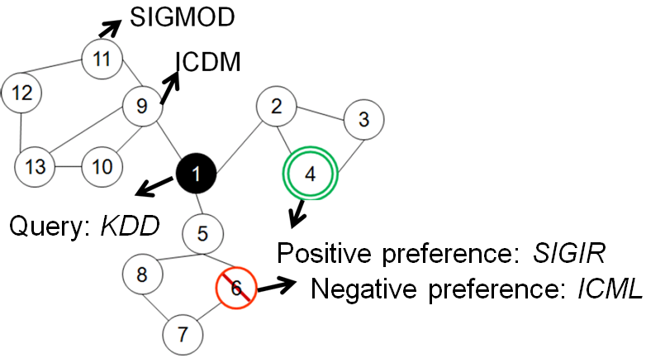
T1.2: Interactive Querying
Given: a graph W, a query node q, and the user’s preference (e.g., like/dislike)
Find: the ranking vector r_{q} (for that user).
Q: What are the most related conferences wrt text mining, for a non-expert user?
(e.g. who likes KDD, SIGIR, but not ICML)

Slide 30
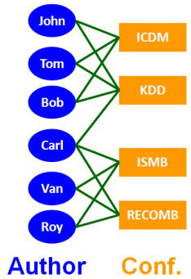
T1.2 iPoG for Interactive Querying
[Tong+ ICDM 08, CIKM 09]
Initial Results | No to `ICML’ | Yes to `SIGIR’
'ICDM' 'ICML' 'SDM' 'VLDB' 'ICDE' 'SIGMOD' 'NIPS' 'PKDD' 'IJCAI' 'PAKDD' | 'ICDM' 'SDM' 'PKDD' 'ICDE' 'VLDB' 'SIGMOD' 'PAKDD' 'CIKM' 'SIGIR' 'WWW' | 'SIGIR' 'TREC' 'CIKM' 'ECIR' 'CLEF' 'ICDM' 'JCDL' 'VLDB' 'ACL' 'ICDE'
two main sub-communities in KDD: DBs (green) vs. Stat (Red) | Negative feedback on ICML will exclude other stats confs (NIPS, IJCAI) | Positive feedback on SIGIR will bring more IR (brown) conferences.
what are most related conferences wrt KDD?
(DBLP author-conference bipartite graph)

Slide 31
T1.2 iPoG for Interactive Querying
[Tong+ ICDM 08, CIKM 09]
Initial Results | No to `ICML’ | Yes to `SIGIR’
'ICDM' 'ICML' 'SDM' 'VLDB' 'ICDE' 'SIGMOD' 'NIPS' 'PKDD' 'IJCAI' 'PAKDD' | 'ICDM' 'SDM' 'PKDD' 'ICDE' 'VLDB' 'SIGMOD' 'PAKDD' 'CIKM' 'SIGIR' 'WWW' | 'SIGIR' 'TREC' 'CIKM' 'ECIR' 'CLEF' 'ICDM' 'JCDL' 'VLDB' 'ACL' 'ICDE'
two main sub-communities in KDD: DBs (green) vs. M ML/AI (Red) | Negative feedback on ICML will exclude other ML/AI conf.s (NIPS, IJCAI) | Positive feedback on SIGIR will bring more IR (brown) conferences.
what are most related conferences wrt KDD?
(DBLP author-conference bipartite graph)

Slide 32
T1.2 iPoG for Interactive Querying
[Tong+ ICDM 08, CIKM 09]
Initial Results | No to `ICML’ | Yes to `SIGIR’
'ICDM' 'ICML' 'SDM' 'VLDB' 'ICDE' 'SIGMOD' 'NIPS' 'PKDD' 'IJCAI' 'PAKDD' | 'ICDM' 'SDM' 'PKDD' 'ICDE' 'VLDB' 'SIGMOD' 'PAKDD' 'CIKM' 'SIGIR' 'WWW' | 'SIGIR' 'TREC' 'CIKM' 'ECIR' 'CLEF' 'ICDM' 'JCDL' 'VLDB' 'ACL' 'ICDE'
two main sub-communities in KDD: DBs (green) vs. M ML/AI (Red) | Negative feedback on ICML will exclude other ML/AI conf.s (NIPS, IJCAI) | Positive feedback on SIGIR will bring more IR (brown) conferences.
what are most related conferences wrt KDD?
(DBLP author-conference bipartite graph)

Slide 33
T1.2 iPoG for Interactive Querying
[Tong+ ICDM 08, CIKM 09]
Initial Results | No to `ICML’ | Yes to `SIGIR’
'ICDM' 'ICML' 'SDM' 'VLDB' 'ICDE' 'SIGMOD' 'NIPS' 'PKDD' 'IJCAI' 'PAKDD' | 'ICDM' 'SDM' 'PKDD' 'ICDE' 'VLDB' 'SIGMOD' 'PAKDD' 'CIKM' 'SIGIR' 'WWW' | 'SIGIR' 'TREC' 'CIKM' 'ECIR' 'CLEF' 'ICDM' 'JCDL' 'VLDB' 'ACL' 'ICDE'
two main sub-communities in KDD: DBs (green) vs. M ML/AI (Red) | Negative feedback on ICML will exclude other ML/AI conf.s (NIPS, IJCAI) | Positive feedback on SIGIR will bring more IR (brown) conferences.
what are most related conferences wrt KDD?
(DBLP author-conference bipartite graph)

Slide 34
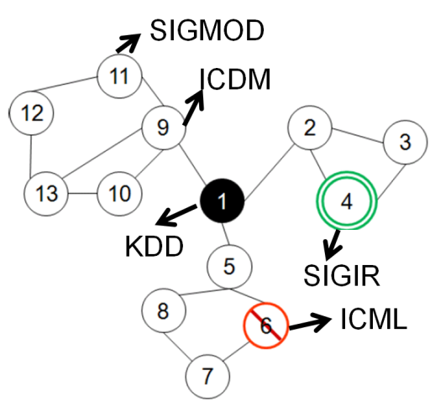
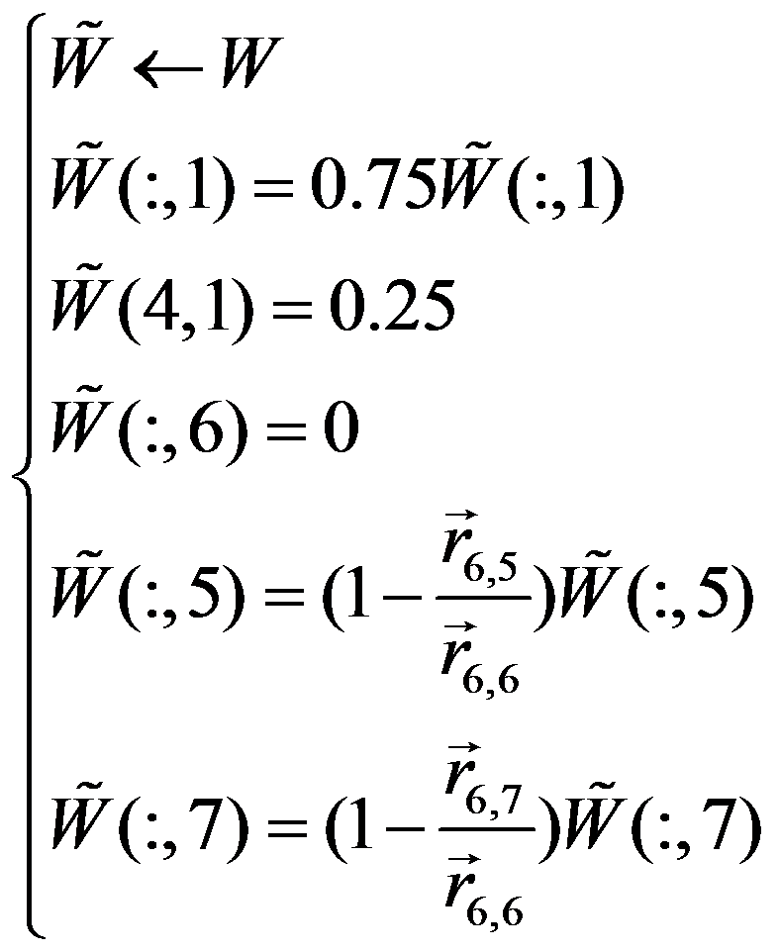
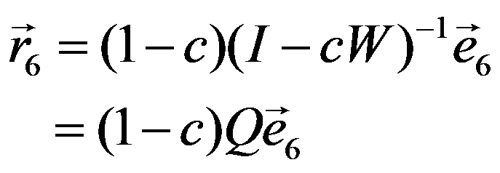
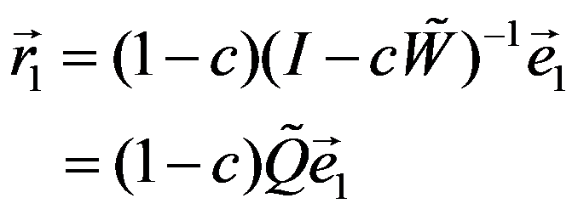
T1.2 iPoG: Algorithm
details
~
~
W=W+δ
Q=Q+∆
Sink
S
~
Original Graph: W
Prox w/o
Feedback
Biased Graph: W
Prox w/
Feedback

Slide 35
Overview
Tasks
Static Graphs
Dynamic Graphs
Querying
CePS, iPoG
(KDD06, ICDM08, CIKM09)
pTrack/cTrack
(SDM08, SAM08)
T1
T2
FastProx (ICDM06,
KAIS07, KDD07 b, ICDM08)
FastProx
(SDM08, SAM08)
T3
T3
Mining
NetShield
T4
Colibri-S
(KDD08)
Colibri-D
(KDD08)
T5
T5

Slide 36
T2 pTrack: Challenge
[Tong+ SDM 08]
Observations (CePS, iPoG…)
  All for static graphs
  Proximity: main tool
Graphs are evolving over time!
  New nodes/edges show up;
  Existing nodes/edges die out;
  Edge weights change…

Slide 37
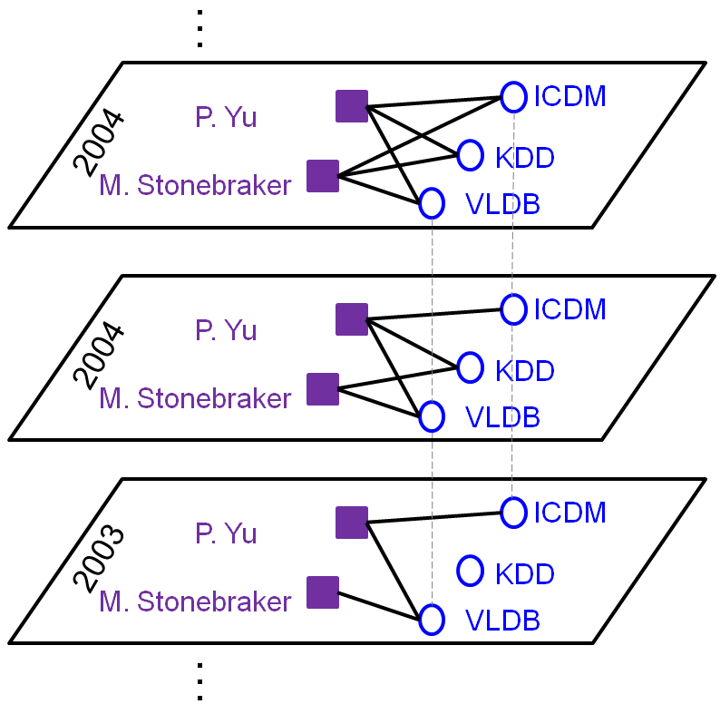
Given: an Author-Conference Bipartite Graph
  Find: (1) the top-k conferences for Yu over years
  (2) the closeness of KDD to VLDB over years
  Solution: Track proximity, incrementally!
2005

Slide 38
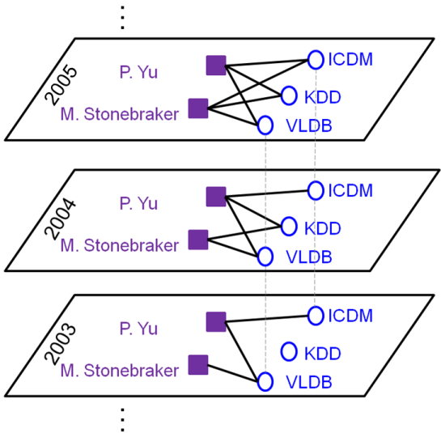
pTrack: Philip S. Yu’s Top-5 conferences up to each year
ICDE ICDCS SIGMETRICS PDIS VLDB | CIKM ICDCS ICDE SIGMETRICS ICMCS | KDD SIGMOD ICDM CIKM ICDCS | ICDM KDD ICDE SDM VLDB
1992 | 1997 | 2002 | 2007
DBLP: (Au. x Conf.)
- 400k authors,
- 3.5k conferences
- 20 years
Databases
Performance
Distributed Sys.
Databases
Data Mining

Slide 39
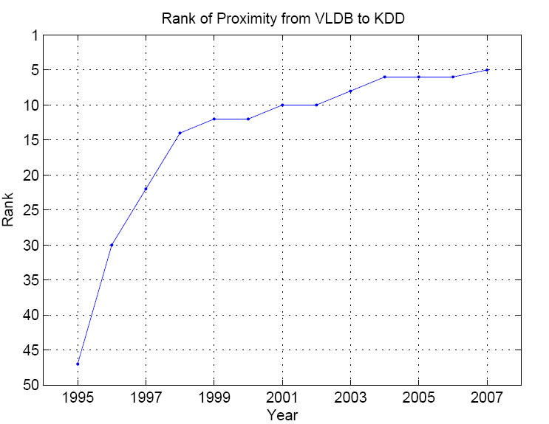
KDD’s Rank wrt. VLDB over years
Prox. Rank
(Closer)
Data Mining and Databases
are getting closer & closer
Year

Slide 40
T2: pTrack on Bipartite Graphs
m edges
Given: a time-evolving bi-partite graph W^{(t)}, and a query node q;
Find: the ranking vector for q at each time stamp (quickly)
n₁ Authors
Computational Challenges (n₁ > n₂)
  Iterative method O(m)
  Straight-forward update O(n₂ +m.n₂)
³
n₂ Conferences

Slide 41
T2: pTrack on Bipartite Graphs
m edges
Computational Challenges (n₁ > n₂)
  Iterative method O(m)
  Straight-forward update O(n₂ +m.n₂)
Example:
  NetFlix dataset
    2.6m users x 18k movies, 100m ratings
  Both need >1hr
Our Solution (Fast-Update): ~20 seconds
³
n₁ Authors
n₂ Conferences

Slide 42
T2: pTrack on Bipartite Graphs
KDD
Obs. #1 (skinny matrix): n₁ >> n₂
  DBLP: > 400k authors, 3.5k conf.s
  Obs. #2 (low rank update) : min(n₁,n₂) << m
  m edges updated (n₁ authors, n₂ conf.s)
  Rank of update: min(n₁,n₂)
Proposed algorithm: Fast-Update
n₁ Authors
~
~
~
…
~
~
~
~
~
…
…
n₂ Conferences
Theorem: (Tong+ 2008)
(1) Fast-Update has no quality loss
(2) Fast-Update is
~
~
~
²
~
O(min(n₁,n₂).n₂+m)

Slide 43
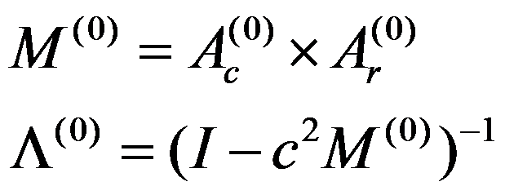
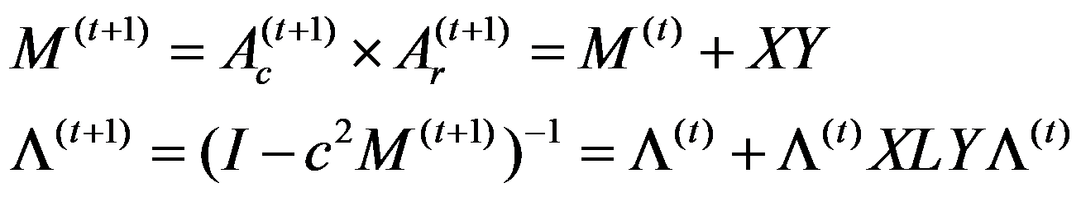
T2: Fast-Update Algorithm
details
Initialize the core matrix
Update the core matrix
Update the ranking vector:
n₂xn₂ conference-conference adj. matrix
n₂xn₂ conference-conference proximity matrix
~
~
M^{(t+1)} is a rank min(n₁,n₂) perturbation
big matrix inverse (n₂)
~
~
Obs #2
much smaller matrix inverse (min(n₁,n₂))
Obs #1
big matrix inversion (n₁+n₂) 2 sparse matrix-vector multiplications

Slide 44
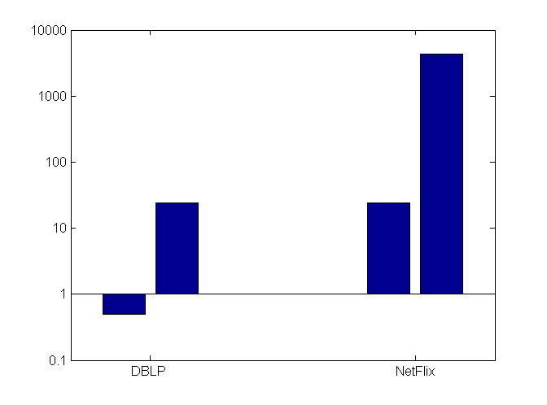
T2: Speed Comparison
log(Time) (Seconds)
176x
40x
Our
Our
Data Sets
DBLP
44
Netflix

Slide 45
Overview
Tasks
Static Graphs
Dynamic Graphs
Querying
CePS, iPoG
(KDD06, ICDM08, CIKM09)
pTrack/cTrack
(SDM08, SAM08)
T1
T2
FastProx (ICDM06,
KAIS07, KDD07 b, ICDM08)
FastProx
(SDM08, SAM08)
T3
T3
Mining
NetShield
T4
Colibri-S
(KDD08)
Colibri-D
(KDD08)
T5
T5

Slide 46
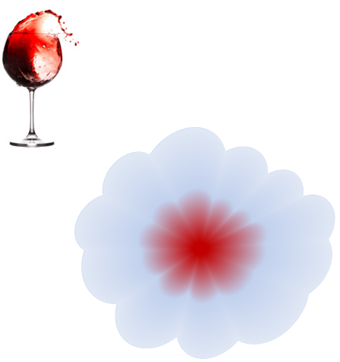
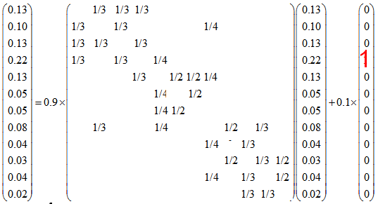
Computing RWR
(Normalized)
Adjacency matrix
Restart p
Starting vector
Ranking vector
9
10
2
12
1
8
3
11
4
5
6
7
n x 1
n x n
nx1
nxn
nx1
Footnote: “Maxwell Equation” for Web [Soumen Chakrabarti]

Slide 47
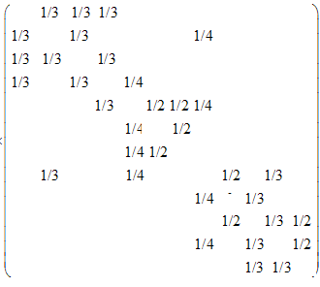
Computing RWR
Given: a graph W and a query i,
Find: the ranking vector for i
Query
?
?
Ranking vector
Adjacency matrix
Starting vector
Ranking vector

Slide 48
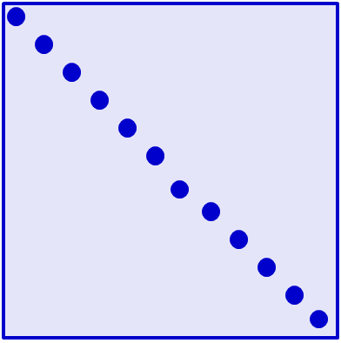

Computing RWR
details
9
10
2
12
1
8
3
11
4
5
6
7
-1
= - - c x
Q
Q
I
W
Dfn. Of RWR:

Slide 49
Computing RWR
details
0.04
0.03
0.10
9
10
0.13
2
0.08
12
8
0.02
1
3
0.13
11
0.04
4
5
6
0.05
0.13
7
0.05
-1
= - - c x
Q
Q
I
W
How to get (elements) of Q?

Slide 50
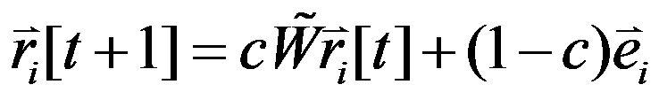
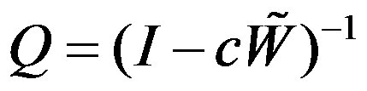
Computing RWR
Power Method
  No Pre-Computation;
  Light Storage Cost O(m)
  Slow On-Line Response: O(m x Iter)
Pre-Compute
  Fast On-Line Response
  Prohibitive Pre-Compute Cost: O(n³)
  Prohibitive Storage Cost: O(n²)

Slide 51

Q: How to Balance?
On-line
Off-line
Goal: Efficiently get elements of

Slide 52
B_Lin: Pre-Compute
[Tong+ ICDM 2006]
Find Communities
Compute & Store Within-
Communities Scores
Q₃₃
Q₁₁
10
10
10
9
10
9
9
9
12
12
12
12
2
2
2
2
8
8
8
1
8
1
1
11
1
11
11
3
11
3
3
3
4
4
4
4
6
6
6
5
6
5
5
5
Q₂₂
7
7
7
7

Slide 53
B_Lin: On-Line
[Tong+ ICDM 2006]
Find Communities
2
2
1
1
3
3
4
4
10
9
10
0.04
9
0.03
12
10
12
0.10
9
2
2
0.13
0.08
12
8
2
1
8
0.02
1
11
8
3
11
1
3
3
0.13
11
0.04
4
4
4
6
6
0.05
5
6
5
5
0.13
7
0.05
7
7
10
9
10
Combine
9
12
2
12
2
8
1
8
1
11
3
11
3
4
4
6
Estimate the impact
of the bridges
5
6
5
7
7

Slide 54
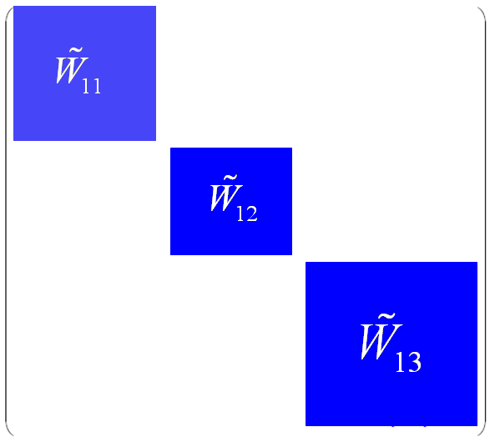
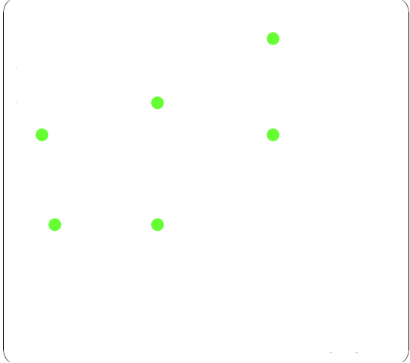
B_Lin: details
details
W_{1,1}
+
W_{2,2}
W
=
W_{2,2}
W_{1,1}
U
S
V
~
W_{2,2}
+
~
W_{2,2}
W₁: within community
Cross community

Slide 55
B_Lin: details
details
W_{1,1}
U
S
V
W_{2,2}
W_{2,2}
-1
-1
~
I – c
W
~
W₁
I – c – cUSV
Easy to be inverted
LRA difference

Slide 56
B_Lin: details
details
W_{1,1}
U
S
V
W_{2,2}
W_{2,2}
-1
-1
~
I – c
W
~
W₁
I – c – cUSV
Easy to be inverted
LRA difference
Sherman–Morrison Lemma: If B=A-USV
Then B⁻¹ = A⁻¹ + A⁻¹U(S⁻¹-VA⁻¹U)⁻¹VA⁻¹
A
USV

Slide 57
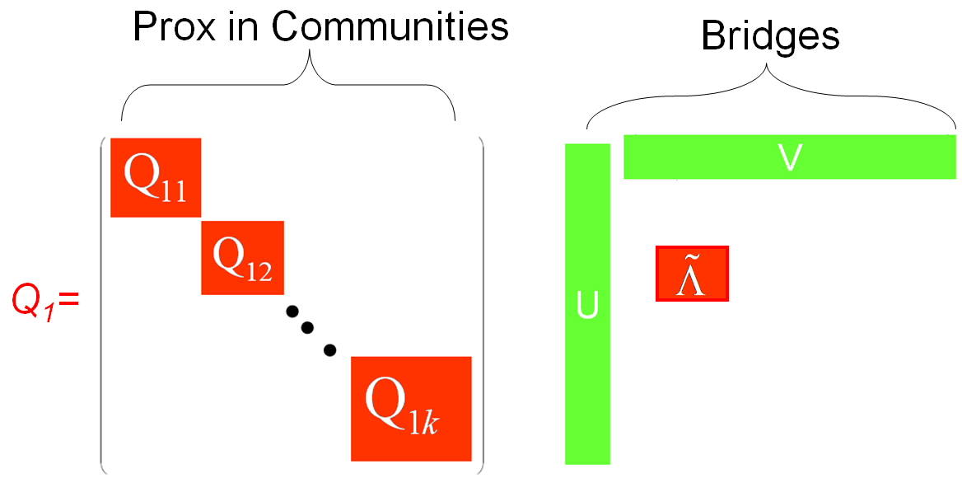


B_Lin: Pre-Compute Stage
details
Q: Efficiently compute and store Q
A: A few small, instead of ONE BIG, inverted matrices
Proximities within communities
Effect of bridges
Q_{1,1}
U
>
V
Q_{1,1}
Q_{2,2}
Q_{2,2}
Q₁=
.
.
.
Q_{k,k}
Q_{k,k}
Footnote: Q₁=(I-cW₁)⁻¹

Slide 58
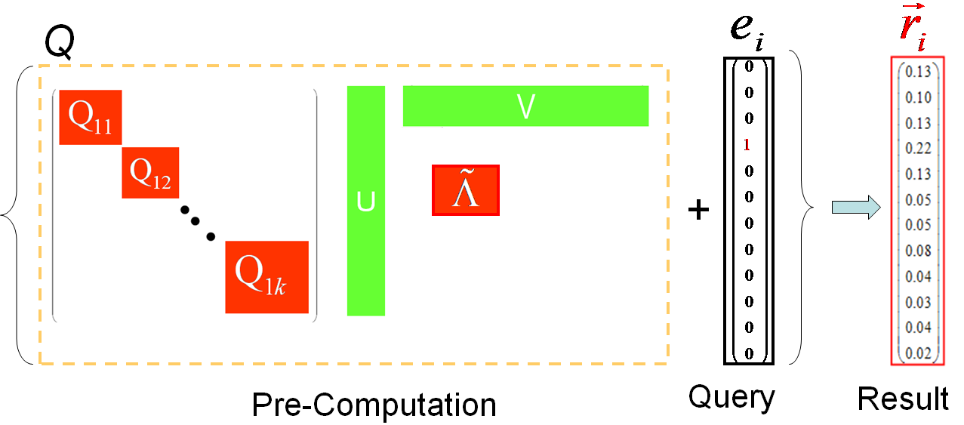
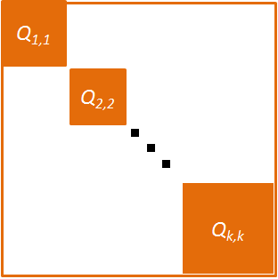
B_Lin: On-Line Stage
details
Q: Efficiently recover one column of Q
A: A few, instead of MANY, matrix-vector multiplications
→
→
e_{i}
r_{i}
U
>
V
Pre-computed
Query Result
58

Slide 59
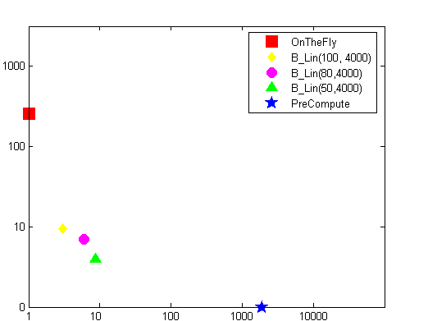
Query Time vs. Pre-Computation Time
Log Query Time
Our Results
Log Pre-computation Time
Quality: 90%+
On-line: Up to 150x speedup
Pre-computation: 2 orders of magnitude saving

Slide 60
More on Scalability Issues for Querying
(the spectrum of ``FastProx’’)
B_Lin: one large linear system
  [Tong+ ICDM06, KAIS08]
BB_Lin: the intrinsic complexity is small
  [Tong+ KAIS08]
FastUpdate: time-evolving linear system
  [Tong+ SDM08, SAM08]
FastAllDAP: multiple linear systems
  [Tong+ KDD07 a]
Fast-iPoG: dealing w/ on-line feedback
  [Tong+ ICDM 2008, Tong+ CIKM09]

Slide 61
Overview
Tasks
Static Graphs
Dynamic Graphs
Querying
CePS, iPoG
(KDD06, ICDM08, CIKM09)
pTrack/cTrack
(SDM08, SAM08)
T1
T2
FastProx (ICDM06,
KAIS07, KDD07 b, ICDM08)
FastProx
(SDM08, SAM08)
T3
T3
Mining
NetShield
T4
Colibri-S
(KDD08)
Colibri-D
(KDD08)
T5
T5

Slide 62
Immunization
Given: a graph A, virus prop model and budget k;
Find: k ‘best’ nodes for immunization.
23
16
24
15
12
14
25
22
13
26
11
21
27
9
34
20
10
1
28
4
8
33
19
2
29
3
7
18
5
30
6
17
31
32
SARS costs 700+ lives; $40+ Bn; H1N1 costs Mexico $2.3bn

Slide 63
Immunization
Given: a graph A, virus prop model and budget k;
Find: k ‘best’ nodes for immunization.
23
16
24
15
12
14
25
22
13
26
11
21
27
9
34
20
10
1
28
4
8
33
19
2
29
3
7
18
5
30
6
17
31
32
SARS costs 700+ lives; $40+ Bn; H1N1 costs Mexico $2.3bn

Slide 64
T4: SIS Virus Model [Chakrabarti+ 2008]
Background
‘Flu’ like: Susceptible-Infectious-Susceptible
If the virus ‘strength’ s < 1/ λ , an epidemic can not happen
Intuition
  s ≈ # of sneezes before heal
  Largest eigenvalue λ ≈ # of edges/paths

Slide 65
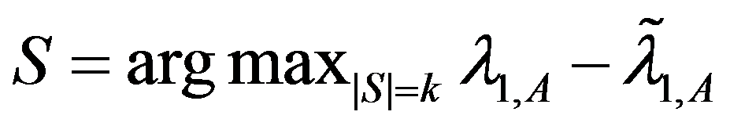
T4: Optimal Method
Select k nodes, whose absence creates the largest drop in λ
λ-λ_{s}
9
9
11
9
10
10
1
1
4
4
8
8
2
2
3
7
3
7
5
5
6
6
Original Graph: λ
Without {2, 6}: λ_{s}

Slide 66
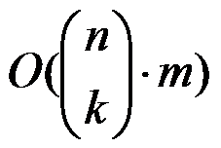
T4: Optimal Method
Select k nodes, whose absence creates the largest drop in λ
But, we need in time
  Example:
    1,000 nodes, with 10,000 edges
    It takes 0.01 seconds to compute λ
    It takes 2,615 years to find best-5 nodes !
λ-λ_{s}
Largest eigenvalue
w/o subset of nodes S

Slide 67
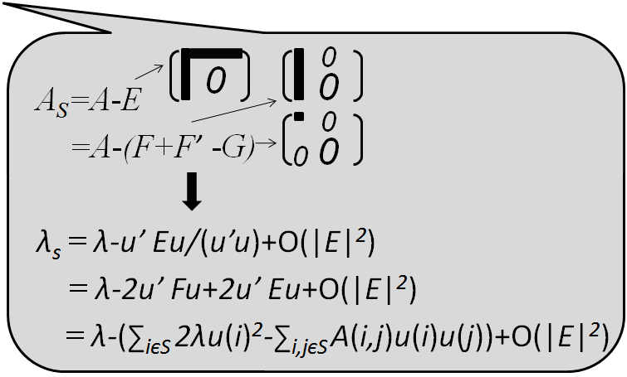
T4: Netshield to the Rescue
Theorem: (Tong+ 2009)
(1) λ - λ_{s}≈Sv(S)= ∑_{iєS} 2λu(i)²-∑_{i,jєS} A(i,j)u(i)u(j)
A
u
u
= λ X
u(i): eigen-score
Footnote: u(i) ~ PageRank(i) ~ in-degree(i)

Slide 68
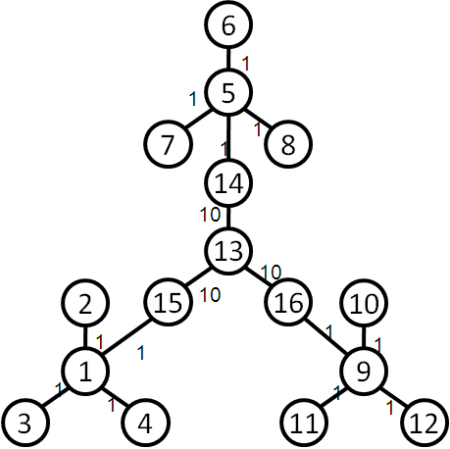
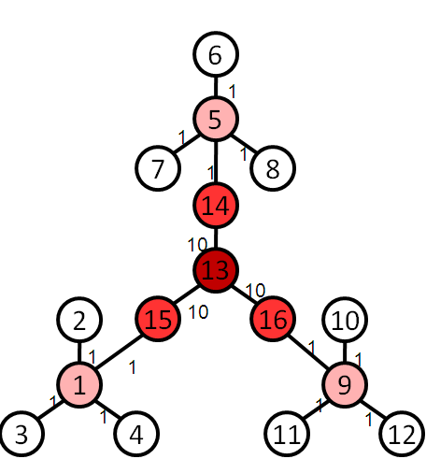
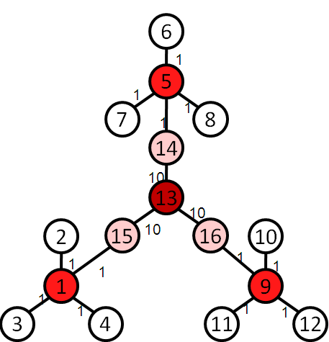
T4: Netshield to the Rescue
Intuition
Theorem: (Tong+ 2009)
(1) λ - λ_{s}≈Sv(S)= ∑_{iєS} 2λu(i)²-∑_{i,jєS} A(i,j)u(i)u(j)
find a set of nodes S (e.g. k=4), which
  (C1) each has high eigen-scores
  (C2) diverse among themselves
Original Graph
Select by C1
Select by C1+C2

Slide 69
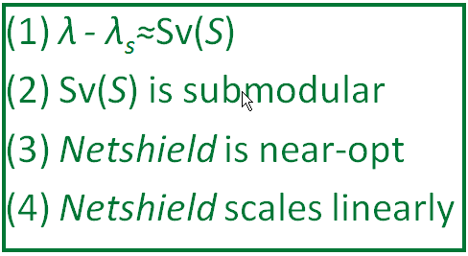
T4: Netshield to the Rescue
Theorem: (Tong+ 2009)
(1) λ - λ_{s}≈Sv(S)= ∑_{iєS} 2λu(i)²-∑_{i,jєS} A(i,j)u(i)u(j)
(2) Sv(S) is sub-modular
Example: 1,000 nodes, with 10,000 edges
  Netshield takes < 0.1 seconds to find best-5 nodes !
  … as opposed to 2,615 years
Corollary: (Tong+ 2009)
(3) Netshield is near-optimal (wrt max Sv(S))
(4) Netshield is O(nk²+m)
Footnote: near-optimal means Sv(S ^{Netshield}) >= (1-1/e) Sv(S ^{Opt})

Slide 70

Why Netshield is Near-Optimal?
Marginal benefit of deleting {5,6}
Marginal benefit of deleting {5,6}
9
3
10
9
3
1
10
5
1
δ
5
2
6
8
7
2
6
8
7
4
4
Benefit of deleting {1,2}
Benefit of deleting {1,2, 3,4}
>=
Sub-Modular (i.e., Diminishing Returns)
δ

Slide 71
Why Netshield is Near-Optimal?
9
3
10
9
3
1
10
5
1
δ
5
2
6
8
7
2
6
8
7
4
4
>=
Sub-Modular (i.e., Diminishing Returns)
δ
Theorem: k-step greedy alg. to maximize a sub-modular function guarantees (1-1/e) optimal [Nemhauster+ 78]

Slide 72
T4: Why Sv(S) is sub-modular?
Newly deleted
9
3
10
1
5
2
6
8
7
4
Already deleted

Slide 73
T4: Why Sv(S) is sub-modular?
Newly deleted
Marginal Benefit of deleting {5,6}
=
9
3
Sv(S_{green} U S_{blue}) - Sv(S_{green})
∑_{iєSblue} 2λu(i)²-∑_{i,jєSblue} A(i,j)u(i)u(j)
(∑_{iєSblue, jєSgreen} A(i,j)u(i)u(j)+∑_{iєSgreen, jєSblue} A(i,j)u(i)u(j))
10
-
1
5
2
6
8
7
4
Already deleted
Pure benefit
from {5,6}
Interaction between
{5,6} and {1,2}
Only purple term depends on {1, 2}!

Slide 74
T4: Why Sv(S) is sub-modular?
9
3
9
3
10
10
1
1
5
5
2
6
2
6
8
7
8
7
4
4
Marginal Benefit = Blue –Purple
More Green
More Purple
Less Red
Marginal Benefit of Left >= Marginal Benefit of Right
Footnote: greens are nodes already deleted; blue {5,6} nodes are nodes to be deleted

Slide 75
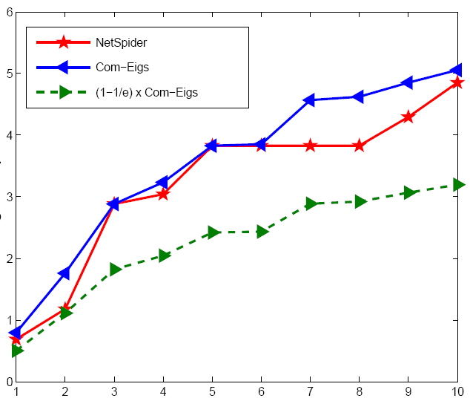
T4: Quality of Netshield
(better)
Optimal
Netshield
Eig-Drop
(1-1/e) x Optimal
# of vaccines

Slide 76

T4: Comparison of Immunization
Log(fraction of infected nodes)
(better)
Abnormality
PageRank
Between (short)
Degree
Between (RW)
Acquaintance
Netshield
Eigs (=HITS)
Time Epoch

Slide 77

T4: Speed of Netshield
> 10 days
>=1,000,000
Com-Eigs
100,000
10,000
Com-Eval
Time
10,000,000x
1,000
(better)
100
10
Netshield
0.1 seconds
1
0.1
# of vaccines
0.01
NIPS co-authorship Network: 3K nodes, 15K edges

Slide 78

T4: Scalability of Netshield
Time
(better)
# of edges
X 10⁸

Slide 79
Overview
Tasks
Static Graphs
Dynamic Graphs
Querying
CePS, iPoG
(KDD06, ICDM08, CIKM09)
pTrack/cTrack
(SDM08, SAM08)
T1
T2
FastProx (ICDM06,
KAIS07, KDD07 b, ICDM08)
FastProx
(SDM08, SAM08)
T3
T3
Mining
NetShield
T4
Colibri-S
(KDD08)
Colibri-D
(KDD08)
T5
T5

Slide 80
Motivation [Tong+ KDD 08 b]
Q: How to find patterns from a large graph?
  e.g., communities, anomalies, etc.
John
ICDM
Tom
Bob
KDD
Carl
ISMB
Van
Roy
RECOMB
Author
Conference

Slide 81
Motivation [Tong+ KDD 08 b]
Q: How to find patterns from a large graph?
  e.g., communities, anomalies, etc.
A: Low-Rank Approximation (LRA) for adjacency matrix of the graph.
A
L
X
M
X
R
~
~

Slide 82
LRA for Graph Mining
Conference
John
1 | 1 | 0 | 0
1 | 1 | 0 | 0
1 | 1 | 0 | 0
0 | 1 | 1 | 1
0 | 0 | 1 | 1
0 | 0 | 1 | 1
ICDM
Tom
Bob
KDD
Author
Carl
ISMB
Van
Roy
RECOMB
Author
Conference
Adjacency matrix: A

Slide 83
LRA for Graph Mining: Communities
R: Conf. Group
John
Adj. matrix: A
ICDM
X
X
Tom
KDD
~
Bob
~
Carl
M: Group-Group
Interaction
ISMB
Van
Roy
RECOMB
L: author group
Author
Conf.

Slide 84
LRA for Graph Mining: Anomalies
~
John
Adj. matrix: A
Reconstructed A
ICDM
Tom
Bob
KDD
Carl
ISMB
Van
Roy
RECOMB
Author
Conf.
Recon. error is high
→ ‘Carl-KDD’ is abnormal

Slide 85

Abnormal Network Traffic Detection [Sun+ 2007]
Dst.
Recon. Error
Dst.
Src.
Time
Src.
Abnormal Traffic
(due to scanning activity)
Normal Traffic
  Network traffic
  - 21,837 nodes
  - 1,220 hours; 22,800 edges/hr

Slide 86
Challenges
Prob.1 (static graph)
  Given: a static graph A,
  Find: (C1) (L, M, R) efficiently,
  (C2) the interpretation of (L, M, R)
Prob. 2 (dynamic graph)
  Given: a dynamic graph A^{t} (t=1,2,…),
  Find: (C3) (L^{t}, M^{t}, R^{t}) incrementally
None of existing methods fully meets
our wish list!

Slide 87

Why Not SVD and CUR/CMD?
SVD (Optimal in L₂ and L_{F} )
  Efficiency
    Time:
    Space: (L, R) are dense
  Interpretation
    Linear Combination of many columns
  Dynamic: Not Easy
CUR/CMD (Example-based)
  Efficiency
    Better than SVD
    Redundancy in L
  Interpretation
    Actual Columns from A xxxx
  Dynamic: Not Easy

Slide 88
Solutions: Colibri [Tong+ KDD 08 b]
Colibri-S: for static graphs
  Basic idea: remove linear redundancy
Colibri-D: for dynamic graphs
  Basic idea: leverage smoothness over time
Theorem: (Tong+ 2008)
(1) Colibri = CUR/CMD in accuracy
(2) Colibri <= CUR/CMD in time
(3) Colibri <= CUR/CMD in space

Slide 89
Comparison SVD, CUR vs. Colibri
details
s Wish List | SVD [Golub+ 1989] | CUR [Drineas+ 2005] | Colibri [Tong+ 2008]
C1: Efficiency
C2: Interpretation
C3: Dynamics

Slide 90

Performance of Colibri-S
SVD
SVD
Accuracy
  Same 91%+
Time
  12x of CMD
  28x of CUR
Space
  ~1/3 of CMD
  ~10% of CUR
CUR
CUR
CMD
CMD
Our
Our
Time
Space

Slide 91

Performance of Colibri-D
Time
CMD
(Prior Best Method)
  Network traffic
  - 21,837 nodes
  - 1,220 hours
  - 22,800 edge/hr
Colibri-S
Colibri-D
Accuracy
- Same 93%+
# of changed cols
Colibri-D achieves up to 112x speedup

Slide 92
Overview
Tasks
Static Graphs
Dynamic Graphs
Querying
CePS, iPoG
(KDD06, ICDM08, CIKM09)
pTrack/cTrack
(SDM08, SAM08)
T1
T2
FastProx (ICDM06,
KAIS07, KDD07 b, ICDM08)
FastProx
(SDM08, SAM08)
T3
T3
Mining
NetShield
T4
Colibri-S
(KDD08)
Colibri-D
(KDD08)
T5
T5

Slide 93
Some of my other work
  #1: FastDAP (in KDD07 a)
  Predict Link Direction
#2: Graph X-Ray (in KDD 07 b)
  Best Effort Pattern Match in Attributed Graphs.
  #3: GhostEdge (in KDD 08 a)
  Classification in Sparsely Labeled Network
#4: TANGENT (in KDD09)
  ``surprise-me’’ recommendation
#5: GMine (in VLDB 06)
  Interactive Graph Visualization and Mining
  #6: Graphite (in ICDM 08)
  Visual Query System for Attributed Graphs
# 7: T3/MT3: (in CIKM 08)
  Mine Complex Time-stamped Events
#8: BlurDetect (in ICME 04)
  Determine whether or not, and how, an image is blurred
#9: MRBIR (in MM 04, TIP06)
  Manifold-Ranking based Image Retrieval
#10: GBMML (in CVPR05, ACM/Multimedia 05)
  Graph-based Multiple Modality Learning

Slide 94

Overview
(this talk + others)
Tasks | Static Graphs | Dynamic Graphs | Images
Querying
CePS, iPoG, Basset, DAP, G-Ray, Graphite, TANGENT, FastRWR
(KDD06, ICDM06, KDD07a, KDD07b, IICDM08, KAIS08, CIKM09, KDD09, PAKDD10)
pTrack, cTrack,
Fast-Update
(SDM08, SAM08)
MRBIR, UOLIR
(MM04, CVPR05)
Netshield, Colibri-S, GhostEdge, Gmine, Pack, Shiftr
(VLDB06, KDD08a, KDD08b, SDM-LinkAnalysis 09, )
T3/MT3, Colibri-D
(KDD08a, CIKM08)
BlurDetect, GBMML, iQuality, iExpertise
(ICDE04, ICIP04, MMM05, PCM05, MM05)
Mining

Slide 95
Roadmap
Motivations
Selected Research Work
Future Plans

Slide 96
What is Next?
Plans Goals | Step 1 (this talk) | Step 2 (medium term) | Step 3 (long term)
G1 Querying | CePS, iPoG, pTrack | Rec. System | Querying rich data
G2 Mining | Netshield, Colibri | Immunization | Mining rich data
G3 Scalability | All of the above | O(m) or better (single machine) | Scalable by parallel Scalable on rich data
Research Theme: Help users understand
and utilize large graph-related data

Slide 97
M1: Current Recommendation System
(Focus on Relevance)
adventure
Sci. fiction
comedy
1
100
1
horror
Red nodes: by (most of) existing algorithms
Nodes: movies; Edge: similarity between movies

Slide 98
M1: ``Broad Spectrum Rec. System’’
(focus on completeness = relevance + diversity + novelty)
adventure
Sci. fiction
comedy
1
100
1
horror
Nodes: movies; Edge: similarity between movies

Slide 99
What is Next?
Plans Goals | Step 1 (this talk) | Step 2 (medium term) | Step 3 (long term)
G1 Querying | CePS, iPoG, pTrack | Rec. System | Querying rich data
G2 Mining | Netshield, Colibri | Immunization | Mining rich data
G3 Scalability | All of the above | O(m) or better (single machine) | Scalable by parallel Scalable on rich data
Research Theme: Help users understand
and utilize large graph-related data

Slide 100
M2: Immunization
This talk: SIS (e.g., flu)
In the future
  Immunization for SIR (e.g., chicken pox)
  Immunization in dynamic settings
    Dynamic graphs,
      e.g., edges/nodes are changing
    Dynamic viruses,
      e.g., the infection/healing rates are changing
SIR: susceptible-infectious-recovered.

Slide 101
What is Next?
Plans Goals | Step 1 (this talk) | Step 2 (medium term) | Step 3 (long term)
G1 Querying | CePS, iPoG, pTrack | Rec. System | Querying rich data
G2 Mining | Netshield, Colibri | Immunization | Mining rich data
G3 Scalability | All of the above | O(m) or better (single machine) | Scalable by parallel Scalable on rich data
Research Theme: Help users understand
and utilize large graph-related data

Slide 102

L1: Querying Rich Graphs
(e.g., geo-coded, attributed)
Node Attr.
Teenager
Adult
Phone
MSN
Edge Attr.
What is difference between North America and Asia?

Slide 103
L2: Mining Rich Graphs
(e.g., geo-coded, attributed)
Teenager
Adult
Phone
telemarketer
MSN
How to find patterns?
(e.g., communities, anomalies)

Slide 104
What is Next?
Plans Goals | Step 1 (this talk) | Step 2 (medium term) | Step 3 (long term)
G1 Querying | CePS, iPoG, pTrack | Rec. System | Querying rich data
G2 Mining | Netshield, Colibri | Immunization | Mining rich data
G3 Scalability | All of the above | O(m) or better (single machine) | Scalable by parallel Scalable on rich data
Research Theme: Help users understand
and utilize large graph-related data

Slide 105
L3: Scalability
Two orthogonal efforts
  E1: O(m) or better on a single machine
  E2: Parallelism
    (implementation, decouple, analysis)

Slide 106

Research Theme: Help users understand and utilize large graph-related data
Real Data
Scalability
User (Q+M)

Slide 107



























My Collaboration Graph
(During Ph.D Study)
Legends:
Green: Querying
Yellow: Mining
Purple: Others
T3
M2
M3
Q1
MT3
CePS
iPoG
Mining
Basset
Colibri
M1
NetShield
cTrack
Q2
pTrack
GhostEdge
G-Ray
Graphite
Fast-iPoG
Q3
Basset
DAP
FastUpdate
GMine
BLin
Pack
NBLin
BBLin
TANGENT

