Slide 1
Towards Optimal Teams in Big Networks
Hanghang Tong
hanghang.tong@asu.edu
http://tonghanghang.org
@ the 2nd International Workshop on Machine Learning Methods for Recommender Systems (MLRec 2016)

Slide 2
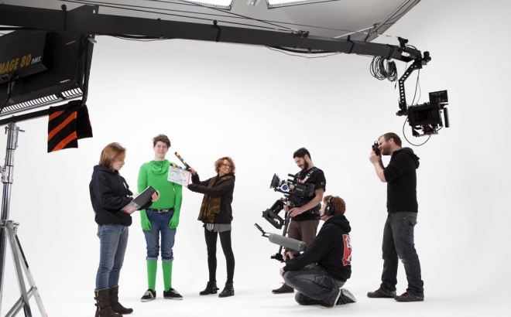
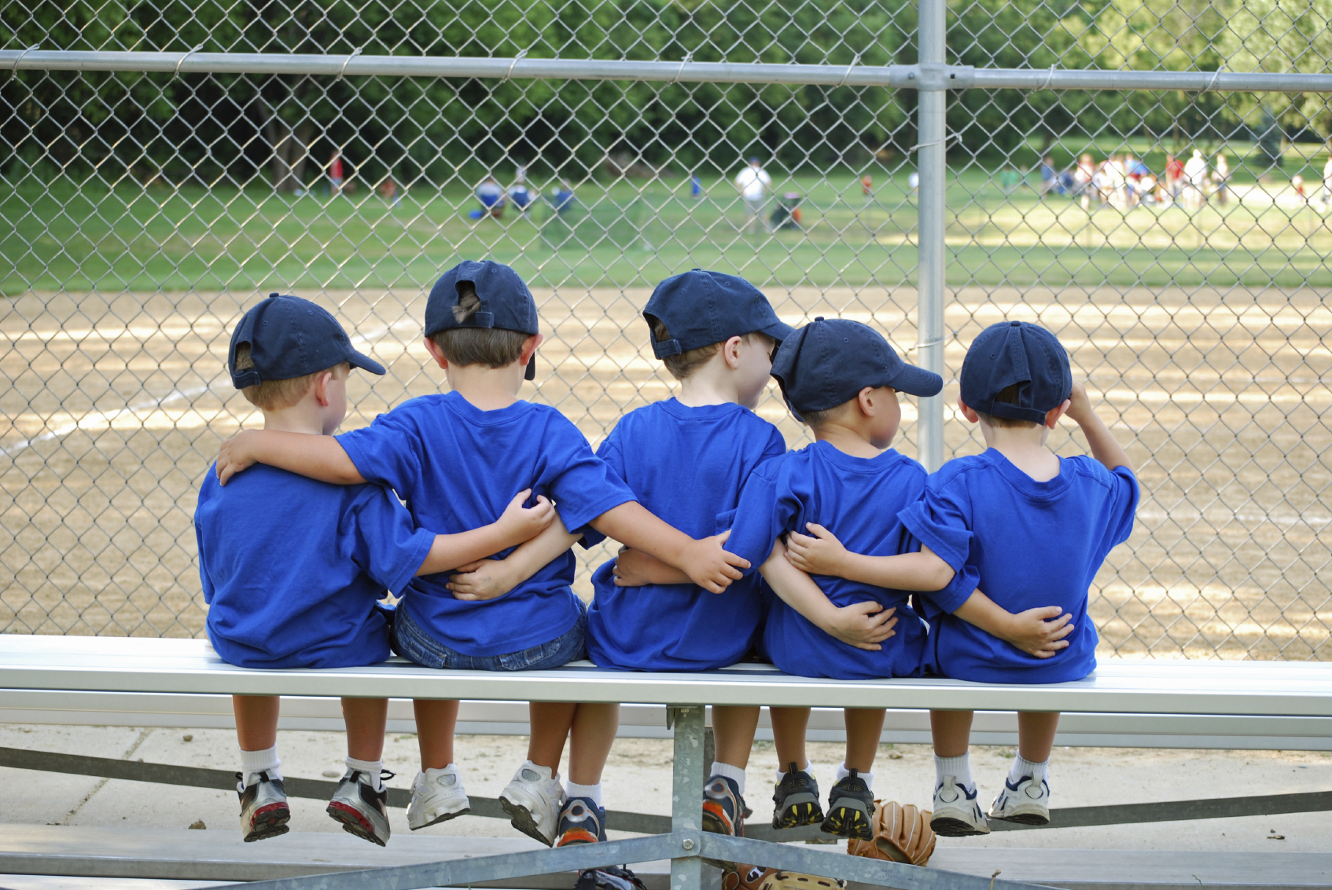


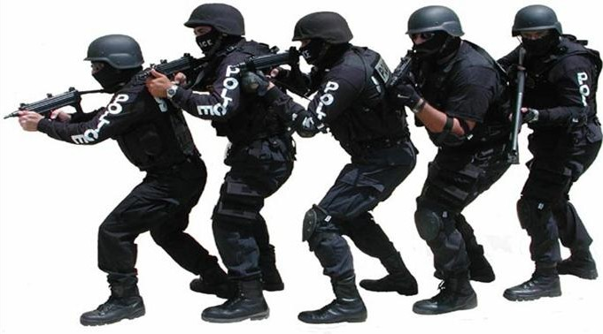
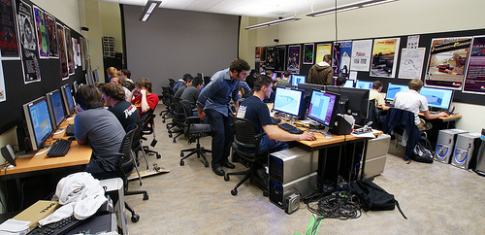
Teams Are Everywhere
1. Film Crew
2. Sports Team
3. Sales Team
4. Research Team
5. Military Team
6. Development Team
Wuchty, Stefan, Ben Jones, and Brian Uzzi. "The Increasing Dominance of Teams in the Production of Knowledge," Science, May 2007, 316:1036-1039.

Slide 3
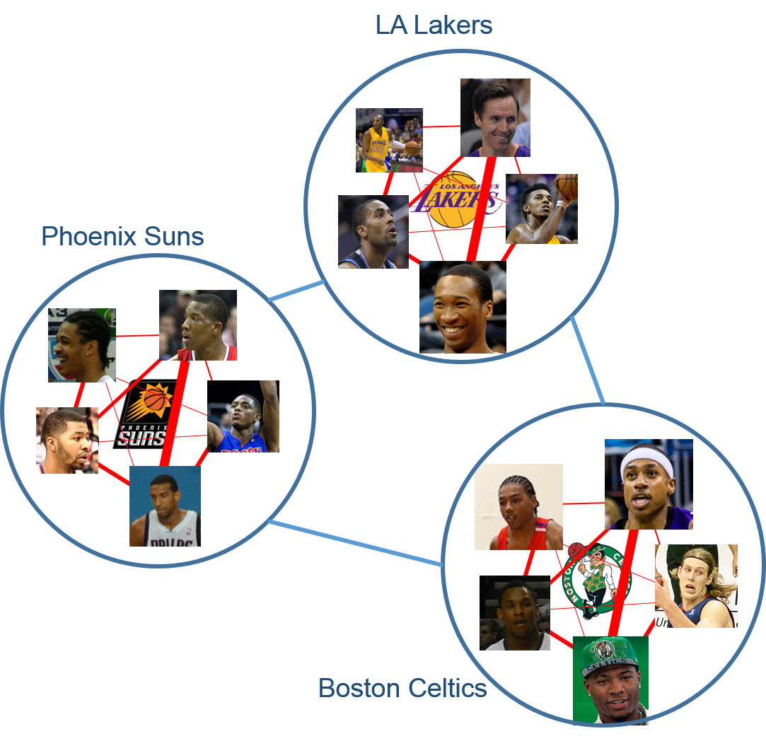
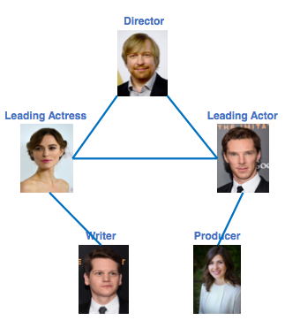

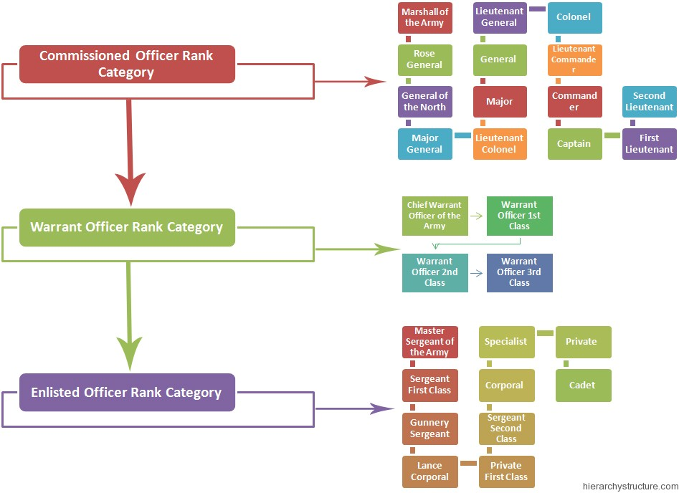


Networks Are Everywhere in Teams
1. Film Crew
2. Sports Team
3. Sales Team
4. Research Team
5. Military Team
6. Development Team
Wuchty, Stefan, Ben Jones, and Brian Uzzi. "The Increasing Dominance of Teams in the Production of Knowledge," Science, May 2007, 316:1036-1039.

Slide 4
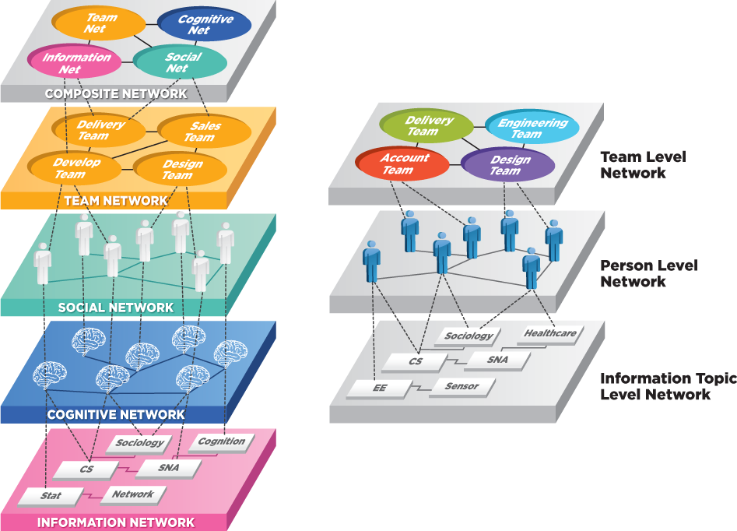
Network Science of Teams
People collaborate as a team to collectively perform
some complex tasks
Team Level Network
Person Level Network
Information Topic Level Network
Wuchty, Stefan, Ben Jones, and Brian Uzzi. "The Increasing Dominance of Teams in the Production of Knowledge," Science, May 2007, 316:1036-1039.

Slide 5
Research Questions
Q1: What do high-performing teams share in common? [Uzzi+Science13]
Q2: How to foresee the success at an early stage? [Wang+Science13]
Q3: What’s the optimal design for a team in the context of networks?[Lappas+KDD09, Rangapuram+WWW13]
S. Wuchty, B. Jones, and B. Uzzi. The Increasing Dominance of Teams in the Production of Knowledge, Science, 2007
D. Wang, C. Song, and A.-L. Barabasi. Quantifying long-term scientific impact. Science, 342(6154): 127-132, 2013.
T. Lappas, K. Liu, and E. Terzi. Finding a team of experts in social networks. In KDD, pages 467–476, 2009.
S. S. Rangapuram, T. Buhler, and M. Hein. Towards realistic team formation in social networks based on densest subgraphs. WWW 2013.

Slide 6
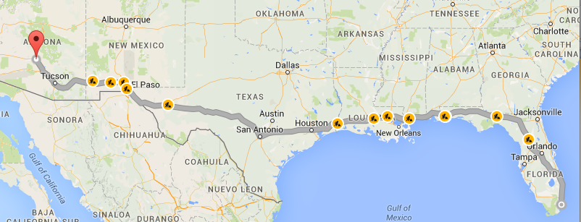
Roadmap
Motivations
Q1: Team Performance Characterization
Q2: Team Performance Prediction
Q3: Team Performance Optimization
Open Challenges

Slide 7


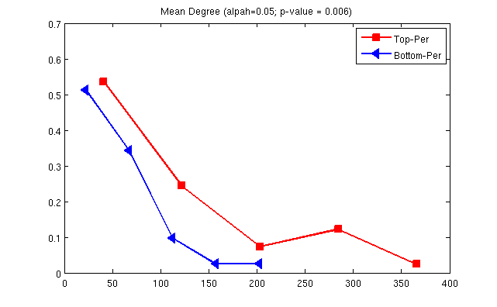
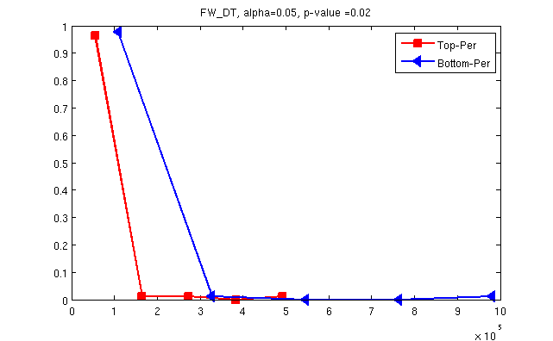

Degrees, Forwarding, Tie Skewness and Sociability
Empirical Findings:
The average degree
The maximum tie skewness of team members
The sociability of team members
The information forwarding efficiency.
Network metrics | T-Statistic | P-value
Mean degree | 1.739 | 0.084
Min sociability | -1.907 | 0.058
Max sociability | -2.165 | 0.031
Max tie skewness | 3.305 | 0.0001
For a given person:
Log (degree: d)
_{Prob}
_{Prob}
Log (P(w))
ɑ
λ
weight (w)
_{ave degree}
_{ave forwarding delay}
weight (w)
d w ^{ɑ}
; ɑ: sociability
Red: top-teams; Blue: bottom-teams
P(w) w^{-λ}
;λ: tie skewness
A focused team with larger reachability performs better
Notes:
7

Slide 8





The Effect of Team Leaders
Result initially found with sales teams and replicated in 2 independent studies with software teams showing measurable effects on productivity and quality even after taking into account team-level communication structure. Accounts for > 55% variance
Low
High
  Leader DC=0.032 (0.077)
  Rest DC=0.027 (0.069)
  Leader out/in =0.498 (0.260)
  Leader vs Rest =0.411 (0.195)
it is not just about communication and centrality of the leader
Low
# of Delivery
Leader DC=0.137 (0.248)
Rest DC=0.107 (0.221)
Leader out/in =0.639 (0.230)
Leader vs Rest =0.544 (0.216)
High
but also about the directionality of the leader’s interactions
Delivery Quality
Teams perform better when (formal) leader is central in communication out-flow but not in-flow [Ehrlich & Tong WIDS12]

Slide 9
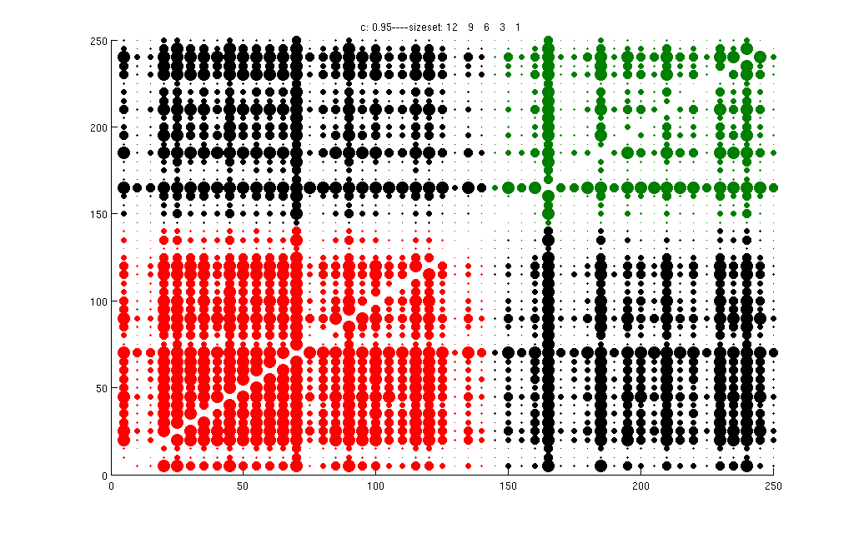
The Effect of Team Network Connectivity
Pair-wised team similarity
struggling
successful
successful
struggling
"Happy families are all alike; every unhappy family is unhappy in its own way."
- Leo Tolstoy

Slide 10
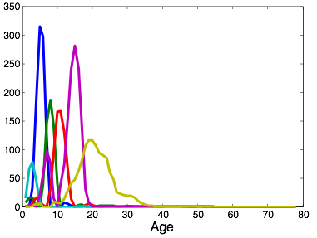
Performance Dynamics
(metric: long-term citation counts)
pick up fast in early years
Scaled Citation
Delayed pattern
Impact of scientific work from different domains behaves differently
L. Li, and H. Tong: The Child is Father of the Man: Foresee the Success at the Early Stage. KDD 2015: 655-664

Slide 11
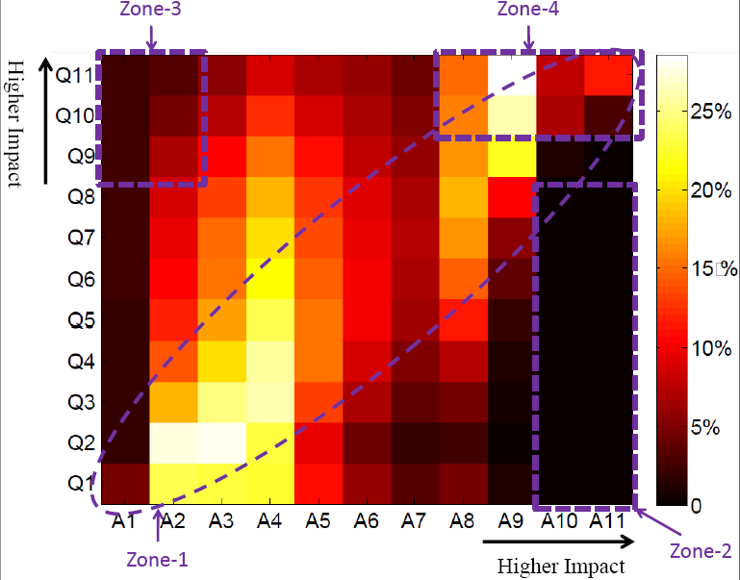
Performance/Impact Coupling
Zone 1: strong positive correlation, r=0.67, p-value < 0.0001
Zone 2: want a good A? Ask a good Q first!
Zone 3: harder Qs
Zone 4: high Q ←→ high A
Better questions
Better Answers
Analysis conducted on stack overflow,
independently verified on another CQA: math overflow
Y. Yao, H. Tong, F. Xu, J. Lu: Predicting long-term impact of CQA posts: a comprehensive viewpoint. KDD 2014
“Data Mining Reveals the Secret to Getting Good Answers”, MIT Technology Review, 2013

Slide 12
Roadmap
Motivations
Q1: Team Performance Characterization
Q2: Team Performance Prediction
Q3: Team Performance Optimization
Open Challenges

Slide 13
Performance Prediction: Setup
Given: Initial Performance of a team
Predict:
  (1) Long-Term Performance [KDD15]
  (2) Performance Trajectory [SDM16]
Performance
(e.g., citations)
Time
L. Li, and H. Tong: The Child is Father of the Man: Foresee the Success at the Early Stage. KDD 2015: 655-664
L. Li, H. Tong, J. Tang and W. Fan: “iPath: Forecasting the Pathway to Impact”. SDM 2016

Slide 14
Performance Prediction: Challenges
C1: Scholarly feature design
C2: Non-linearity
C3: Domain heterogeneity
C4: Dynamics
L. Li, and H. Tong: The Child is Father of the Man: Foresee the Success at the Early Stage. KDD 2015: 655-664

Slide 15
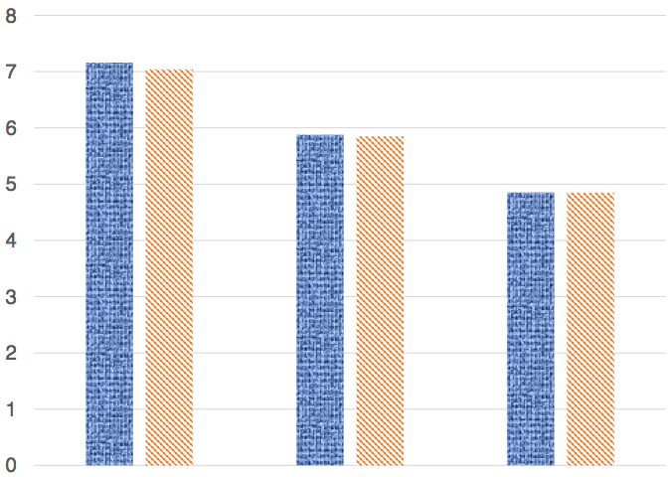
C1: Scholarly Feature Design
Root Mean Squared Error
1 year
2 year
3 year
1 year + content
2 year + content
3 year + content
Obs.: Adding content features brings little improvement

Slide 16
C2: Non-linearity
Root Mean Squared Error
Non-linear Methods
Linear Methods
Obs.: Non-linear methods > linear ones

Slide 17
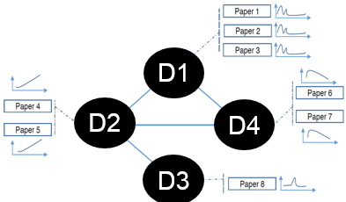
C3: Domain heterogeneity
pick up fast in early years
Scaled Citation
Delayed pattern
Obs.: Impact of scientific work from different domains behaves differently

Slide 18
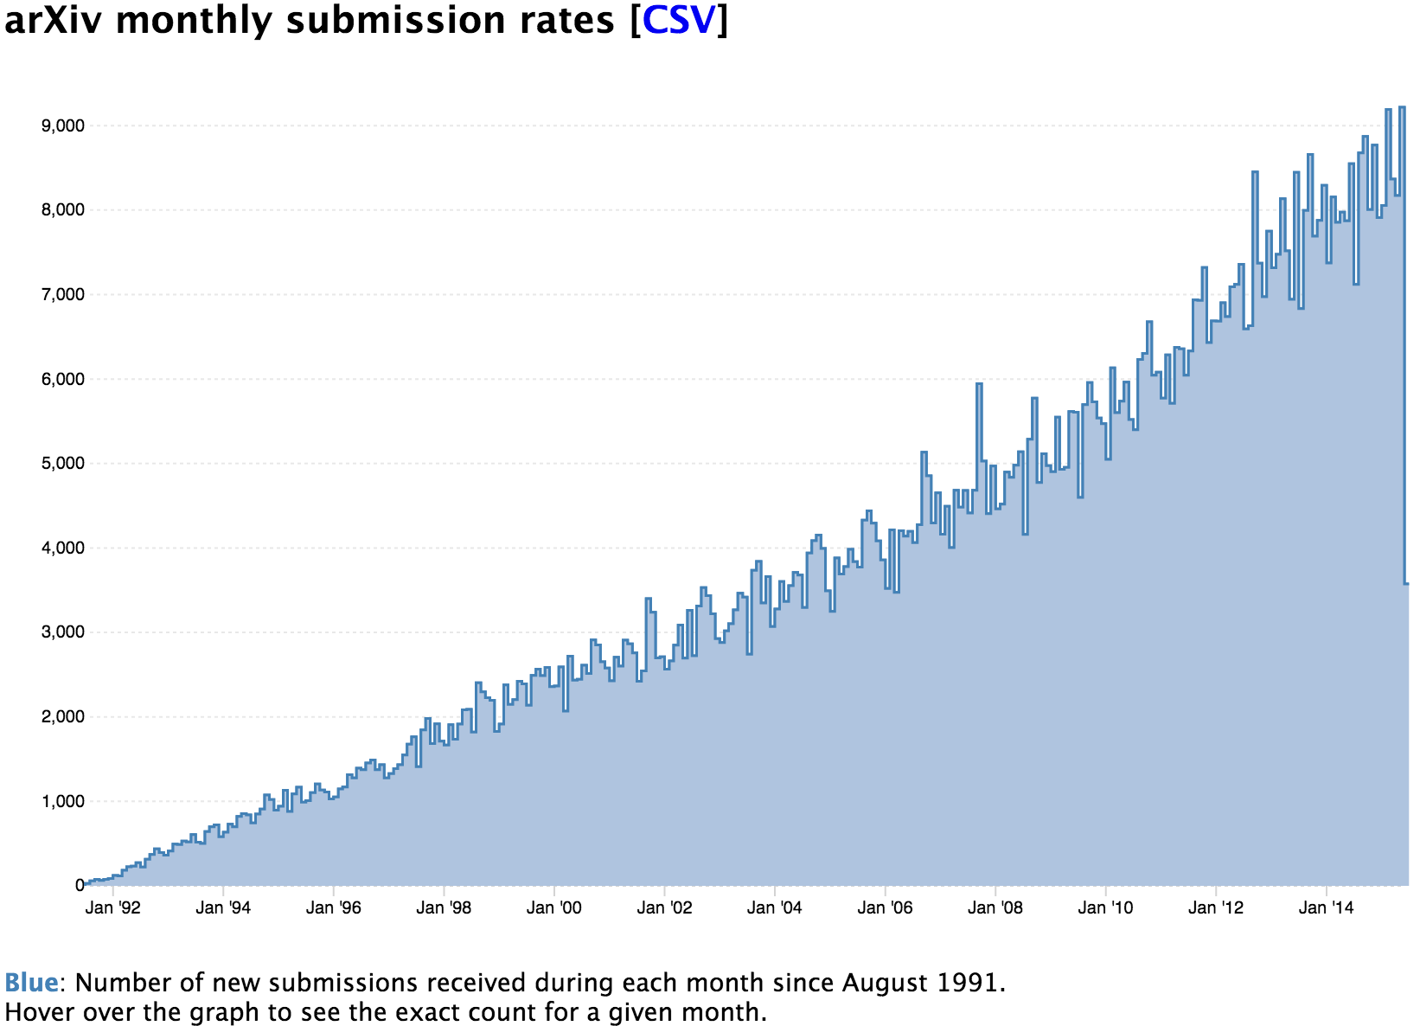
C4: Dynamics
arXiv monthly submission rates
# Submissions
Month
Q: How to quickly update the predictive model?

Slide 19
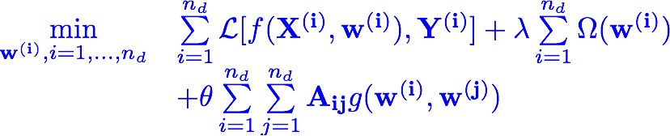
iBall — Formulations
Optimization Formulation
Within-Domain Model
Remarks
  Within-Domain Model: regression/classification, linear/non-linear
  Cross-Domain Consistency: similar domains have similar models
Cross-Domain Consistency
Question: how to instantiate such consistency?
L. Li, and H. Tong: The Child is Father of the Man: Foresee the Success at the Early Stage. KDD 2015: 655-664

Slide 20
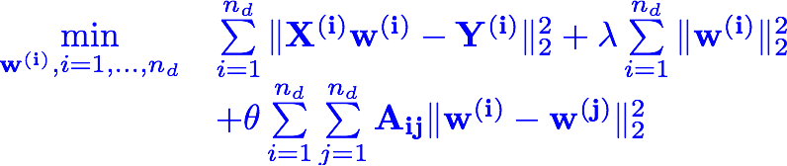


iBall — linear formulation
Details:
Intuitions:
similar domains (large )
same feature has similar effect (small )

Slide 21

iBall — non-linear formulation
Details:
Predicted output
(domain i domain i)
Predicted output
(domain j domain i)
Intuitions:
similar domains (large )
similar predicted outputs (small )

Slide 22

iBall — Closed-form Solutions
Closed-form Solution
  iBall — linear:
k
k
k
k
Time Complexity:
O(dk)³)
d: # of features; k: # of domains
(dk: in the order of 10 or 100)

Slide 23

iBall — Closed-form Solutions
Closed-form Solution
  iBall — non-linear:
k
k
k
n: total # of training examples
(in the order of millions)
Time Complexity:

Slide 24


iBall — Scale-up with Dynamic Update
Key idea #1: Approx S by low-rank approx
Details:
Complexity:
Benefit: avoid matrix inverse
(Overall: )
(Overall: )
Question: how to avoid re-computing low-rank
approx at each time step?

Slide 25


iBall — Scale-up with Dynamic Update
Key idea #2: Incrementally update the low rank structure of S
Details:
Complexity:
Benefit: avoid re-computing low-rank approx
white: zeros
blue: old at t
pink: new at t+1
(low rank, sparse)
L. Li, H. Tong, Y. Xiao, W. Fan. Cheetah: Fast Graph Kernel Tracking on Dynamic Graphs. SDM 2015.

Slide 26
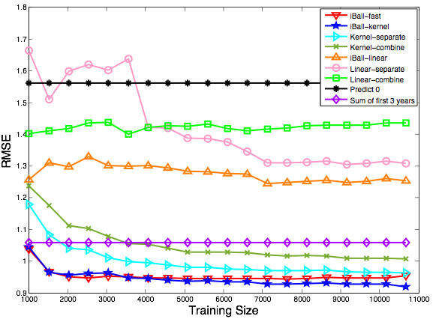
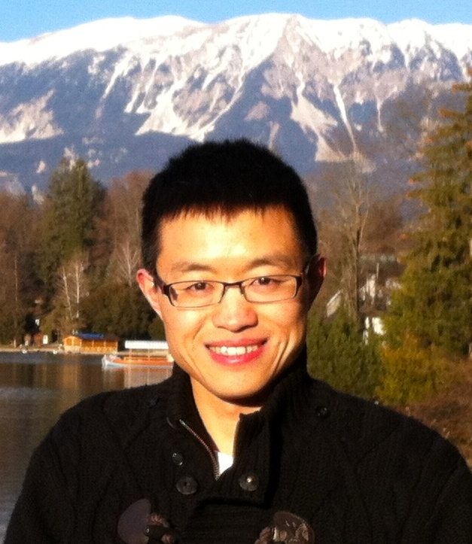
Paper Citation Prediction Performance
Root Mean Squared Error
iBall
non-linear
Proposed Sol.
Training Size
Datasets: AMiner (2,243,976 papers, 1,274,360 authors,
8,882 venues)

Slide 27
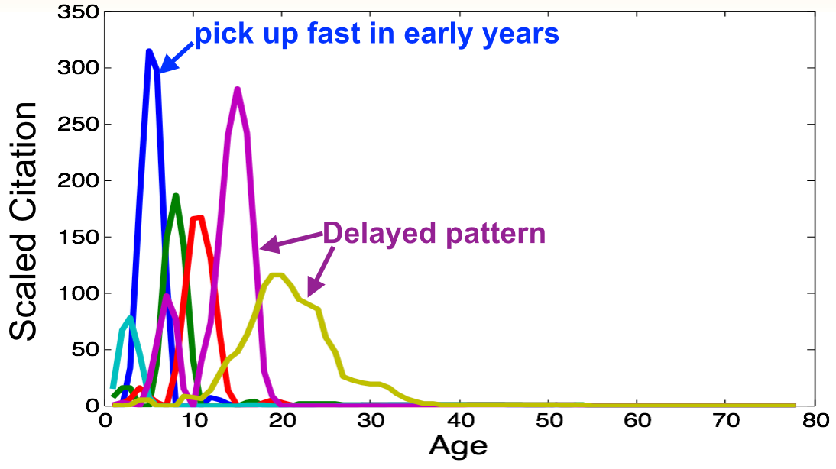
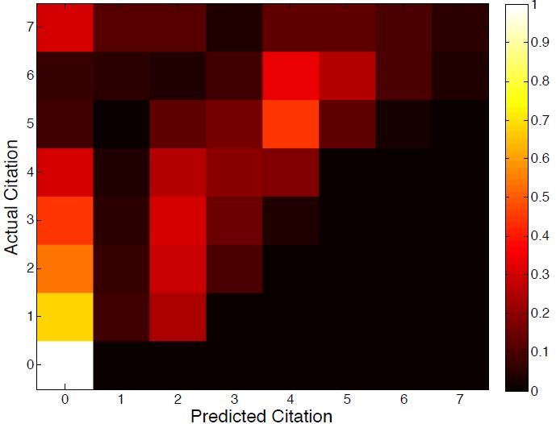
Error Analysis
Actual Normalized Citation
Predicted Normalized Citation
Obs.: bright region at x = y
L. Li, and H. Tong: The Child is Father of the Man: Foresee the Success at the Early Stage. KDD 2015

Slide 28
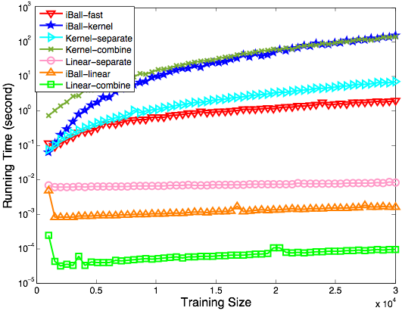
Running Time Comparison
iBall-kernel
kernel-combine
kernel-separate
iBall-fast
Running Time (second)
linear
models
Training Size
Obs.: iBall-fast outperforms other non-linear methods

Slide 29
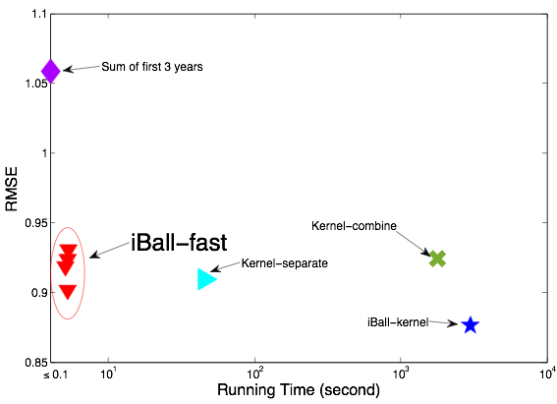

Quality vs. Speed
RMSE
iBall-fast
Running Time (second)
Obs.: iBall-fast: good trade-off between quality and speed

Slide 30
iBall: Summary
Goal: predict long-term impact of scholarly entities
Solutions: joint predictive model (iBall)
Results:
  iBall joint models better than separate versions
  iBall-fast updates efficiently and accurately
Challenges | feature design | non-linearity | domain-heterogeneity | dynamics
Tactics | first 3 years’ citation | kernel trick | domain consistency | low-rank approximation
C1
C2
C3
C4
L. Li, and H. Tong: The Child is Father of the Man: Foresee the Success at the Early Stage. KDD 2015: 655-664

Slide 31
Roadmap
Motivations
Q1: Team Performance Characterization
Q2: Team Performance Prediction
Q3: Team Performance Optimization
  Team Replacement
  Team Enhancement
Open Challenges

Slide 32
Churn of A Team Member
Case 1: Employee resigns in a sales team
Case 2: Task force down in a SWAT team
Case 3: Rotation tactic between benches in NBA team
Q: How to find the best alternative when a team member leaves?
L. Li, H. Tong, N. Cao, K. Ehrlich, Y.-R. Lin and N. Buchler: Replacing the Irreplaceable: Fast Algorithms for Team Member Recommendation, WWW 2015
N. Cao, Y.-R. Lin, L. Li, H. Tong: g-Miner: Interactive Visual Group Mining on Multivariate Graphs, ACM CHI 2015
System prototype & video demo: http://team-net-work.org

Slide 33




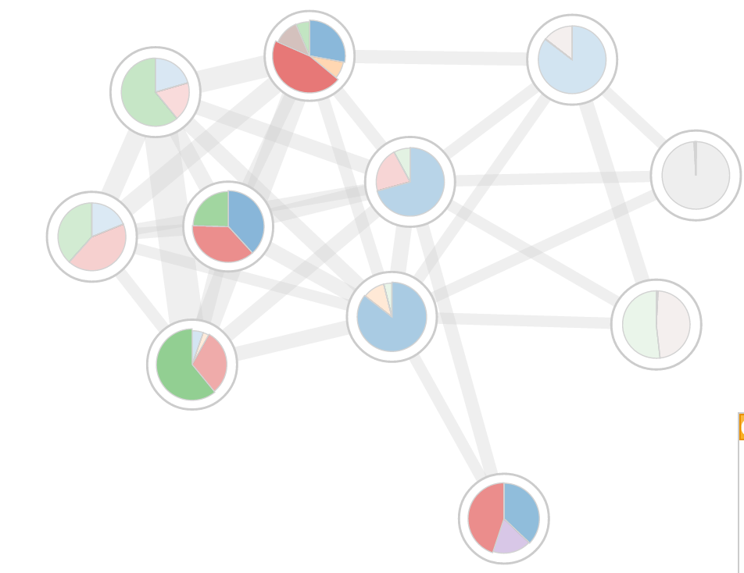
Team Member Replacement
Adj. Matrix
Problem Definition:
Given: (1) A labelled social network
  (2) A team
  (3) A team member
Recommend: A “best” alternative to replace the person p’s role in the team
Skill Indicator
Team
Q: who is a good candidate to replace the person to leave
Leave

Slide 34
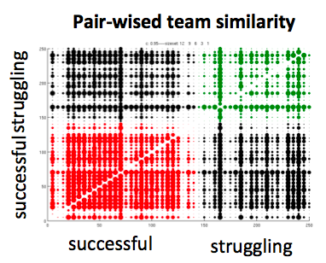
Social Science Literature
Team members prefer to work with people they have worked before [Hinds+OBHDP00]
Distributed teams perform better when members know each other [Cummings+CSCW08]
Specific communication patterns amongst team members are critical for performance [Cataldo+CHI12]
Conjecture: The similarity should be measured in the context of the team itself

Slide 35


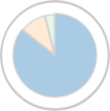
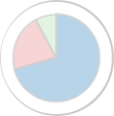
Design Objectives
Objective 1: A good candidate should have a similar skill set
Team
Skill Matching
To leave
Candidate 1
Leave
Skill Set:
New team would have a similar skill set as the old team to continue to complete the task

Slide 36


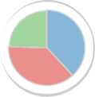

Design Objectives
Objective 2: A good candidate should have a similar network structure
Structure Matching
Team
To leave
Candidate 1
Leave
Skill Set:
New team would have a similar network structure as the old team to collaborate effectively

Slide 37
Design Objectives
The skill and structure match should be fulfilled simultaneously!
Team
Leave
Skill Set:
New team would have similar skill and communication configuration for each sub-task
L. Li, H. Tong, N. Cao, K. Ehrlich, Y.-R. Lin and N. Buchler: Replacing the Irreplaceable: Fast Algorithms for Team Member Recommendation, WWW 2015

Slide 38
Random Walk based Graph Kernel
1
a
h
2
5
b
e
i
3
4
c
d
j
6
7
8
f
g
Graph 1
Graph 2
Details:
  1. Compare similarity of every pair of nodes from each graph
  — Eg: (1,2) vs (a, j) less similar
  (1,5) vs (a,e) more similar
  2. Node pair similarity is measured by random walks
  3. Two graphs are similar if they share many similar node pairs

Slide 39
Random Walk based Graph Kernel
Subtask 1
Subtask 2
Subtask 2
1
a
Subtask 1
h
2
5
b
e
i
3
4
c
d
j
6
7
8
f
g
Team 1
Team 2
Remarks:
Incorporates both attributes and structures similarity
Ideal fit for our two design objectives simultaneously

Slide 40
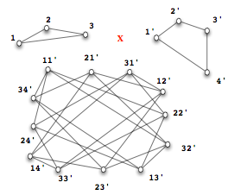
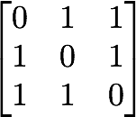
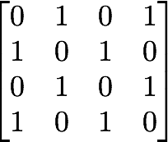


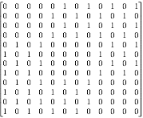



Kronecker Product Graph w/o Attribute
Graph Illustration
Matrix Description
Kronecker product
One Random Walk on
One Random Walk on
One Random Walk on
S. V. N. Vishwanathan, Nicol N. Schraudolph, Imre Risi Kondor, and Karsten M. Borgwardt. Graph Kernels. Journal of Machine Learning Research, 11:1201–1242, April 2010.

Slide 41

RW Graph Kernel — Formulation
Taking expectations instead of summing
Attribute Indicator
:
Computational cost (A_{x}: t² x t²)
  Exact methods: [Vishwanathan+JMLR2010]
    O(t⁶) - Direct computation
    O(t³) - Sylvester equation
  Approx methods: O(t²r⁴+mr+r⁶) [Kang+SDM12]
U. Kang, Hanghang Tong, Jimeng Sun. Fast Random Walk Graph Kernel. SDM 2012
S. V. N. Vishwanathan, N. N. Schraudolph, I. Kondor, and K. M. Borgwardt. Graph Kernels. JMLR 2010.

Slide 42

TEAMREP-BASIC
Find a new member q not in the current team that satisfies:
Team
One graph kernel computation for every
possible candidate
Leave
Challenge: need to compute many graph kernel
  overall complexity: O(nt³)
Questions:
  Q1: how to reduce the number of graph kernels
  Q2: how to speed up the computation for each graph kernel
L. Li, H. Tong, N. Cao, K. Ehrlich, Y.-R. Lin and N. Buchler: Replacing the Irreplaceable: Fast Algorithms for Team Member Recommendation, WWW 2015

Slide 43

Scale-up: Candidate Filtering
Pruning Strategy: Filter out all the candidates w/o any connections to any of the rest team members.
Team
Leave
Theorem: The pruning is safe: wont’ miss any potentially good replacement
Benefit: The number of graph kernel computations is reduced to O(size of the neighborhood of T)

Slide 44
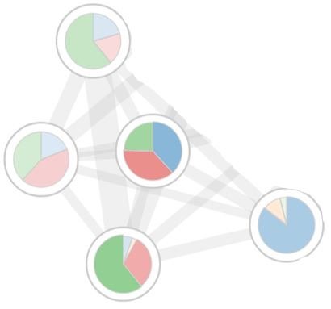
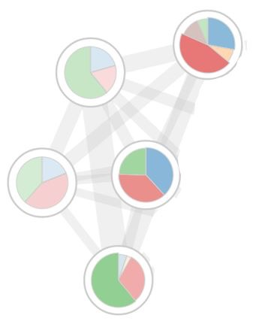

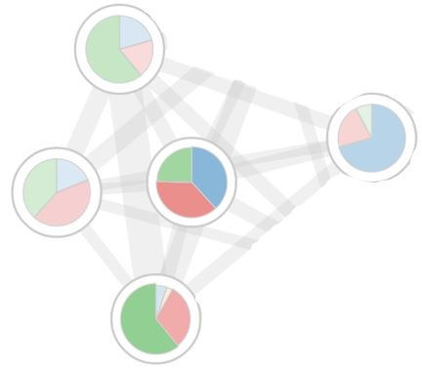
Speedup — Observation
Candidate 1
To leave
Old Team
New Team
To leave
Candidate 2
Old Team
New Team
Observation:
Many redundancies — the nodes and edges within the rest team members remain the same

Slide 45
Speedup — Approx Approach
Fixed
Fixed
To leave
Candidate 1
Fixed
Unique
Unique
Original Team
Fixed
New Team
The common part is the adjacency matrix of
the rest team members

Slide 46
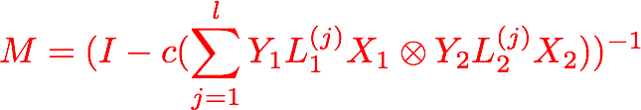



Speedup — Approx Approach
Details
Time Complexity:
Original Complexity:

Slide 47
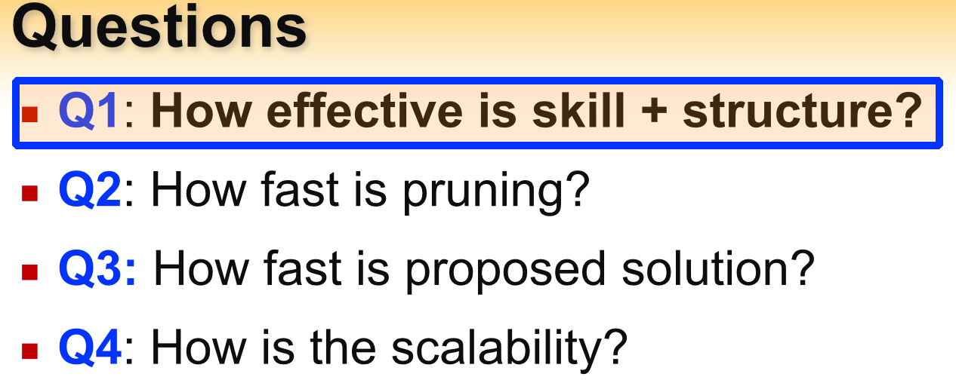
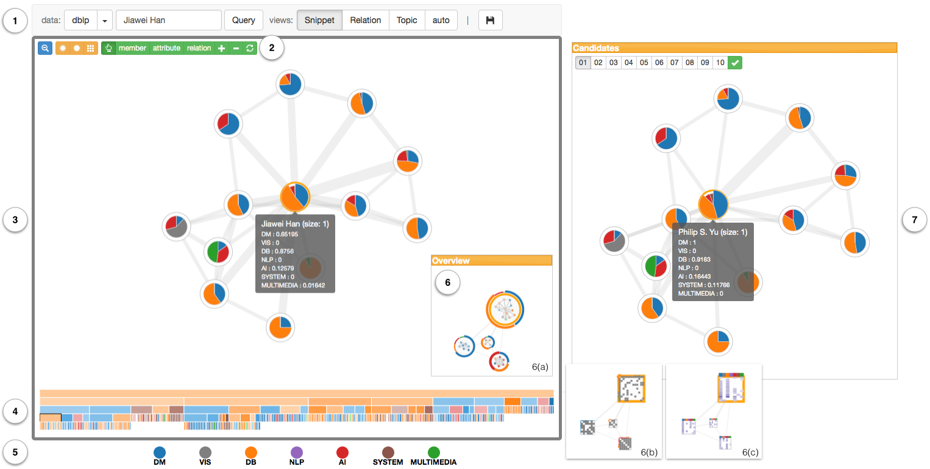
Prototype Systems
prototype: http://team-net-work.org
Nan Cao, Yu-Ru Lin, Liangyue Li, Hanghang Tong.”g-Miner: Interactive Visual Group Mining on Multivariate Graphs”, ACM CHI 2015.

Slide 48
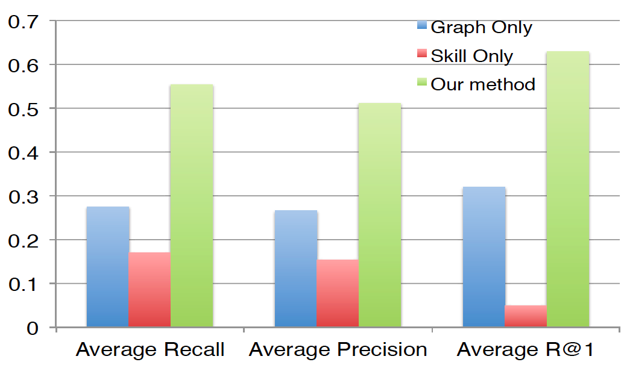
User Studies
Our method achieves the best average recall, precision and R@1
L. Li, H. Tong, N. Cao, K. Ehrlich, Y.-R. Lin and N. Buchler: Replacing the Irreplaceable: Fast Algorithms for Team Member Recommendation, WWW 2015

Slide 49
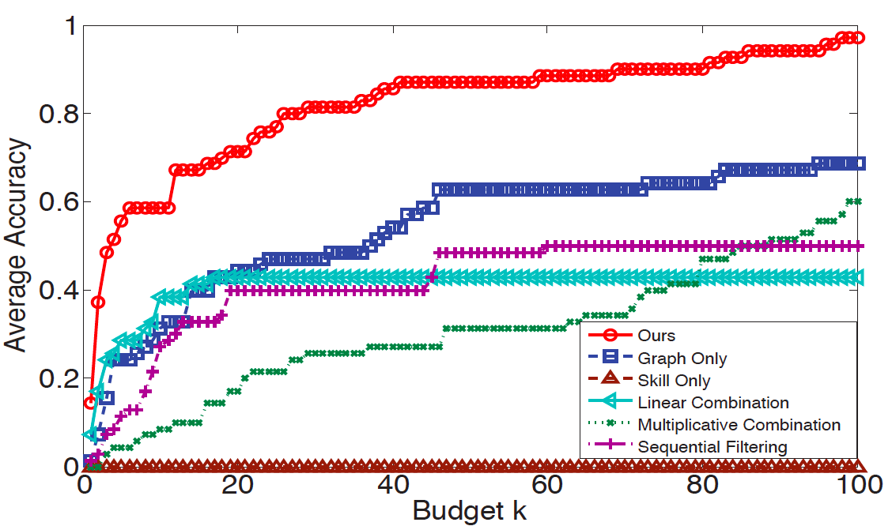
Application in Author Alias Prediction
proposed
alternative
ways to
combine
skill+graph
Average Accuracy
Budget k
Our method achieves the highest accuracy
Author Alias: Alexander J. Smola vs. Alex J. Smola

Slide 50
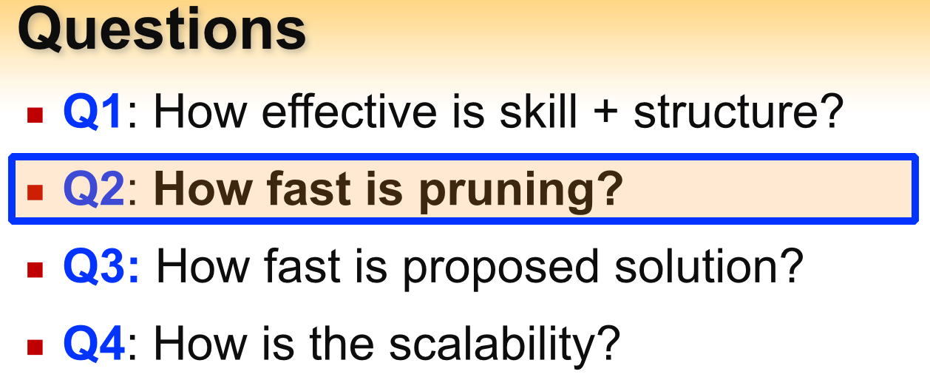
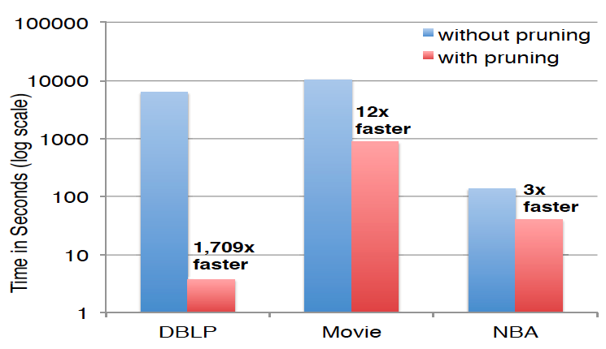
Speed-up by Pruning
Time in Second (log scale)
Pruning has dramatic speed improvement

Slide 51
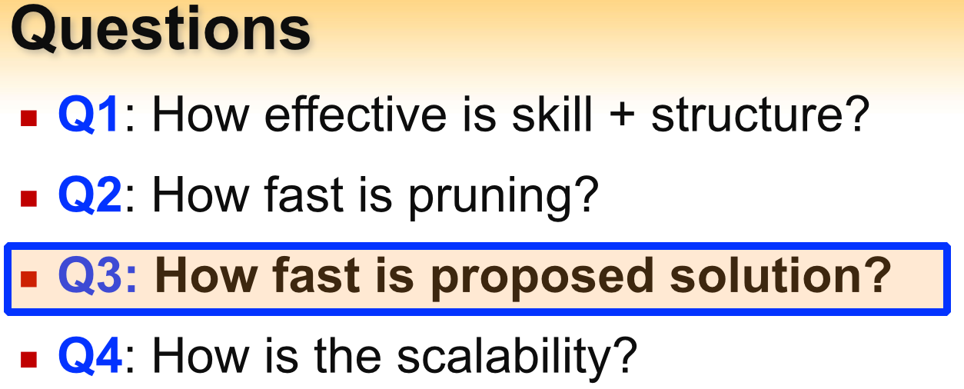
Further Speed-up
Time in Second
Time in Second
Team Size
Team Size
Exact methods
Approximate methods
Exploiting redundancy leads to additional speed-up!

Slide 52
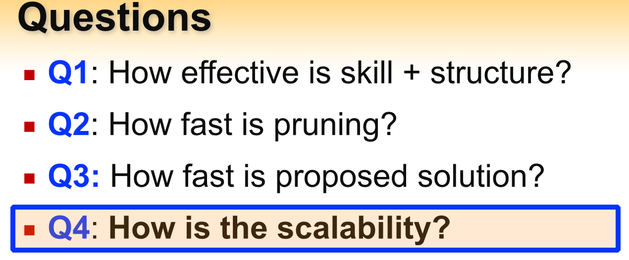
Scalability
Time in Second
Time in Second
TEAMREP-FAST-EXACT
TEAMREP-FAST-APPROX
Our fast solutions scale sub-linearly

Slide 53
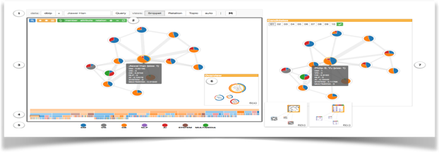
Team Member Replacement - Summary
Problem Def: Team Member Replacement
Design Objectives: skill + structural matching
Solutions: graph kernel and fast algorithms
Prototype Systems: http://team-net-work.org/
L. Li, H. Tong, N. Cao, K. Ehrlich, Y.-R. Lin and N. Buchler: Replacing the Irreplaceable: Fast Algorithms for Team Member Recommendation, WWW 2015
N. Cao, Y.-R. Lin, L. Li, H. Tong: g-Miner: Interactive Visual Group Mining on Multivariate Graphs, ACM CHI 2015

Slide 54
Beyond Team Member Replacement
Team Shrinkage
  If we need to reduce the size of an existing team (e.g., for the purpose of cost reduction), who shall leave the team?
Team Expansion
  If the team leader perceives the need to enhance certain expertise of the entire team, who shall we bring into the team?
Team Conflict Resolution
  If the team leader sees a conflict between certain team members, how shall we resolve it?
Key Idea: Solve all these team enhancement scenarios by team member replacement !
L. Li, H. Tong, N. Cao, K. Ehrlich, Y.-R. Lin and N. Buchler: Enhancing Team Composition in Professional Networks: Problem Definitions and Fast Solutions, 2016

Slide 55
Open Challenges
Team Performance Characterization
  Correlation → Causality
  When does “1+1 < 2” ?
Team Performance Prediction
  Joint Content-Individual-Team Prediction
  Prediction→ Attribution
Team Performance Optimization
  Predictive Optimization
  Team Optimization → Network Optimization

Slide 56


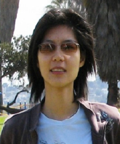
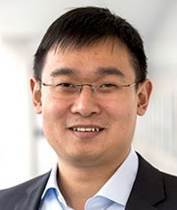

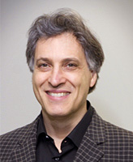







Acknowledgement
Norbou Buchler, Tina Eliassi-Rad, Nan Cao, Kate Erhlich, Wei Fan, Liangyue Li, Yuru Lin, Jie Tang, Brian Uzzi, Dashun Wang
Project website: http://team-net-work.org (for data, paper, slides and systems, etc)

