Slide 1
Recent Advances in Applied Matrix Technologies
Fei Wang Hanghang Tong
IBM Research City College, CUNY

Slide 2
Outline
Introduction
Overview of the Technologies
Applications in Health Informatics
Applications in Social Informatics
Conclusions and Future Works

Slide 3

What are Matrices?

Slide 4
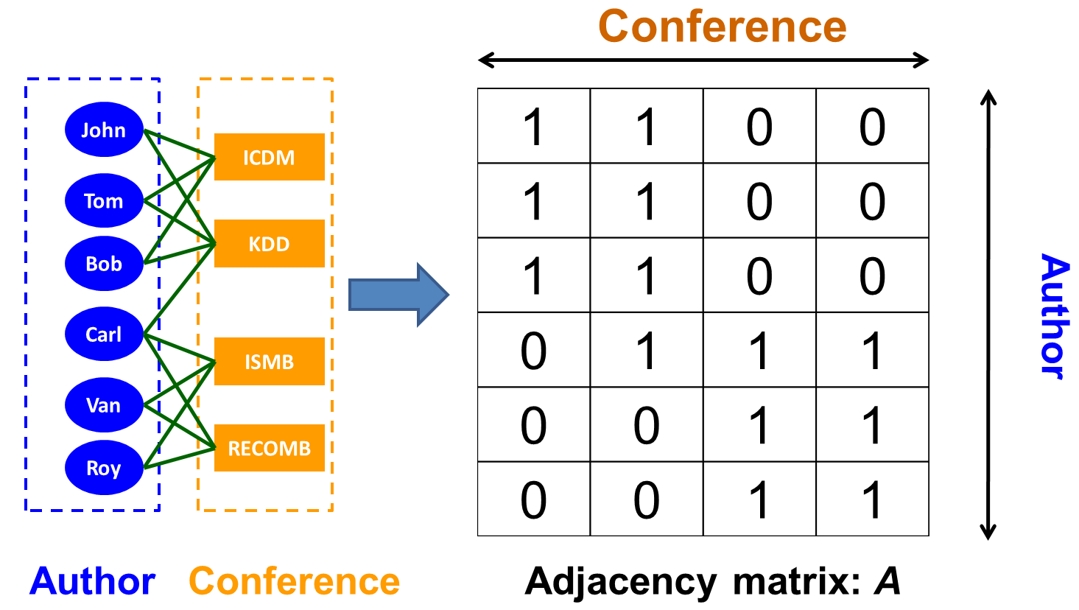
Matrix: A Natural Representation for Networks/Graphs/Relational Data
4

Slide 5
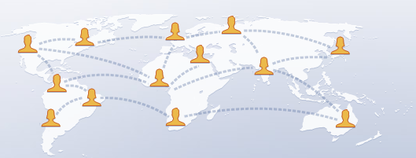
Matrices in Social Networks
Research Qs: How to find common friends?
Matrices: rows/columns: users; entries: friendship
Matrix Tools: graph proximity
5

Slide 6

Matrices in Social Networks
Teenager
Adult
Phone
telemarketer
MSN
Research Qs: How to spot abnormal calling activities?
Matrices: rows/columns: users; entries: phone calls
Matrix Tools: graph proximity; low-rank approximation
6

Slide 7
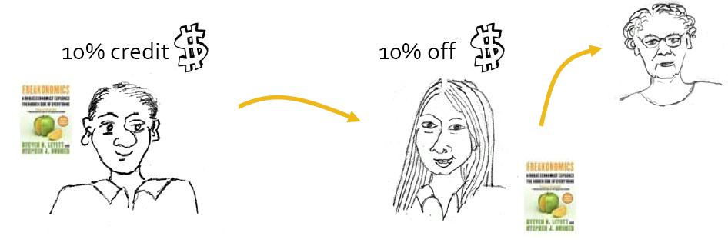
Matrices in Social Networks [Leskovec+ 2007]
Research Qs: Can we boost the purchase?
Matrices: rows/columns: people; entries: recommendation
Matrix Tools: eigenvalue optimization
7

Slide 8
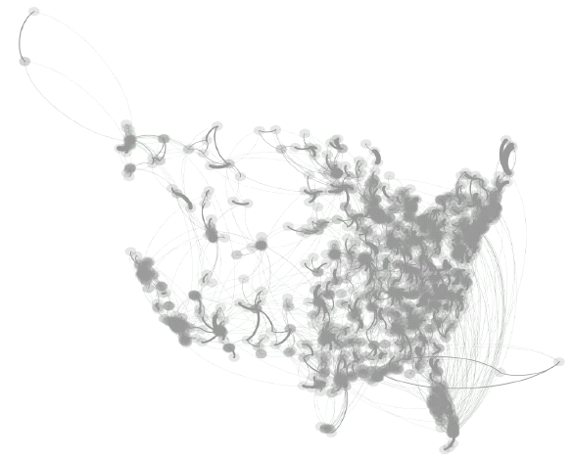
Matrices in Healthcare [Prakash+ 2013]
US-Medicare Network
Critical Patient transferring
Move patients → specialized care
→ highly resistant micro-organism → Infection controlling → costly & limited
Research Qs: How to optimally allocate resources?
Matrices: rows/columns: hospitals; entries: patient transfer
Matrix Tools: eigenvalue optimization
8

Slide 9
Matrices in Healthcare [Parikshit+ 2012]
Heart Attack
Expanded
Wheezing
Expanded
Cough
Fever
Ankle Edema
Expanded
Rales
Chest Pain
Initial
Initial
Research Qs: How to find more, related symptoms?
Matrices: rows/columns: symptoms; entries: co-occurrence
Matrix Tools: graph proximity
9

Slide 10






Matrices in Healthcare [Fei+ 2011]
Tom, Male, 30
Hypertension
John, Male, 53
Heart Failure
Roy, Male, 40
Sepsis
Natasha, Female, 42
Hyperlipidemia
Sara, Female, 28
Asthma
Jack, Male, 30
Pneumonia
Research Qs: How to find clinically similar patients?
Matrices: rows: patients; cols: clinical features; entries: values
Matrix Tools: eigenvalue decomposition
10
Notes:
comorbidity

Slide 11
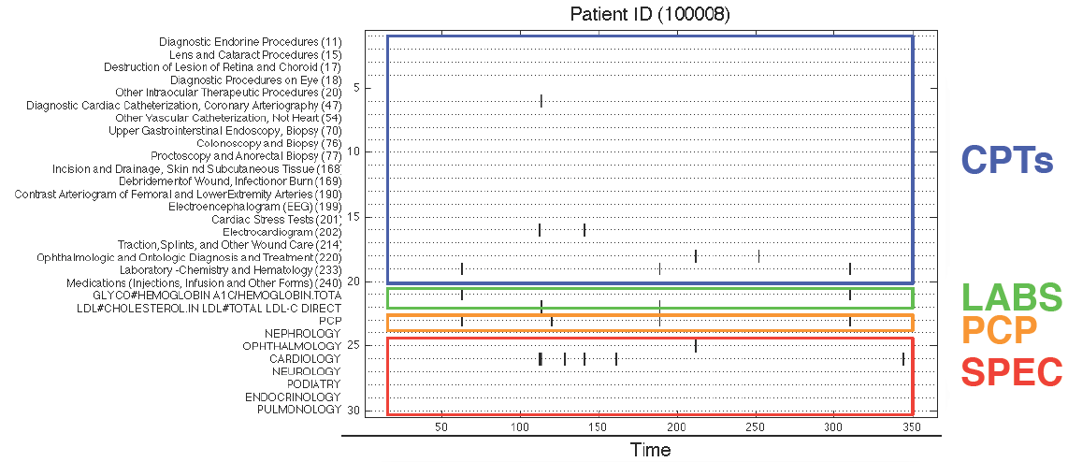
Matrices in Healthcare [Fei+ 2012]
Research Qs: How to find frequent event subsequences?
Matrices: rows: events; cols: time; entries: indicator
Matrix Tools: Low rank approximation
11

Slide 12
Outline
Introduction
Overview of the Technologies
Applications in Health Informatics
Applications in Social Informatics
Conclusions and Future Works

Slide 13
T1: Graph Proximity
T2: Low-Rank Approximation
T3: Sparse Learning
T4: Large-Scale Learning
T5: Eigenvalue Opt. (in Section 4)
Overview of the Technologies

Slide 14
Basic Techniques: RWR
Recent Advance #1: Supervision
Recent Advance #2: Graph Kernel
T1: Graph Proximity

Slide 15


Basic Tech.: Node Proximity Measurement
A
B
a.k.a Relevance, Closeness, ‘Similarity’…
Q: How close is A to B?

Slide 16
Basic Tech. : Random Walk with Restart
[Tong+ ICDM 2006]
0.03
0.04
 | Node 4
Node 1 Node 2 Node 3 Node 4 Node 5 Node 6 Node 7 Node 8 Node 9 Node 10 Node 11 Node 12 | 0.13 0.10 0.13 0.22 0.13 0.05 0.05 0.08 0.04 0.03 0.04 0.02
10
0.10
9
12
0.13
2
0.08
0.02
1
8
0.13
11
3
0.04
4
0.05
6
5
0.13
7
0.05
Nearby nodes, higher scores
Ranking vector
More red, more relevant
Notes:
In the next 4-5 foils, I will give you some intuitions of rwr, althought I know that it might be a strategic mistake to talk about background in an intervie

Slide 17

RWR: Think of it as Wine Spill
Spill a drop of wine on cloth
Spread/diffuse to the neighborhood

Slide 18

RWR: Wine Spill on a Graph
9
10
2
12
1
8
3
11
4
5
6
Query
7
wine spill on cloth
RWR on a graph
Same Diffusion Eq.
Notes:
In RWR, let’s say, if we want to measure prox for node 4 in the right graph.
First, we will spill/land a drop of wine on the query node, and then let it spread/diffuse to its neighborhod.
Eventually, closer nodes will receivers more red/wines, and therefore higher proximity

Slide 19
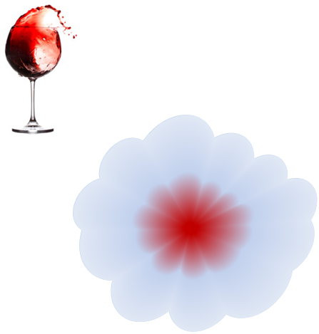
Random Walk with Restart
10
9
12
2
1
8
3
11
4
6
5
7
Same Diffusion Eq.
Notes:
More formally, in order to measure proximity from node 4, let a random particle, starting from node 4, do romdom surfing on this graph.
Basically, it is a random walk on the graph, with some small probability to return to the query node at each step.

Slide 20
Intuition: Why RWR is A Good Score?
A
B
Prox (A, B) =
Score (Red Path) +
Score (Green Path) +
Score (Blue Path) +
Score (Purple Path) + …
…
High proximity many, short, heavy-weighted paths

Slide 21
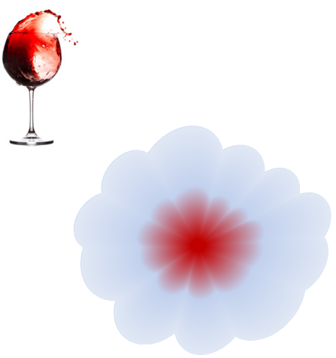
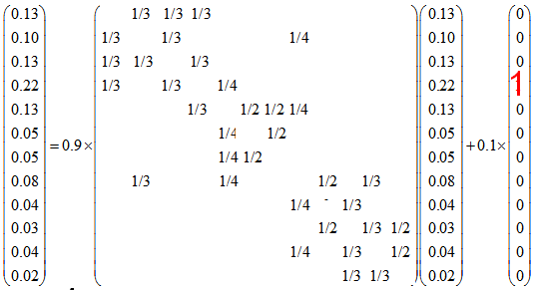
Computing RWR
(Normalized)
Adjacency matrix
Restart p
Starting vector
Ranking vector
9
10
2
12
1
8
3
11
4
5
6
7
n x 1
n x n
nx1
nxn
nx1
Footnote: “Maxwell Equation” for Web [Soumen Chakrabarti]
Notes:
So far it’s good. Now, let’s turn to the computational issue of rwr. (Well, here is the definition of rwr. (Given a query node i, how can we compute its relevance score with every other node j, in other words, how can we can the ranking vector r_i;)
OK, here is the definition of random walk with restart, such that r is n x 1, where n is the # of the nodes in the graph, ranking vector, W-tuda is n x n normalized adjacent matrix, e_i is n x 1 starting vector, and 1-c is the restarting prob. by setting the different starting vector, we can get the different ranking vector for different query node (For example, setting the 4^th element of e_i to be 1 and 0 for all others, we can get the ranking vector query node 4.)
So, given a query node, or equivalently given a starting vector, how can we solve this linear system?

Slide 22
Recent Advance #1: Supervision
Q: What is the optimal W?
A: Learning optimal weights from supervision
Key Idea: if we know some preference, we use such supervision to guild random walks to minimize
  Penalty of preference violation + model complexity
L. Backstrom, J. Leskovec.: Supervised Random Walks: Predicting and Recommending Links in Social Network. WSDM 2011
A. Agarwal, S. Chakrabarti: Learning random walks to rank nodes in graphs. ICML 2007

Slide 23
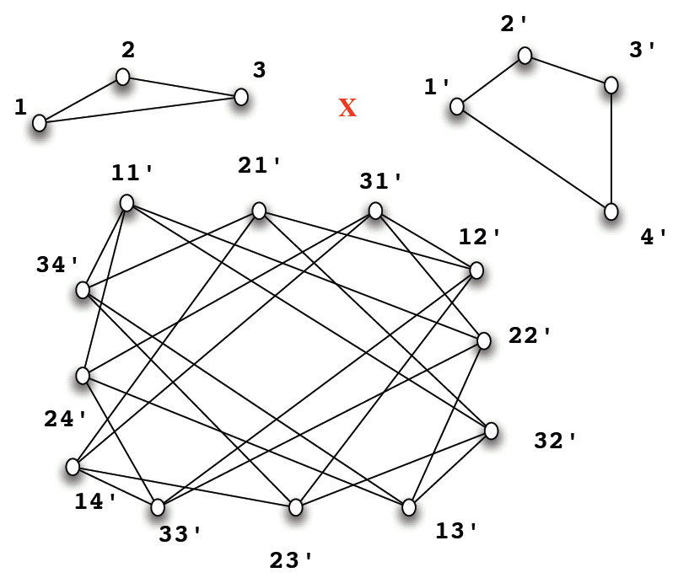
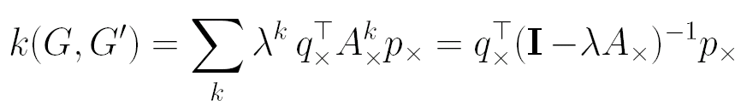
Recent Advance #2:
Node Proximity → Graph Similarity/Kernel
A₂
A₁
Q: Sim(A₁, A₂) ?
A: Do two random walks (A₁, A₂)!
… = one random walk on A_{x}
A_{x}
SVN Vishwanathan. Fast computation of random walk graph kernels. NIPS 2006
K. Borgwardt and X. Yan: Graph Mining and Graph Kernels. KDD 2008 Tutorial
U. Kang, H. Tong and J. Sun: Fast Random Walk Graph Kernel. SDM 2012
~20+ other graph similarity measures

Slide 24
T1: Graph Proximity
T2: Low-Rank Approximation
T3: Sparse Learning
T4: Large-Scale Learning
T5: Eigenvalue Opt. (in Section 4)
Overview of the Technologies

Slide 25
Why low rank approximation
Collaborative Filtering
  it is commonly believed that only a few factors contribute to anyone's taste or preference.
Health Informatics
  Usually the progression of disease is highly associated with a certain set of risk factors
…
Notes:
Thanks, Hanghang. I’m gonna continue the technique overview.
The second technique we want to mention here is low rank approximation of the data matrices. We give two examples here on why low rank approximation is needed. In collaborative filtering, it is commonly believed that only a few factors contribute to anyone’s taste or preference; in health informatics, usually the progression of disease is highly associated with a certain set of risk factors.

Slide 26
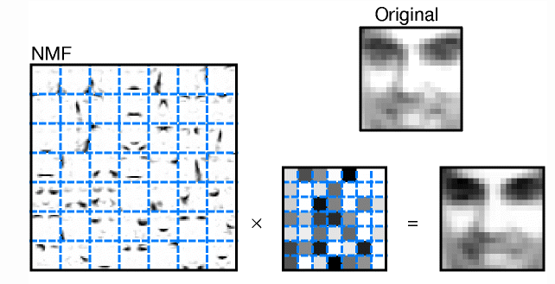
Low Rank Approximation
Nonnegative Matrix Factorization (NMF)
Nuclear norm related technologies
Daniel D. Lee and H. Sebastian Seung. Learning the parts of objects by non-negative matrix factorization. Nature 401, 788-791 (21 October 1999)
Notes:
One typical low rank approximation technique is nonnegative matrix factorization, which is a very hot research area in data mining in recent years, tons of papers come out from this topic. This is a very famous figure from the nature paper of lee and seung, where the right part is the basis images learned by NMF from a set of face images, which clearly correspond to different part of the faces. The figure in the middle is the reconstruction coefficients for this image using those learned basis, and this is the reconstructed face image, which is very close to the original image shown on the top

Slide 27
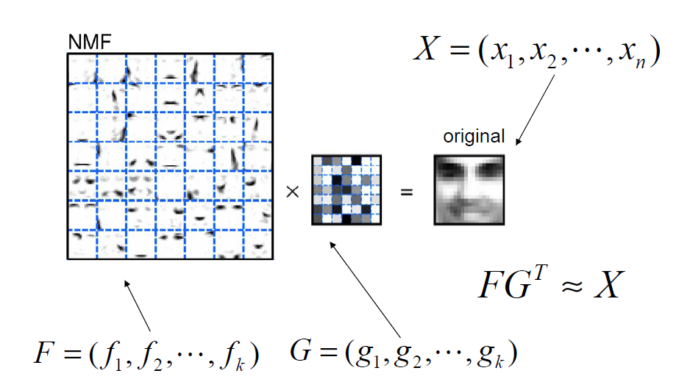


Nonnegative Matrix Factorization (NMF)
Factorizing a nonnegative matrix to the product of two low-rank matrices
Notes:
More concretely, suppose we have a set of n face images with each image stretched as a vector, the entries in these vectors correspond to the pixel intensities, and X is the matrix constructed by concatenating all those vectors, which is clearly nonnegative
let F be a set of k basis images we want to learn from X, and G be the reconstruction coefficients. Then the goal of NMF is to approximate X by the product of F and G transpose with F and G constrained to be nonnegative.
Part of the reason why NMF can result in part based representation is because we constrain the reconstruction coefficients to be nonnegative, this means that each face can be reconstructed by adding a set of basis images, there won’t be any cancellations. Thus ideally those basis should correspond to different parts of the face.
Here the loss function to measure the approximation error is square loss, we can also use other loss functions such as KL divergence. Unfortunately this optimization problem is not convex and in the following we will review two typical strategies to solve this problem.

Slide 28
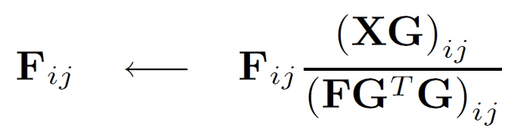
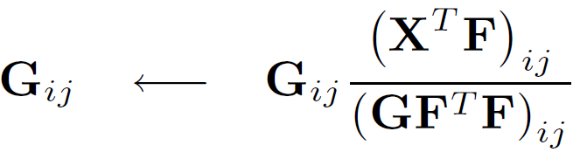
NMF Solutions: Multiplicative Updates
Multiplicative update method
Daniel D. Lee and H. Sebastian Seung (2001). Algorithms for Non-negative Matrix Factorization. NIPS 2001.
H Zhou, K Lange, and M Suchard. (2010) Graphical processing units and high-dimensional optimization, Statistical Science, 25:311-324
Notes:
One popular approach is multiplicative updates proposed in lee and seung’s nips paper, this approach starts by nonnegative initialization of F and G, and then iteratively updates them according to multiplicative rules like this. This is the rule when the approximation loss is square loss. The convergence of this method can be understood from an auxiliary function minimization point of view, also recently there is one paper pointing out that this algorithm can also be understood from the majorization-minorization perspective.

Slide 29




NMF Solutions: Alternating Nonnegative Least Squares
Initialize F and G with nonnegative values
Iterate the following procedure:
  Fixing , Solve
  Fixing , Solve
Projected Gradient: http://www.csie.ntu.edu.tw/~cjlin/nmf/
(2) Newtown Type of Method: http://www.cs.utexas.edu/users/dmkim/Source/software/nnma/index.html
(3) Block Principal Pivoting: https://sites.google.com/site/jingukim/nmf_bpas.zip?attredirects=0
P. Paatero and U. Tapper. Positive matrix factorization: A non-negative factor model with optimal utilization of error estimates of data values. Environmetrics, 5(1):111–126, 1994
C.-J. Lin. Projected gradient methods for non-negative matrix factorization. Neural Computation,19(2007), 2756-2779.
D. Kim, S. Sra, I. S. Dhillon, Fast Newton-type Methods for the Least Squares Nonnegative Matrix Approximation Problem. SDM 2007.
J. Kim and H. Park. Toward Faster Nonnegative Matrix Factorization: A New Algorithm and Comparisons. ICDM 2008.
Notes:
Another type of strategy for solving NMF problem under least square loss is this alternating nonnegative least square procedure.
With proper initializations of F and G, this approaches alternatively solves a nonnegative least square problem with respect to either F or G with the other variable fixed.
Many approaches following this strategy have been proposed in recent years, some representative ones including projected gradient, Newtown type of method and block principal pivoting. For your information I have listed the links for the softwares of those methods, which are kindly provided by the authors

Slide 30
NMF: Extensions
General loss
  Bregman Divergence
Different constraints
  Semi-NMF, Convex NMF, Symmetric NMF
Incorporating supervisions
  Pairwise constraints, label
Multiple factorized matrices
  Tri-factorization
I. S. Dhillon and S. Sra. Generalized Nonnegative Matrix Approximations with Bregman Divergences. NIPS 2005.
Chris H. Q. Ding, Tao Li, Michael I. Jordan: Convex and Semi-Nonnegative Matrix Factorizations. IEEE Trans. Pattern Anal. Mach. Intell. 32(1): 45-55 (2010)
Chris H. Q. Ding, Tao Li, Wei Peng, Haesun Park: Orthogonal nonnegative matrix t-factorizations for clustering. KDD 2006.
Fei Wang, Tao Li, Changshui Zhang: Semi-Supervised Clustering via Matrix Factorization. SDM 2008: 1-12
Yuheng Hu, Fei Wang, Subbarao Kambhampati. Listen to the Crowd: Automated Analysis of Live Events via Aggregated Twitter Sentiment. IJCAI 2013.

Slide 31
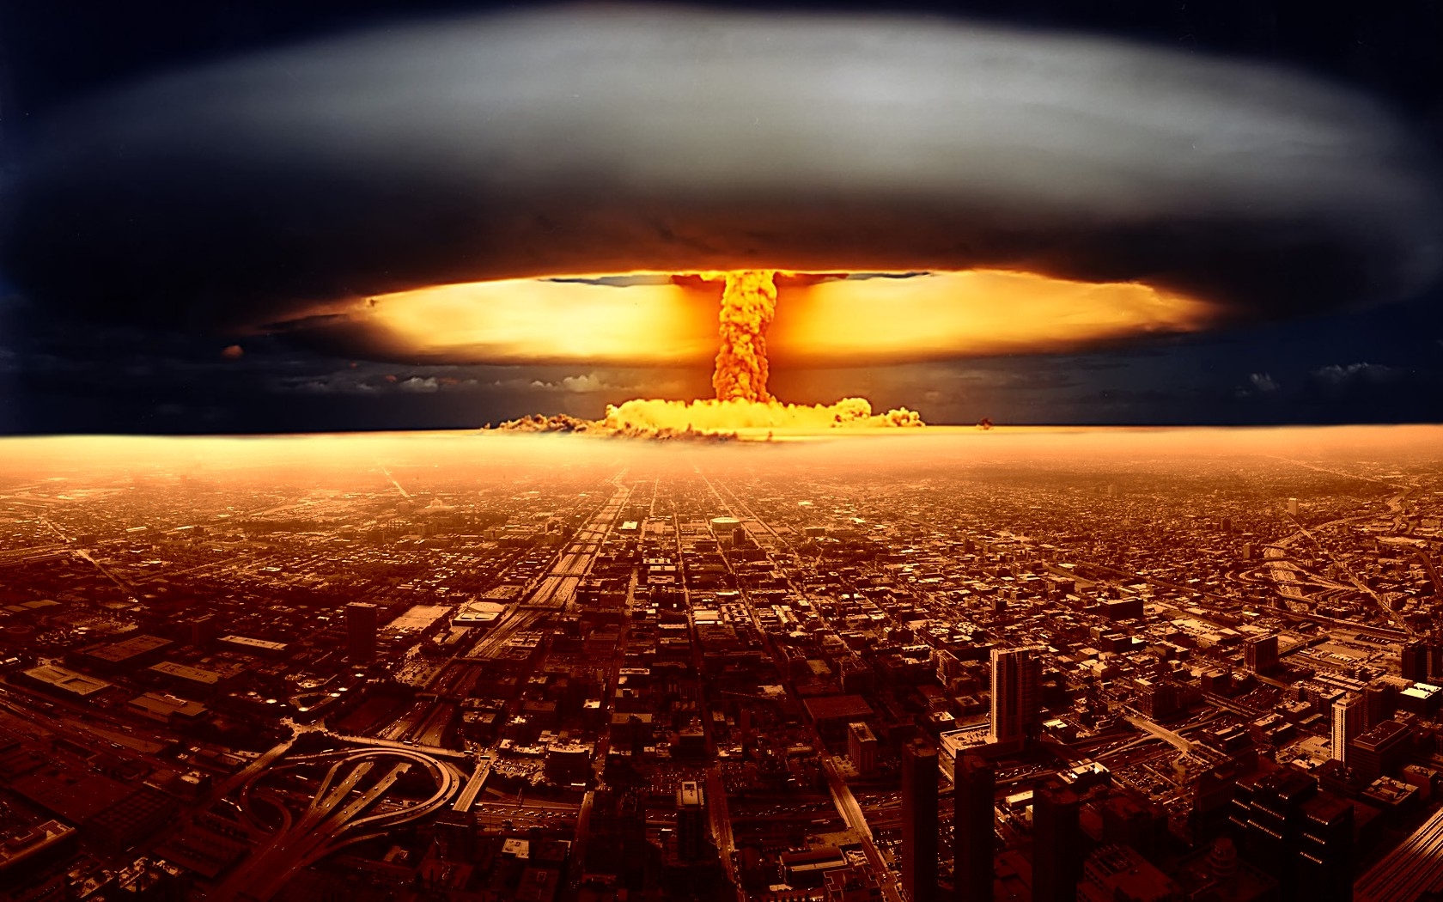
Low Rank Approximation
Nonnegative Matrix Factorization
Nuclear norm related technologies

Slide 32
Rank Minimization and Nuclear Norm
Matrix completion with rank minimization
Convex relaxation
NP hard
M. Fazel, H. Hindi, S. Boyd. A Rank Minimization Heuristic with Application to Minimum Order System Approximation. Proceedings American Control Conference, 6:4734-4739, June 2001.

Slide 33
Nuclear Norm Minimization
Singular Value Thresholding
  http://svt.stanford.edu/
Accelerated gradient
  http://www.public.asu.edu/~jye02/Software/SLEP/index.htm
Interior point methods
  http://abel.ee.ucla.edu/cvxopt/applications/nucnrm/
J-F. Cai, E.J. Candès and Z. Shen. A Singular Value Thresholding Algorithm for Matrix Completion. SIAM Journal on Optimization. Volume 20 Issue 4, January 2010 Pages 1956-1982.
Shuiwang Ji and Jieping Ye. An Accelerated Gradient Method for Trace Norm Minimization. The Twenty-Sixth International Conference on Machine Learning (ICML 2009)
Z. Liu, Lieven Vandenberghe. Interior-point method for nuclear norm approximation with application to system identification. SIAM Journal on Matrix Analysis and Applications (2009)

Slide 34
T1: Graph Proximity
T2: Low-Rank Approximation
T3: Sparse Learning
T4: Large-Scale Learning
T5: Eigenvalue Opt. (in Section 4)
Overview of the Technologies

Slide 35
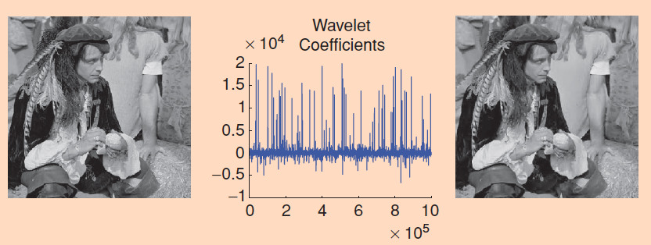
Why Sparse Learning
Candes, E.J., Wakin, M.B. An Introduction To Compressive Sampling. Signal Processing Magazine, IEEE. Volume: 25, Issue: 2. Page(s): 21 – 30.

Slide 36
Sparsity: L0 Norm & L1 Norm
Lower
Bound
http://www.stanford.edu/class/ee364b/lectures/l1_slides.pdf

Slide 37



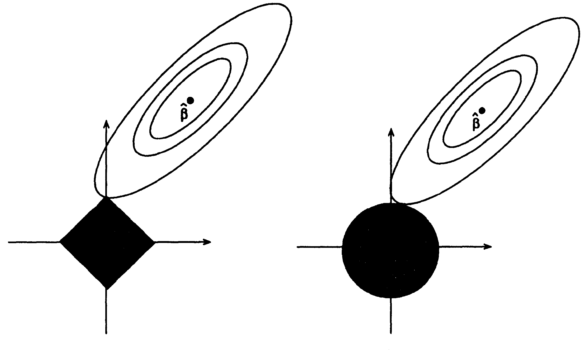


Why L1 Norm Can Achieve Sparsity
Robert Tibshirani. Regression Shrinkage and Selection Via the Lasso. Journal of the Royal Statistical Society, Series B. 1994.

Slide 38
Other Sparsity Penalties
Group Lasso: L1/2 norm
Exclusive Lasso: L2/1 norm
Elastic Net Regularization
Fused Lasso
Tree Structured Group Lasso
SLEP: A Sparse Learning Package
http://www.public.asu.edu/~jye02/Software/SLEP/
Lukas Meier, Sara Van De Geer, Peter Bühlmann. The group lasso for logistic regression. Journal of the Royal Statistical Society: Series B, 70(1), 53–71, 2008.
Y. Zhou, R. Jin, and S. C. H. Hoi. Exclusive Lasso for Multi-task Feature Selection. AISTATS 2010.
Zou, Hui; Hastie, Trevor. Regularization and Variable Selection via the Elastic Net. Journal of the Royal Statistical Society, Series B: 301–320. 2005.
R. Tibshirani, M. Saunders, S. Rosset, J. Zhu, K. Knight. Sparsity and smoothness via the fused lasso. Journal of the Royal Statistical Society: Series B. 67(1), 91–108. 2005.
J. Liu, J. Ye. Moreau-Yosida Regularization for Grouped Tree Structure Learning. NIPS 2010.

Slide 39
T1: Graph Proximity
T2: Low-Rank Approximation
T3: Sparse Learning
T4: Large-Scale Learning
T5: Eigenvalue Opt. (in Section 4)
Overview of the Technologies

Slide 40
Distributed Learning
Parallel Matrix Factorization
  H. F. Yu, C. J. Hsieh, S. Si, and I. S. Dhillon. Scalable Coordinate Descent Approaches to Parallel Matrix Factorization for Recommender Systems. ICDM 2012.
  Lester Mackey, Ameet Talwalkar, and Michael I. Jordan. Divide-and-Conquer Matrix Factorization. NIPS 2011.
Parallel Spectral Clustering
  W. Chen, Y. Song, H. Bai, C. Lin, E. Y. Chang. Parallel Spectral Clustering in Distributed Systems. IEEE TPAMI 33(3), 568-586. 2011.
Parallel SVD
  M. W. Berry, D. Mezher, B. Philippe, and A. Sameh. Parallel Algorithms for the Singular Value Decomposition. In Erricos John: Handbook on Parallel Computing and Statistics. https://www.irisa.fr/sage/bernard/publis/SVD-Chapter06.pdf
Parallel Optimization
  Y. Censor, S. A. Zenios. Parallel Optimization: Theory, Algorithms and Applications. Oxford University Press. 1998

Slide 41
Online Learning
Online Matrix Factorization
  J. Mairal, F. Bach, J. Ponce and G. Sapiro. Online Learning for Matrix Factorization and Sparse Coding. Journal of Machine Learning Research, volume 11. pages 19-60. 2010.
  Fei Wang, Chenhao Tan, Christian Konig, Ping Li. Online Nonnegative Matrix Factorization for Document Clustering. SDM 2011.
  A. Lefèvre, F. Bach, and C. Févotte. Online algorithms for Nonnegative Matrix Factorization with the Itakura-Saito divergence. WASPAA 2011.
General Online Learning
  Shai Shalev-Shwartz. Online Learning: Theory, Algorithms, and Applications. The Hebrew University of Jerusalem. PH.d. thesis. July 2007.
Parallel Online Learning
  Daniel Hsu, Nikos Karampatziakis, John Langford, Alex Smola. Parallel Online Learning. http://arxiv.org/abs/1103.4204v1.

Slide 42

Matrix Tools vs Applications
Clinical Patterns
Similar Patient
Symptom Exp’
Risk Factor
Immunization
C’ Patterns
Anomalies
Influ’ Prop
Tools
Prox.
LRA
Sparse L’
Large L’
Eigen. Opt.
Social Networks
Healthcare

Slide 43
Outline
Introduction
Overview of the Technologies
Applications in Health Informatics
Applications in Social Informatics
Conclusions and Future Works

Slide 44
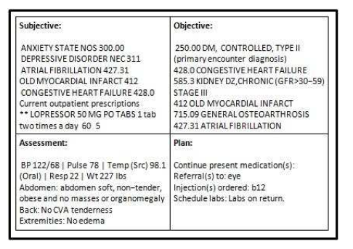
Longitudinal Medical Records
Diagnosis
Procedure
Pharmacy
ICD9, DxGroup
Date of Service
CPT
Date of Service
NDC
Days of Supplies
Lab
Demography
Lab results
Break down by age and sex groups
Age
Ingredient
Gender
HCC, Hierarchy
Date Filled
Date of test
Patient Records

Slide 45
Applications in Health Informatics
Patient Similarity Learning
Risk Factor Identification
Clinical Pattern Detection

Slide 46
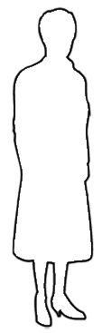

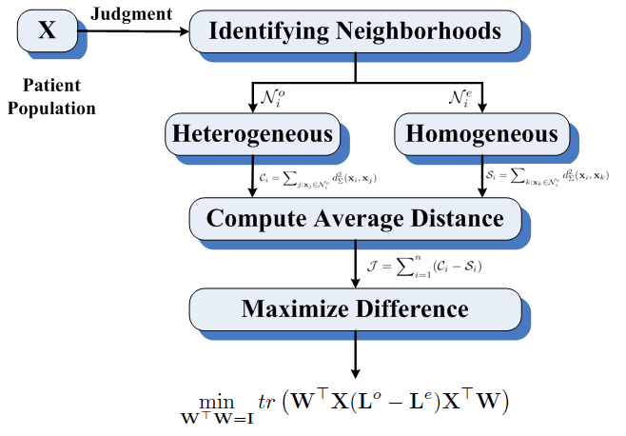
Patient Similarity Assessment
Patient Similarity Learning
Physician feedback
Generating patient cohorts such that the patients within the same cohort are similar to each other
Explain why they are similar
Leverage historical data about the similar patients to diagnose the query patient
Provide positive/negative feedback about the similar patient results
Vector Space Model
Patient Profile
[
]
x=
x1
x2
…
…
xi
xd
Summary statistic of the i-th feature during a specific time period
Locally Supervised Metric Learning (LSML)
Fei Wang. Semi-Supervised Metric Learning by Maximizing Constraint Margin. IEEE TSMC-B. 2011.
Fei Wang, Changshui Zhang. Feature Extraction by Maximizing the Average Neighborhood Margin. CVPR 2007.

Slide 47
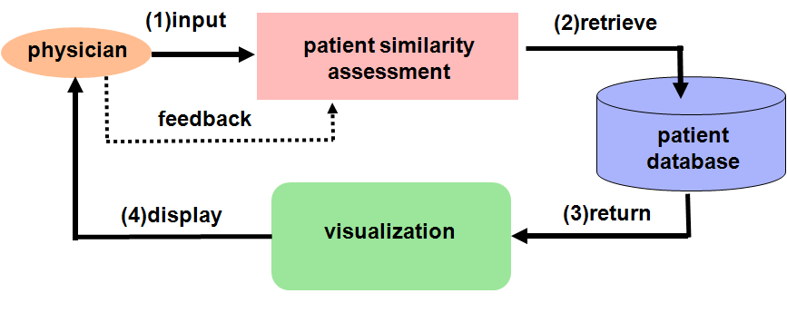


Online Adjustment of Patient Similarity
Physician Decision Support System
Learning the distance metric is equivalent to learn the projection matrix W, which can be solved by doing eigenvalue decomposition on
Any physicians’ feedback is an increment on the matrix
How to adjust the learned patient similarity by incorporating physician’s feedback in real time?
Efficient eigensystem update of a matrix: matrix perturbation theory
iMet: interactive Metric Learning
solution
matrix
eigensystem
perturbation
Fei Wang, J. Sun, J. Hu, S. Ebadollahi. iMet: Interactive Metric Learning in Healthcare Applications. SDM 2011.

Slide 48
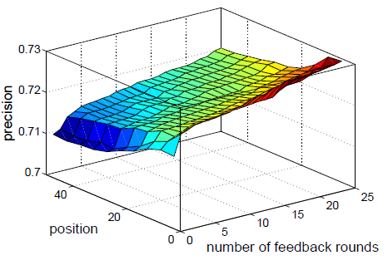
Performance Evaluation
Initial Metric: The patient population was clustered into 10 clusters using Kmeans with the features as counts of the HCC codes over one year. An initial distance metric was then learned using LSML
Feedback: For each round of simulated feedback, an index patient was randomly selected and 20 similar patients were retrieved based on current distance metric. The feedback is based on whether these retrieved patients have the same label as the index patient
Performance metric: precision@position measure
Index patient
1
1
1
3
0
Precision @ 3: 2/3 = 0.67
1
5
0
Precision @ 5: 3/5 = 0.6
0
. . .
Retrieved patients

Slide 49

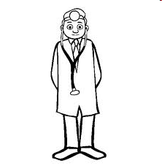
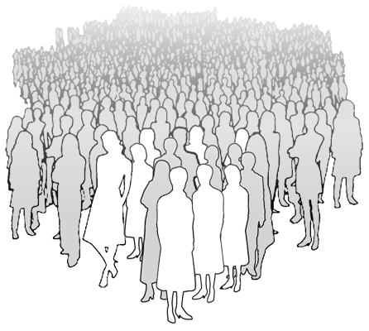
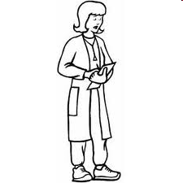
Integrating Multiple Physicians’ Inputs
Different physicians have their own opinions on patient similarities
Comdi: Composite Distance integration
Patient Population
How to integrate these judgments from multiple physicians to a consistent similarity measure?
Fei Wang, Jimeng Sun, Shahram Ebadollahi. Integrating Distance Metrics Learned from Multiple Experts and its Application in Inter-Patient Similarity Assessment. SDM 2011.

Slide 50
Comdi: Experimental Evaluation
Data:
Scale: 135 k
Aggregation period: 1 year
Cohorts: 247, select 30
Feature: HCC codes
Experimental Setting:
Share versions: learning on all 30 cohorts
Individual versions: learning on 1 cohort
Observations:
Shared version perform better than individual versions
Comdi is comparable to LSML, which is the best among sharing versions

Slide 51
Applications in Health Informatics
Patient Similarity Learning
Risk Factor Identification
Clinical Pattern Detection

Slide 52
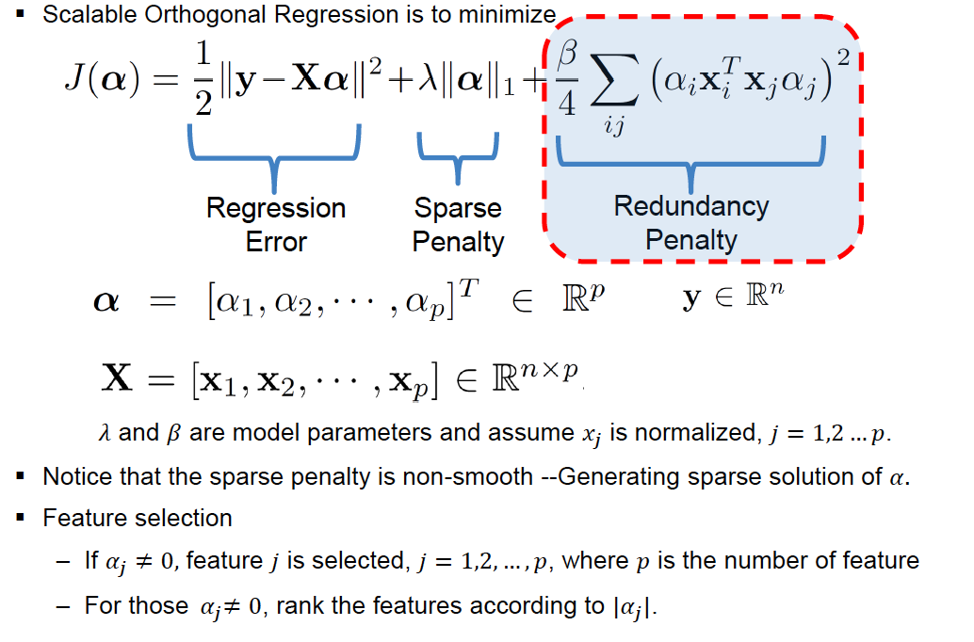
Scalable Orthogonal Regression
Dijun Luo, Fei Wang, Jimeng Sun, Marianthi Markatou, Jianying Hu, Shahram Ebadollahi. SOR: Scalable Orthogonal Regression for Low-Redundancy Feature Selection and its Healthcare Applications. SDM 2012.

Slide 53
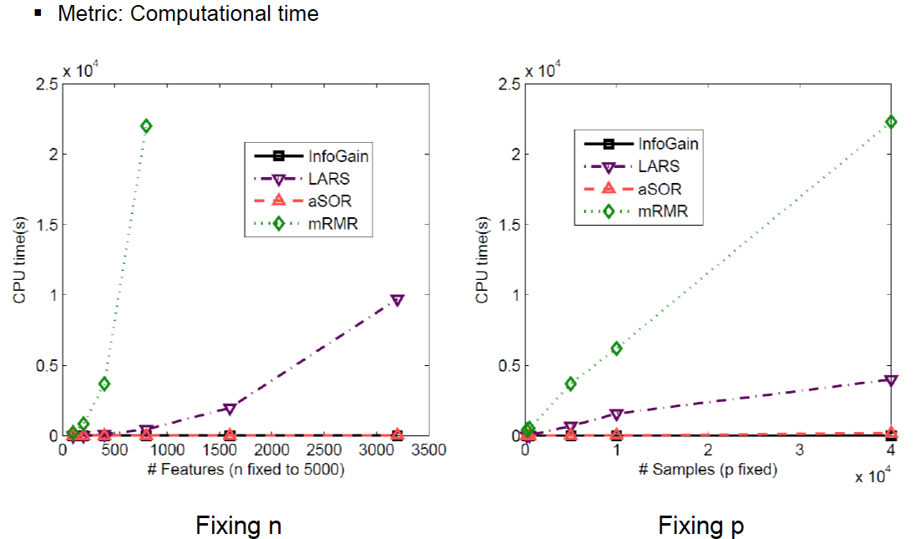
Scalability Comparison

Slide 54
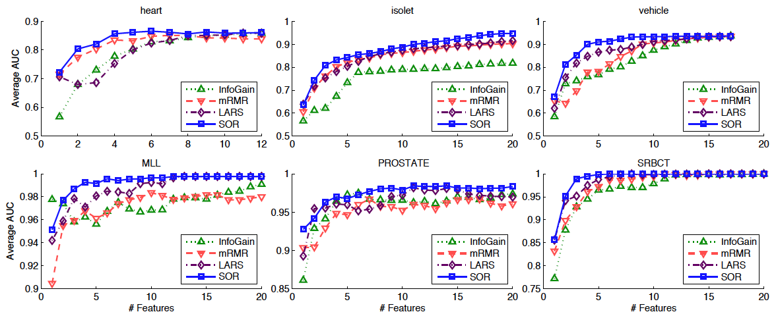
AUC Comparison

Slide 55
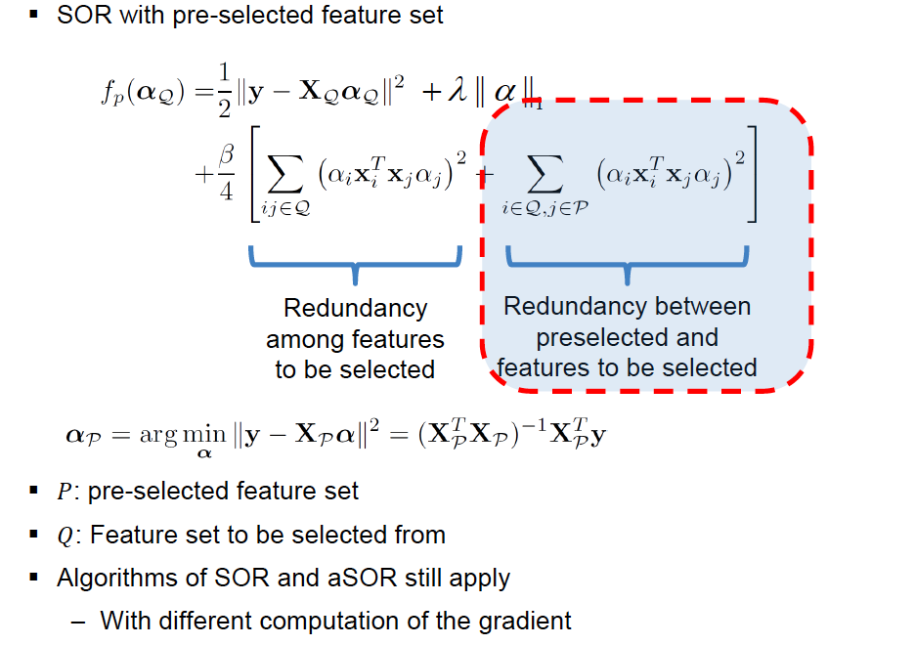
Augmented SOR

Slide 56
Performance of aSOR

Slide 57
Finding Relevance: Mining Clinical Notes
Clinical Notes
Symptom Identification
Identified Symptoms
Input
Symptom Graphs
Graph Construction
RWR Symptom Expansion
Related symptoms
SOAP sections of a Clinical Note
Output
Input
Initial symptoms
57
P. Sondhi, J. Sun, H. Tong, C. Zhai: SympGraph: a framework for mining clinical notes through symptom relation graphs. KDD 2012
Notes:
More recently, we have been exploring graph analytics to explore the rich knowledge from un-structured clinical notes.
Here is the current flowchart for mining soap section of the clinical notes. Given the original raw clinical notes, we first extract/identify the symptom from it, then we construct a so-called symptom graph, (basically based on their co-occurrence together with localition proximity). Then, given such a symptom graph, and some initial symptoms for a patient, we can identify more related symptom – symptom expanson
By symptom we really mean any (keywords) physical symptoms/medical conditions/diseases etc.

Slide 58
Mining Clinical Notes: Symptom Expansion
Key Idea: Symptom Expansion → graph node proximity.
i.e., which symptoms are most relevant to initial symptoms?
Heart Attack
Expanded
Wheezing
Expanded
Cough
Fever
Ankle Edema
Expanded
Rales
Chest Pain
Initial
Initial
58
Notes:
The key idea of symptom expansion is to turn it into a graph node proximity problem.
For example, in this illustrative symptom graph, given two initial symptoms (the red nodes), the related symptoms could be cough, chest pain and heart attack.

Slide 59
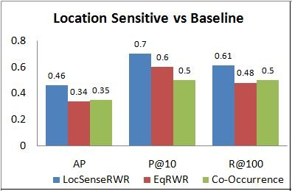
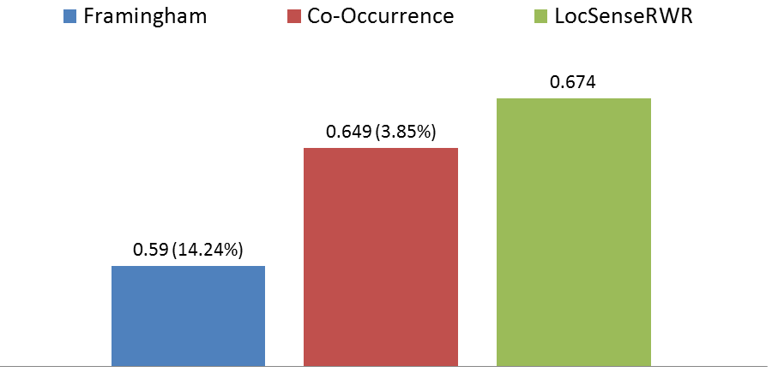
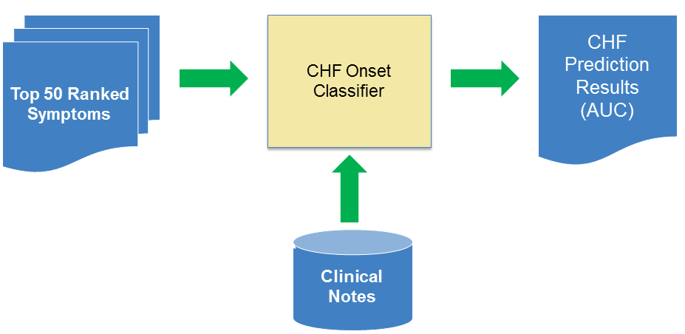
Framingham Symptom Expansion
Evaluations
[Parikshit+ KDD 2012]
Evaluation Details:
Experts: 2; 175 symptoms judged
Relevant: 72 , Irrelevant: 103
Inter-annotator agreement : 81.8%
Symptoms labeled as related by both experts were considered as relevant.
CHF Prediction (AUC)
Evaluation Details:
CHF： affecting 1 out of 5 adults in US; _{most costly in CMS}
_{Framingham, 1971 → 50s, 60s}
59
Notes:
CHF affecting 1 out of 5 US adult, the single most costly problem in (CMS) us centers of medicare and medicaid services
Framingham Symptom is established in 1971 based on clinical notes in 50s and 60s
We evaluated our method for framingham symptom expansion, and found that in most cases, it achieves a much higher precision and recall. When we evaluated it for CHF prediction, it also achieves much higher AUC.
CHF: congestive heart failure

Slide 60
Applications in Health Informatics
Patient Similarity Learning
Risk Factor Identification
Clinical Pattern Detection

Slide 61
Matrix Representation of a Patient
Fei Wang, Noah Lee, Jianying Hu, Jimeng Sun, Shahram Ebadollahi. Towards Heterogeneous Temporal Clinical Event Pattern Discovery:A Convolutional Approach. KDD 2012.
Fei Wang, Noah Lee, Jianying Hu, Jimeng Sun, Shahram Ebadollahi. A Framework for Mining Signatures from Event Sequences and Its Applications in Healthcare Data. TPAMI 2012.

Slide 62
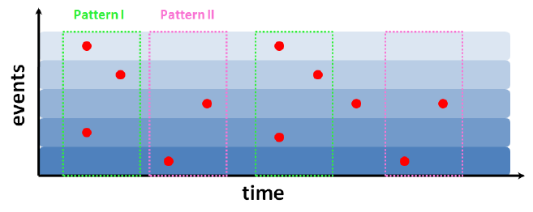
Temporal Patterns in Longitudinal Patient Records

Slide 63
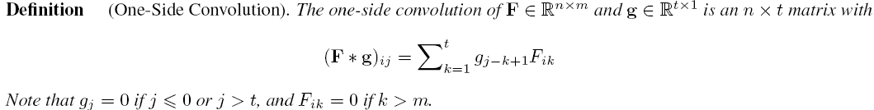
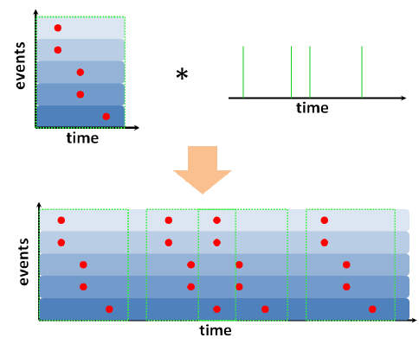
One-Side Convolution

Slide 64
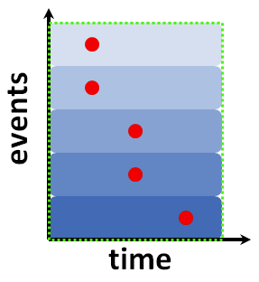
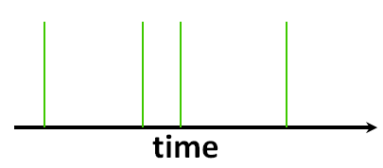
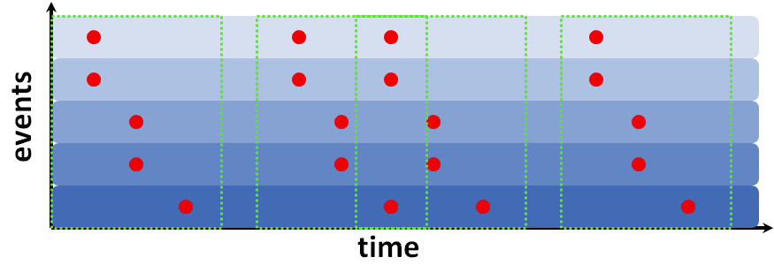

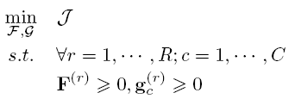
One-Side Convolutional NMF

Slide 65
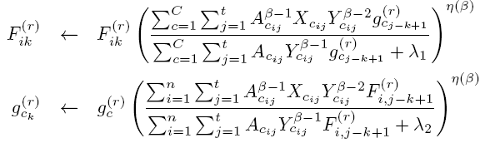
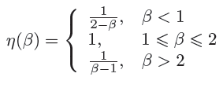
Multiplicative Updates

Slide 66
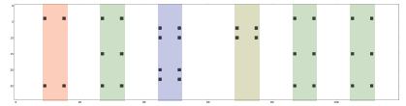
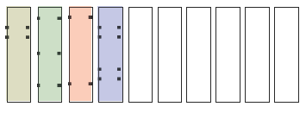
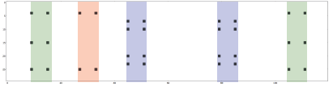
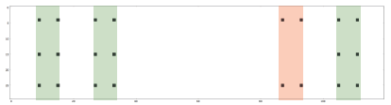
A Synthetic Example

Slide 67
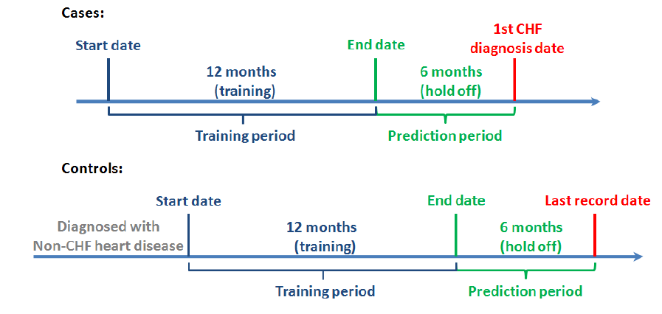
An Evaluation Case

Slide 68
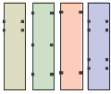



Bag-of-Pattern Representation
[ 1 3 1 1 ]
[ 0 2 1 2 ]
[ 0 3 1 0 ]

Slide 69
Results

Slide 70
Outline
Introduction
Overview of the Technologies
Applications in Health Informatics
Applications in Social Informatics
Conclusions and Future Works

Slide 71
Applications in Social Informatics
Finding Complex User Patterns
(Matrix-based) Anomaly Detection
Influence and Virus Propagation
71

Slide 72
Finding Commonality: Center-Piece Subgraph Discovery
[Tong+ KDD06, VLDB06, TKDE13]
Given: a graph W, and a query set
Find: the most central node (wrt the query set)
A
Q: Who is the most central node wrt the black nodes?
(e.g., master-mind criminal, common advisor/collaborator, etc)
B
C
Notes:
In the first application, the ceps

Slide 73
Center-Piece Subgraph Discovery
[Tong+ KDD06, VLDB06, TKDE13]
Input: original graph
Output: CePS
A
A
CePS Node
B
C
B
C
Q: How to find hub for nodes A, B, C?
Our Solution: Max (Prox(A, Red) x Prox(B, Red) x Prox(C, Red))

Slide 74
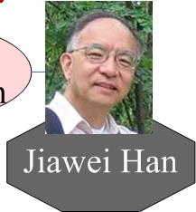
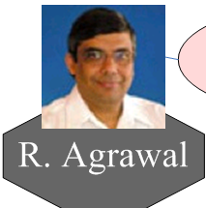



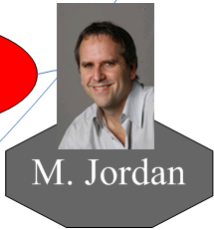


CePS: Example (AND Query)
?
DBLP co-authorship network:
  400,000 authors, 2,000,000 edges
Code at: http://www.cs.cmu.edu/~htong/soft.htm

Slide 75



CePS: Example (AND Query)
10
10
1
1
2
1
1
1
4
6
DBLP co-authorship network:
  400,000 authors, 2,000,000 edges
Code at: http://www.cs.cmu.edu/~htong/soft.htm

Slide 76
Negation: CePS - Initial Result
[ICDM08, CIKM09]
Text Mining
2
Tom M. Mitchell
1
Seán Slattery
Rebecca Hutchinson
1
1
1
1
1
Xuerui
Wang
Rayid Ghani
Andrew
Mccallum
1
1
Yiming
Yang
Jian Zhang
4
2
1
2
John D.
Laffterty
2
Zoubin
Ghahramani
Statistics
CePS between “Andrew Mccallum” and “Yiming Yang”

Slide 77
Negation: CePS – After Feedback
[ICDM08, CIKM09]
Andrew
Ng
7
Michael I.
Jordan
Rong
Jin
6
1
1
2
3
Andrew
Mccallum
2
John D.
Laffterty
2
Zoubin
Ghahramani
2
Yiming
Yang
1
2
2
4
2
4
Fernando
C.N. Pereira
Xiaojin
Zhu
Jian Zhang
CePS between “Mccallum” and “Yang”, avoiding “Mitchell”
entire ‘Text’ connection gone, and more connections on ‘Statistics’

Slide 78

Best-Effort Pattern Match [Tong+ KDD 2007]
Legends:
: Anonymous accounts
: Anonymous banks
How to detect abnormal transaction patterns?
(e.g., money-laundering ring)
7.5% of U.S. adults lost money for financial fraud
50%+ US corporations lost >= $500,000
  e.g., Enron ($70bn) [Albrecht+ 2001]
Total cost of financial fraud: $1trillion [Ansari 2006]
Notes:
7.5 percent of U.S. adults lost money as a result of some sort of financial fraud in 2008
http://www.consumeraffairs.com/news04/2009/03/financial_breach.html
Global financial crisis to cost $4 trillion: IMF
http://en.infoanda.com/link.php?lh=A1UCAgEBDAgH
A 2005 study by Glass Lewis found that investors lost almost $ 1 trillion during 1999-2004 due to accountancy related frauds.
http://www.pafkiet.edu.pk/LinkClick.aspx?fileticket=M%2BR1WW9MzjA%3D&tabid=153&mid=1540

Slide 79



Input
Query Graph
Output
W4. Best-Effort
Pattern Match
Data Graph
Matching Subgraph
Q: How to find matching subgraph?
A: Proximity![Tong+ KDD 2007 b]
Notes:
Here, we want to find ceo, sec, acc and manager, where the matching ceo talks to the matching sec and accountant, while the matching sec talks to the match manager so on and so forth. And we allow some interception, that is the connection between two matching nodes are not necessarily direct.
Imagine in such a scenario, where, the nodes are people & bank,…

Slide 80
G-Ray: How to?
matching node
matching node
matching node
matching node
Goodness = Prox (12, 4) x Prox (4, 12) x
Prox (7, 4) x Prox (4, 7) x
Prox (11, 7) x Prox (7, 11) x
Prox (12, 11) x Prox (11, 12)
May 1st-4th, 2013

Slide 81


Effectiveness: star-query
Databases
Intelligent Agent
Bio-medical
Query
Result
May 1st-4th, 2013
Notes:
Here is a star-query, we want to a star-shape group of co-authors, with one author coming from each of PODS, IAT and ISBMS. We see Dr. Phillips Yu is in the center and the rest matching authors being well known domain experts in each conf.

Slide 82
Team Replacement [Tong+ SDM12b, WIDS12]
Problem Definitions
Given: (1) A social network A; (2) The skill indicator for each person S; (3) a Team T; and (4) A team member;
Find: A “best” alternate t to replace i’s role in the team T.
7
5
6
1
Current Team T
3
8
2
4
9
Q: Who is the best alternative of `5’ in T ?
A: Team-Aware Similarity!
May 1st-4th, 2013
SDM 2013, Austin, Texas
82
Notes:
If we want to recommend person B as ”alternative” to Person A, in a Team T, we will say it is a good recommendation if B is ’similar’ to A, in the sense
that (1) B has similar expertise as A in the context of team T (2) B has similar network structure as A in the context of team T
We can further specify the above two types of similarities: (1) B has similar expertise as A in the context of team T, if B has the same subset of skills as A which matter
team T (i.e., if A has skills on HCI, data mining, system, hardware and only the skills of HCI, data mining are important to team T, we will say B is a good alternative in
terms of expertise similarity as long as s/he matches these two specific skills (i.e., we do not care what kinds of other skills s/he has). (2) B has similar network structure as
A in the context of team T, if B plays a similar role as A in connecting with the other team members (e.g., either a central lead, or leaf node, etc) as well as in connecting the
team with the rest of the world.
Problem 1 (Team Alternative/Replacement)
Given: (1) A social networkAn×n describing the relationship between n persons (i.e., A is the connectivity matrix); (2) A skill indicator table/matrix Sn×l, with each
S(i, j) being the strength of ith person wrt the jth skill and l is the total number of skill; (3) a team T which is a group of people; and (4) a team member i0 from
T who for some reason will leave the team.
Output: A “best” alternative person t who can serve the similar role of person i0 in team T .
82

Slide 83


Team Replacement
Key Observation: Graph Kernel → Team-Aware Similarity
Our Contributions: A Family of Fast Algorithms for Random Walk based Graph Kernel.
Input Graphs | Time Complexity (Our methods) | Time Complexity (Existing methods)
Normalized, unlabelled | O(n²r⁴+r⁶+mr) | O(n³)
Unnormalized, unlabelled | O(nr+r²+mr) | O(n³)
Normalized, labelled | O(d_{n}n²r⁴+r⁶+mr) | O(m²i_{F})
Unnormalized, labelled | O(d_{n}n²r⁴+r⁶+mr) | O(m²i_{F})
efficiency
accuracy
Complexity Comparison
Empirical Evaluations
Notes:
83

Slide 84



Sense-Making of Marked Nodes [Akoglu+ SDM 2013]
(a) Too many connections?
(c) Our sol.: ‘right’ connections
→ better sense-making
+ ‘right’ connections = most succinct way to describe marked nodes
+ MDL-based formulation, NP-Hard
+ Effective Approximate Algorithms
(b) Too few connections?
L. Akoglu, J. Vreeken, H. Tong, D. Chau, N. Tatti, and C. Faloutsos： Mining Connection Pathways for Marked Nodes in Large Graphs. SDM 2013
84
84
Notes:
A very powerful tool for this purpose is the matrix factorization for the adjacency matrix of the graph A, that is, we want to decompose the adjacency matrix A by the multiplication of two low-rank matrices F & G, plus some residual matrix R, where F and G are often good indicator for finding regular patterns, such as communities, and the residual matrix R is often a good indicator for irregular pattern, i.e., anomalies.
For example…
A recent trend is to improve the usability/interpretation for the discovered graph pattern by imposing some additional constraints on the factorization,
(largely in many real applications, the ground-truth does not exist, and the data analyst has to spend a lot of time to interpret the results).
It is now widely realized that non-negativity is a high desired property for interpretation. For the task of community detection, non-negative matrix factorization (by restricting the two low-rank matrices F and G to be non-negative) often lead to part/sub-community-based results.
However, little, if any, is known for the task of anomaly detection. Can we impose the non negative constrains on the residual matrix R, instead of, the two low-rank matrices F & G to improve the usability of anomaly detection. For example, if the residual matrix R is non-negative, we can present the result as an intuitive residual graph, instead of an abstract residual matrix which may contain both positive and negative values, for the data analyst to consume the detection result. This is exactly the main contribution of this disclosure.

Slide 85
Applications in Social Informatics
Finding Complex User Patterns
(Matrix-based) Anomaly Detection
Influence and Virus Propagation
85

Slide 86

Graph Anomalies by Low-Rank Approximation
Q: How to get the low-rank matrix approximations?

Slide 87
Graph Anomalies by Low-Rank Approximation
Q: How to get the low-rank matrix approximations?
A1: Example-based LRA
A2: Non-negative Residual Matrix Factorization

Slide 88
A1: Example-Based LRA
Why Not SVD, PCA? both transform data into some abstract space (specified by a set basis)
  Interpretability problem
  Loss of sparsity (space cost)
  Efficiency (time cost)

Slide 89
A1: Example-Based LRA -- CUR/CX
Example-based projection: use actual rows and columns to specify the subspace
Given a matrix A∈R^{m×n}, find three matrices C∈ R^{m×c}, U∈ R^{c×r}, R∈ R^{r× n} , such that ||A-CUR|| is small
Two recent variants:
  CMD: removing duplicates
  Colibri: removing linear correlations (and tracking)
Example-based
U is the pseudo-inverse of X: U = X† = (U^{T} U )⁻¹ U^{T}
H. Tong, S. Papadimitriou, J. Sun, P.S. Yu, C. Faloutsos: Colibri: fast mining of large static and dynamic graphs. KDD 2008
J. Sun, Y. Xie, H. Zhang, C. Faloutsos: Less is More: Compact Matrix Decomposition for Large Sparse Graphs. SDM 2007
P. Drineas, R. Kannan, M.W. Mahoney: Fast Monte Carlo Algorithms for Matrices II: Computing a Low-Rank Approximation to a Matrix. SIAM J. Comput. (SIAMCOMP) 2006

Slide 90




A Pictorial Comparison
SVD
# of copies
CUR
[Drineas+ 2005]
CMD
[Sun+ 2007]
Colibri-S
[Tong+ 2008]

Slide 91

SVD
SVD
Performance Comparison
Accuracy
  Same 91%+
Time
  12x of CMD
  28x of CUR
Space
  ~1/3 of CMD
  ~10% of CUR
CUR
CUR
CMD
Colibri
CMD
Colibri
Time
Space
Notes:
CMD is an improved version of cur.
Both cur and cmn are special case of colibri-S
We do not present the result by svd, since for the same reconstruction accuracy, svd needs more time & space than cur

Slide 92

A2: Non-negative Residual MF
Observations: anomalies ←→ actual activities
Examples: popularity contest, port scaner, etc
NrMF formulation
_{Weighted Frobenius Form}
Common in Any MF
Weight
_{Unique in NrMF}
_{Non-negative residual}
H. Tong, C. Lin: Non-Negative Residual Matrix Factorization with Application to Graph Anomaly Detection. SDM 2011

Slide 93

Visual Comparisons
Original
NrMF
SVD
Original
NrMF
SVD

Slide 94
Applications in Social Informatics
Finding Complex User Patterns
(Matrix-based) Anomaly Detection
Influence and Virus Propagation
94

Slide 95


An Example: Flu/Virus Propagation
Sick
Healthy
Contact
1: Sneeze to neighbors
2: Some neighbors → Sick
3: Try to recover
Q: How to minimize infected population?
- Q1: Understand tipping point
- Q2: Affecting algorithms

Slide 96



Why Do We Care?
Email Fwd in Organization
Rumor Prop on Twitter in UK riots
Viral Marketing
Malware Infection
Notes:
http://www.guardian.co.uk/uk/interactive/2011/dec/07/london-riots-twitter

Slide 97







SIS Model (e.g., Flu)
p_{t+1} = H (p_{t})
Infection Ratio
Theorem [Chakrabarti+ 2003, 2007]:
Ifλ x (β/δ) ≤ 1; no epidemic
for any initial conditions of the graph)
, δ : virus par
Time Ticks
λ: largest eigenvalue of the graph (~ connectivity of the graph)
β, δ : virus parameters (~strength of the virus)
Generalize to ~ 25 other models; to partial immunity; to dynamic networks

Slide 98



Why is λ So Important?
λ → Capacity of a Graph:
1
1
2
1
2
2
Larger λ → better connected

Slide 99

Minimizing Propagation: Immunization
Given: a graph A, virus prop model and budget k;
Find: k ‘best’ nodes for immunization.
23
16
24
15
12
14
25
22
13
26
11
21
27
9
34
20
10
1
28
4
8
33
19
2
29
3
7
18
5
30
6
17
31
32
99
SARS costs 700+ lives; $40+ Bn; H1N1 costs Mexico $2.3bn
Notes:
http://en.wikipedia.org/wiki/Severe_acute_respiratory_syndrome
http://www.independent.co.uk/news/business/news/sars-costs-asia-11bn-and-the-bill-is-still-rising-594954.html
http://news.yahoo.com/s/ynews/20090428/bs_ynews/ynews_bs317
99

Slide 100

Minimizing Propagation: Immunization
Given: a graph A, virus prop model and budget k;
Find: k ‘best’ nodes for immunization.
23
16
24
15
12
14
25
22
13
26
11
21
27
9
34
20
10
1
28
4
8
33
19
2
29
3
7
18
5
30
6
17
31
32
100
SARS costs 700+ lives; $40+ Bn; H1N1 costs Mexico $2.3bn
Notes:
http://en.wikipedia.org/wiki/Severe_acute_respiratory_syndrome
http://www.independent.co.uk/news/business/news/sars-costs-asia-11bn-and-the-bill-is-still-rising-594954.html
http://news.yahoo.com/s/ynews/20090428/bs_ynews/ynews_bs317
http://www.stimson.org/globalhealth/?SN=GH200905112048
We find that closing all schools in the U.S. for four weeks could cost between $10 and $47 billion dollars (0.1-0.3% of GDP) and lead to a reduction of 6% to 19% in key health care personnel.
100

Slide 101

Optimal Method
Select k nodes, whose absence creates the largest drop in λ
λ-λ_{s}
9
9
11
9
10
10
1
1
4
4
8
8
2
2
3
7
3
7
5
5
6
6
Original Graph: λ
Without {2, 6}: λ_{s}

Slide 102

Optimal Method
Select k nodes, whose absence creates the largest drop in λ
But, we need in time
  Example: 1,000 nodes, with 10,000 edges
    It takes 0.01 seconds to compute λ
    It takes 2,615 years to find best-5 nodes !
λ-λ_{s}
Largest eigenvalue
w/o subset of nodes S
Theorem: (Tong+ CIKM 2012)
Find Optimal k-node Immunization is NP-Hard
102
Notes:
We can show that by the reduction from the independent node set problem

Slide 103

Netshield to the Rescue
Theorem: (Tong+ 2010)
(1) λ - λ_{s}≈Sv(S)= ∑_{iєS} 2λu(i)²-∑_{i,jєS} A(i,j)u(i)u(j)
A
u
u
=λ X
u(i): eigen-score
Footnote: u(i) ~ PageRank(i) ~ in-degree(i)

Slide 104



Netshield to the Rescue
Intuition
Theorem: (Tong+ 2010)
(1) λ - λ_{s}≈Sv(S)= ∑_{iєS} 2λu(i)²-∑_{i,jєS} A(i,j)u(i)u(j)
find a set of nodes S (e.g. k=4), which
  (C1) each has high eigen-scores
  (C2) diverse among themselves
Original Graph
Select by C1
Select by C1+C2

Slide 105
Netshield to the Rescue
Theorem: (Tong+ ICDM 2010)
(1) λ - λ_{s}≈Sv(S)= ∑_{iєS} 2λu(i)²-∑_{i,jєS} A(i,j)u(i)u(j)
(2) Sv(S) is sub-modular (+monotonically non-decreasing)
Example: 1,000 nodes, with 10,000 edges
  Netshield takes < 0.1 seconds to find best-5 nodes !
  … as opposed to 2,615 years
Corollary: (Tong+ ICDM 2010)
(3) Netshield is near-optimal (wrt max Sv(S))
(4) Netshield is O(nk²+m)
105
Footnote: near-optimal means Sv(S ^{Netshield}) >= (1-1/e) Sv(S ^{Opt})

Slide 106

Comparison of Immunization
Log(fraction of infected nodes)
(better)
Abnormality
PageRank
Between (short)
Degree
Between (RW)
Acquaintance
Netshield
Eigs (=HITS)
Time Ticks

Slide 107


Hospital Infection Controlling
(US-Medicare Network)
Current Method
Out Method
Red: Infected Hospitals after 365 days
Using a variant of Netshield (adapting to partial immunity)
B.A. Prakash, L. Adamic, T. Iwashynaz, H. Tong and C. Faloutsos: Fractional Immunization in Networks. SDM 2013.

Slide 108
Maximizing Propagation: Edge Addition
[Tong+ CIKM 2012]
Given: a graph A, virus prop model and budget k;
Find: add k ‘best’ new edges into A.
By 1st order perturbation, we have
  λ_{s} - λ ≈Gv(S)= c ∑_{eєS} u(i_{e})v(j_{e})
So, we are done → need O(n²-m) complexity
Left eigen-score
of source
Right eigen-score
of target
Low Gv
High Gv

Slide 109


Maximizing Propagation: Edge Addition
λ_{s} - λ ≈Gv(S)= c ∑_{eєS} u(i_{e})v(j_{e})
Q: How to Find k new edges w/ highest Gv(S) ?
A: Modified Fagin’s algorithm
k
#2: Sorting
Targets by v
k+d
#3:
Search
space
Search
space
k
k+d
#1: Sorting
Sources by u
Time Complexity: O(m+nt+kt²), t = max(k,d)
:existing edge

Slide 110

Maximizing Propagation: Evaluation
Log (Infected Ratio)
(better)
Time Ticks

Slide 111
Influence & Virus Propagation: Summary
Goal: Guild Dissemination by Opt. Link Structure
Theory: Opt. Dissemination = Opt. λ
Algorithms:
  Netshield to Minimize Dissemination
  NetGel to Maximize Dissemination
More on This Topic
  Beyond Link Structure (content, attribute) [WWW11]
  Beyond Full Immunity [SDM13b]
  Higher Order Variants [CIKM12a]
  Equivalence (node deletion vs. edge deletion) [CIKM12a]
  Immunization on Dynamic Graphs [PKDD10]

Slide 112
Conclusion & Remarks
Clinical Patterns
Similar Patient
Symptom Exp’
Risk Factor
Immunization
C’ Patterns
Anomalies
Influ’ Prop
Tools
Prox.
LRA
Sparse L’
Large L’
Eigen. Opt.
Social Networks
Healthcare

Slide 113
Conclusion
Recent Advances in Applied Matrix Technologies
  Low rank approximation
  Sparse learning
  Large scale learning
Applications in healthcare informatics
Applications in social informatics

Slide 114
backup

Slide 115




Matrices in Social Networks [Koutra+ 2013]
Same or “similar” users?
Research Qs: Can we identify users across social networks?
Matrices: rows/columns: people; entries: friendship
Matrix Tools: graph alignment
115

Slide 116

Matrices in Healthcare
How to identify clinically similar patients?
How to utilize EMR data to perform predictive modeling?
How to characterize the progression course of a specific disease?

Slide 117


Recent Advance #3: Prox. on H. Networks
NetClus
KDD
PathSim
Venue
Paper
Author
VLDB
GenSim
RWR: Path w/ Different Length Meta Path: Path w/ Different Types
Y. Sun, B. Norick, J. Han, X.Yan, P.S. Yu, and X. Yu: Integrating Meta-Path Selection with User-Guided Object Clustering in Heterogeneous Information Networks.KDD'12
Y. Sun, J. Han, X. Yan, P. S. Yu, and T. Wu: PathSim: Meta Path-Based Top-K Similarity Search in Heterogeneous Information Networks. PVLDB 2011
K. Chiang, N. Natarajan, A. Tewari, I. S. Dhillon: Exploiting longer cycles for link prediction in signed networks. CIKM 2011
Notes:
In rwr, we count the paths with different lengths on a homogenous graph as the base to measure proximity → correponding two matrix power (the multiplication of the matrix with itself)
We the network has rich structure, e.g., different types of nodes – the so-called . We can generalize this idea by

Slide 118

Recent Advance #4: Scale-Up
U. Kang, H. Tong, J. Sun, C. Lin, C. Faloutsos: GBASE: a scalable and general graph management system. KDD 2011
U. Kang, C. Tsourakakis, C. Faloutsos: PEGASUS: mining peta-scale graphs. KAIS 2011
Notes:
U. Kang, H. Tong, J. Sun, C. Lin, C. Faloutsos: GBASE: a scalable and general graph management system. KDD 2011: 1091-1099
U. Kang, H. Tong, J. Sun, C. Lin, C. Faloutsos: gbase: an efficient analysis platform for large graphs. VLDB J. 21(5): 637-650 (2012)
U. Kang, C. Tsourakakis, C. Faloutsos: PEGASUS: mining peta-scale graphs. KAIS 2011

Slide 119




Recent Advance #4: Scale-Up
_{Storage Savings}
_{Scalability (size of graph)}
_{Running Time Savings}
_{Scalability (# of Machine)}
U. Kang, H. Tong, J. Sun, C. Lin, C. Faloutsos: GBASE: a scalable and general graph management system. KDD 2011
U. Kang, C. Tsourakakis, C. Faloutsos: PEGASUS: mining peta-scale graphs. KAIS 2011

Slide 120

Learning W:
w: the parameter to learn
h: loss function to penalize the violation
v₁
v₂
h(x)
x²
s
Loss
v₃
x
positive examples
negative examples
p_{l} < p_{d}
p_{l}=p_{d}
p_{l} > p_{d}
s: be the center node; l: destination; d: no-link
edge strength a_{uv} = f_{w}(u,v) = exp(-w^{T}Ψ_{uv})
feature vector Ψ_{uv} (Features of node u; Features of node v; Features of edge (u,v)
Thanks to Jure Leskovec: Social Media Analytics (KDD '11 tutorial)

Slide 121
Link Prediction
i
i
i
i
i
i
i
i
Prox (deleted) >> Prox (absent) !
Footnote:
- Red pair: ``deleted’’;
- Blue pair: ``absent’’

Slide 122
Experimental setting
Node and Edge features for learning:
  Node:
    Age; Gender; Degree
  Edge:
    Age of an edge; Communication; Profile visits; Co-tagged photos
Baselines:
  Decision trees and logistic regression:
    Above features + 10 network features (PageRank, common friends)
Evaluation:
  AUC and precision at Top20
Thanks to Jure Leskovec: Social Media Analytics (KDD '11 tutorial)

Slide 123

Results: Facebook Iceland
Facebook: predict future friends
  Adamic-Adar already works great
  Logistic regression also strong
  SRW gives slight improvement
Thanks to Jure Leskovec: Social Media Analytics (KDD '11 tutorial)

Slide 124

Results: Co-authorship
Arxiv Hep-Ph collaboration network:
  Poor performance of unsupervised methods
  Logistic regression and decision trees don’t work to well
  SRW gives 10% boos in Prec@20
124
Thanks to Jure Leskovec: Social Media Analytics (KDD '11 tutorial)

Slide 125


Computing CePS Score (AND)
details
r_{A}
r_{B}
r_{C}
= x x
Normalized adj.
matrix : W
Proximity matrix:
Q=(I-cW)⁻¹
CePS Score:
r_{ceps}= x x
r_{A}
r_{B}
r_{C}

Slide 126


Graph Anomalies by Proximity
[Sun+ ICDM 2005]
normal
Normality Score
abnormal
Normality Score = Average proximity among neighbors
→ Essentially tries to find bridging nodes/edges
J. Sun, H. Qu, D. Chakrabarti, C. Faloutsos: Neighborhood Formation and Anomaly Detection in Bipartite Graphs. ICDM 2005
Notes:
In this relatively simple case, the

Slide 127

Graph Anomalies by Proximity
Query Graph
Resulting Matching subgraph
Transaction Network
Given: a query graph (pattern) Find: best matching subgraph
Blue Node: anonymous account; Purple Node: Anonymous banks; Edge: Transaction
H. Tong, C. Faloutsos, B. Gallagher, T. Eliassi-Rad: Fast best-effort pattern matching in large attributed graphs. KDD 2007
127
Notes:
Money laundry ring
127

Slide 128



Graph Anomalies by Belief Propagation
The bad guys (humans) create 2 types of users
  Accomplice
    Trade mostly with honest users
    Looks legitimate
  Fraudster
    Trade mostly with accomplices
    Don’t trade with other fraudsters
Node: account; Edge: Positive Rating. (Graph constructed from e-bay on-line auction data)
S. Pandit, D. H. Chau, S. Wang, C. Faloutsos: Netprobe: a fast and scalable system for fraud detection in online auction networks. WWW 2007: 201-210
128
Notes:
Collusion type of fraud from on-line auction (ebay)
128

