Slide 1
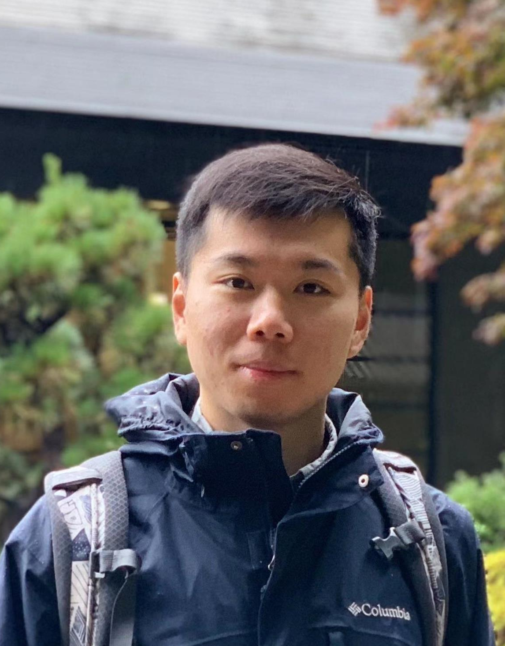
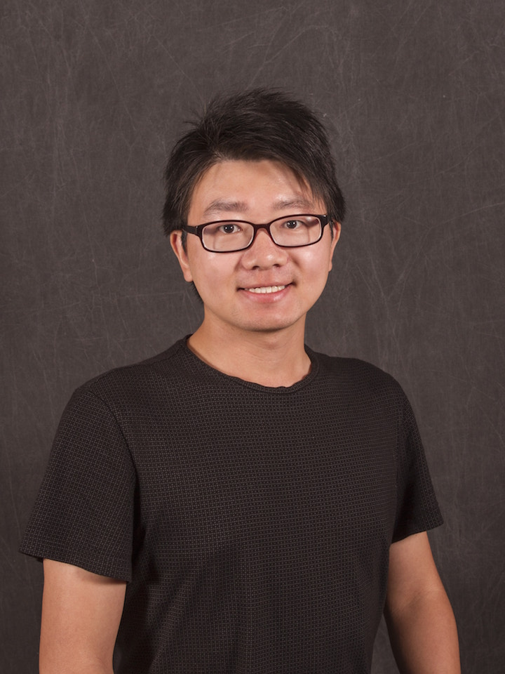
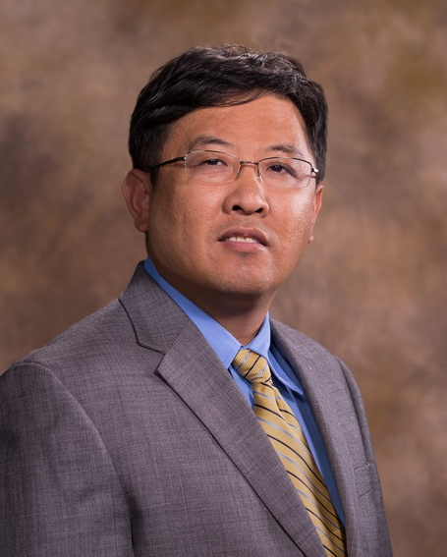
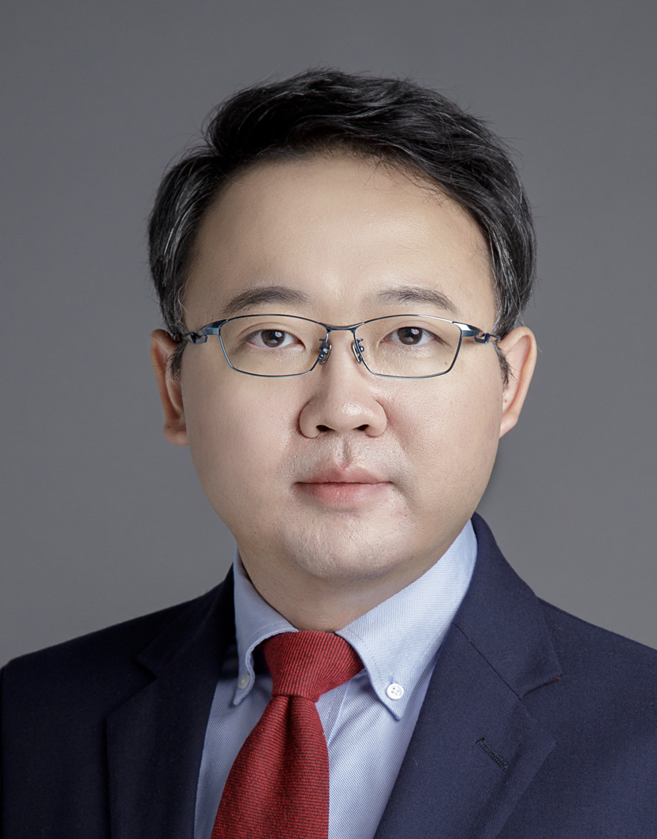
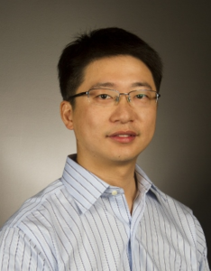
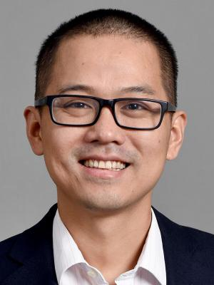
ATTENT: Active Attributed Network Alignment
Presented by Qinghai Zhou
University of Illinois at Urbana-Champaign
Qinghai Zhou
Liangyue Li
Xintao Wu
Nan Cao
Lei Ying
Hanghang Tong
(UIUC)
(Alibaba)
(UArk)
(Tongji Univ.)
(UMich)
(UIUC)

Slide 2
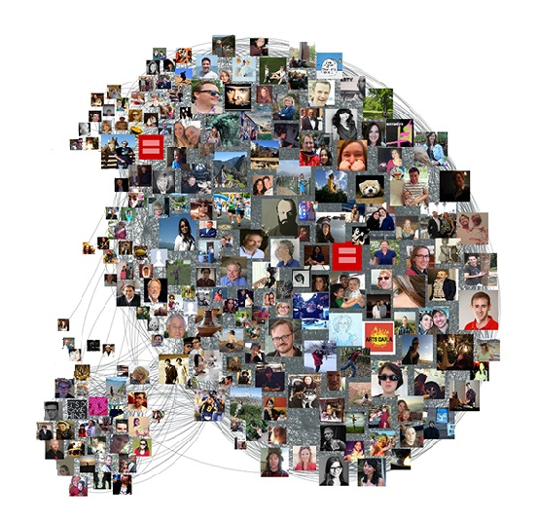
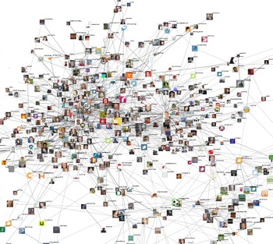
Network Alignment
Finding a similar/same user
Network A: Facebook
Network B: Twitter
Goal: finding someone like you in another social network
Zhang, S., & Tong, H. Final: Fast attributed network alignment. KDD 2016.
2
Notes:
Another interesting problem would be given two social networks, such as facebook and twitter, we want to align similar or same users across these two networks based on the consistency of topology and attribute information. If you already have a desired pattern for a small network, we want to find the best matched subgraph from a large real network.

Slide 3
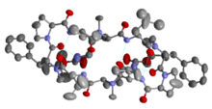
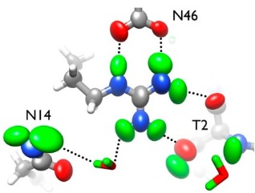
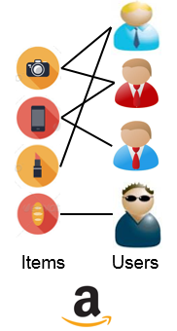
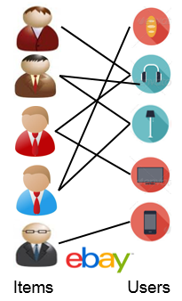
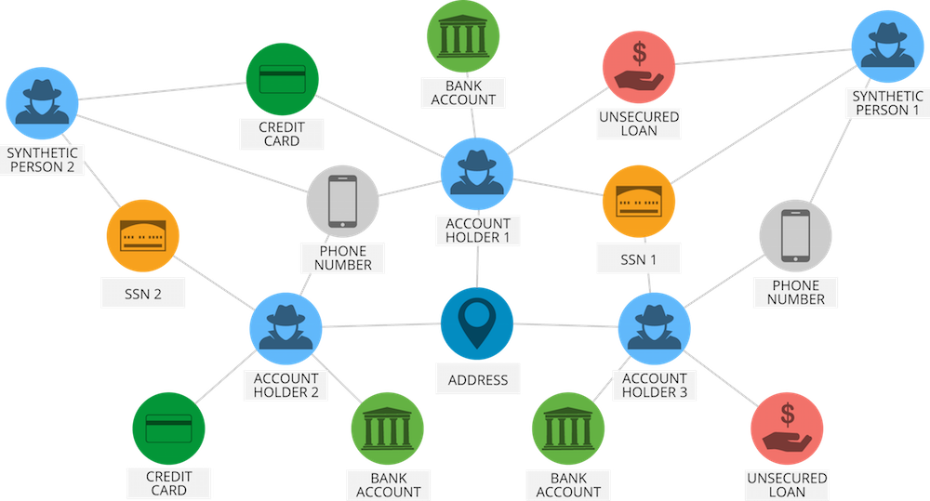
More Applications
A
1
B
5
E
6
2
D
C
4
3
Social network A
Social network B
PPI network A
PPI network B
Social Science[1]
Biology[2]
Recommendation[3]
Finance[4]
[1] Zhang, J., & Yu, P.S. (2015). Multiple Anonymized Social Networks Alignment. 2015 ICDM.
[2] Clark, C., & Kalita, J. (2014). A comparison of algorithms for the pairwise alignment of biological networks. Bioinformatics.
[3] Zhang, Y. (2014). Browser-oriented universal cross-site recommendation and explanation based on user browsing logs. RecSys '14.
[4] Vlasselaer, Véronique Van et al. “APATE: A novel approach for automated credit card transaction fraud detection using network-based extensions.” Decis. Support Syst. 75 (2015)
3

Slide 4
Network Alignment: How
Existing Approaches
Static: FINAL[1], NetAlign[2], IsoRank[3]
Key idea:
topology and attribute consistency.
1
2
1’
2’
6
6’
3’
3
5
4
5’
4’
$$Loss=\sum_{a,b,x,y}{{\left[\frac{X\left(x,a\right)}{\sqrt{f\left(x,a\right)}}−\frac{X\left(y,b\right)}{\sqrt{f\left(y,b\right)}}\right]}^{2}A_{1}\left(a,b\right)A_{2}\left(x,y\right)} \\ ×1\left(N_{1}\left(a,a\right)=N_{2}\left(x,x\right)\right)1\left(N_{1}\left(b,b\right)=N_{2}\left(y,y\right)\right)$$ $×1\left(E_{1}\left(a,b\right)=E_{2}\left(x,y\right)\right)$
1. Topology Consistency
2. Node Attribute Consistency
3. Edge Attribute Consistency
[1] Zhang, S., & Tong, H. Final: Fast attributed network alignment. KDD 2016.
[2] Bayati, M. et al. “Message-Passing Algorithms for Sparse Network Alignment.” TKDD.
[3] Singh, R. et al. “Global alignment of multiple protein interaction networks with application to functional orthology detection.” National Academy of Sciences (2008).
4

Slide 5
Network Alignment: How
Existing Approaches
Active: Matching-based
Key idea: actively query the uncertain nodes; quantify the uncertainty from sampled matchings.
A1
A2
B1
B2
C1
C2
C3
1
A1
A2
M1
2
B1
B2
Sample of matchings
1
2
3
3
M2
C1
C2
C3
G1
G2
A1
A2
B1
B2
C1
C2
C3
Malmi, Eric et al. “Active Network Alignment: A Matching-Based Approach.” CIKM, 2017.
5
Notes:
Bipartite matching problem

Slide 6
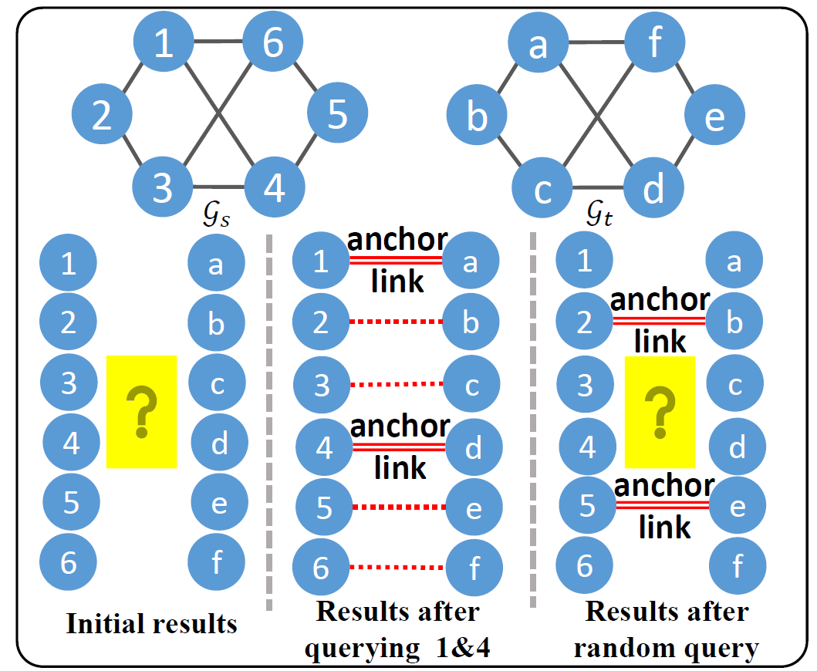
Active Network Alignment: Limitation
Limitations:
Direct influence of query is under-explored;
Efficiency: sampling matchings.
Observation:
Queries (anchor links) have different impact to the alignment results.
Question: what is a good strategy to select essential nodes to query?
Querying 1 and 4 is more helpful
6

Slide 7
Roadmap
Motivations
ATTENT Algorithms
Experimental Results
Conclusions
7

Slide 8
Preliminaries
Attributed Network Alignment
Given two attributed networks, $𝒢_{s}=\{A_{s}, N_{s}, E_{s}\}$ and $𝒢_{t}=\{A_{t}, N_{t}, E_{t}\}$,
$$x=α\tilde{W}x+\left(1−α\right)h$$
1’
2’
3’
4’
1
3’
1
Reshaping solution vector $x$:
2
2’
2
3
4
1’
4’
3
Encoding topology/attribute consistency
4
Alignment preference: anchor links
$$\tilde{W}=D^{−\frac{1}{2}}{WD}^{−\frac{1}{2}}$$
$$W=N_{×}\left(E_{×}⊙A_{×}\right)N_{×}$$
e.g., $A_{×}=A_{1}⊗A_{2}$
$H(i,j)$: prior knowledge of how similar node i and node j are
Zhang, S., & Tong, H. Final: Fast attributed network alignment. KDD 2016.
8

Slide 9
Preliminaries (cont.)
Active learning
Key idea: iteratively query an oracle to label new data points.
Strategies: uncertainty-based, expected model change (error reduction, performance gain)
?
?
large uncertainty:
close to the boundary
9
Notes:
Sylvester equation plays a central role in the network mining problem, for example, given two attributed network G_1 and G_2

Slide 10
Prob. Def.:
Active Attributed Network Alignment
Given:
(1) a pair of networks $𝒢_{s}$and $𝒢_{t}$;
(2) an initial preference matrix $H_{0}$;
(3) a query budget k;
(4) an oracle to annotate;
(5) a utility function for $f(x)$.
Find: a set of k most influential nodes for the oracle to annotate;
Goal: maximize the alignment accuracy for the remaining nodes
10
Notes:
Sylvester equation plays a central role in the network mining problem, for example, given two attributed network G_1 and G_2

Slide 11
Evaluating the Informativeness
Key idea: finding a set of informative nodes to query with significant query feedback.
Question
How to define the informativeness of query?
Potential Solution
Quantify the informativeness of queries by influence function.
Description | Function $f(⋅)$
Squared L2 norm | $$f\left(x\right)={{\left|\left|x\right|\right|}_{2}}^{2}$$
Entropy | $$f\left(x\right)={\left|\left|x⊙\log{x}\right|\right|}_{1}$$
log represents element-wise logarithmic;
We define $0log0=0$.
11
Notes:
After having the closed form solution of the Sylvester equation, we can further represent the results of several multi network mining tasks by a function f, the random walk graph kernel is a multiplication of the Kronecker product q\times and the vectorized solution matrix X

Slide 12
Defining Query Influence
Querying whether node i and j are true alignment
For a given utility function, $f\left(x\right)$,
Node pair query influence:
$ℐ\left(q_{ij}\right)=\frac{∂f(x)}{∂H\left(i,j\right)}$
Node query influence:
$ℐ\left(q_{j}\right)=\sum_{i}{ℐ(q_{ij})}$
Question
How to compute the query influence?
$$H\left(2,2′\right)$$
1
2
1’
2’
6
3
6’
3’
5
4
5’
4’
12
Notes:
After having the closed form solution of the Sylvester equation, we can further represent the results of several multi network mining tasks by a function f, the random walk graph kernel is a multiplication of the Kronecker product q\times and the vectorized solution matrix X

Slide 13
Calculating Query Influence
Let $f\left(x\right)={{\left|\left|x\right|\right|}_{2}}^{2}$, for node pair query influence,
Applying chain rule:
$ℐ\left(q_{ij}\right)=\frac{∂f(x)}{∂H\left(i,j\right)}=[\frac{∂f\left(x\right)}{∂x}]′\frac{∂x}{∂H\left(i,j\right)}$
We get $ℐ\left(q_{ij}\right)=2P\left(k,:\right)x$
For node query,
$k_{1}=\left(j−1\right)n_{t}+i, k_{2}=jn_{t}$
$${(1−α)\left(I−α\tilde{W}\right)}^{−1}h=Ph$$
$$k=\left(j−1\right)n_{t}+i$$
$$P$$
$$x$$
$$×$$
$$ℐ\left(q_{j}\right)=2{\left|\left|P\left(k_{1}:k_{2},:\right)x\right|\right|}_{1}$$
$$k$$
$$P$$
$$x$$
$$k_{1}$$
$$×$$
$$k_{2}$$
13

Slide 14
Calculating Query Influence
The derivation for entropy utility function is similar.
Equations for query influence are summarized as follows.
Utility function | Node pair $(i,j)$ query Influence | Node $(j)$ query influence
Squared L2 norm | $$2P\left(k,:\right)x$$ | $$2{\left|\left|P\left(k_{1}:k_{2},:\right)x\right|\right|}_{1}$$
Entropy | $$−P\left(k,:\right)(log\left(x\right)+1)$$ | $${\left|\left|P\left(k_{1}:k_{2},:\right)(log\left(x\right)+1)\right|\right|}_{1}$$
Where $k=\left(j−1\right)n_{t}+i, k_{1}=\left(j−1\right)n_{t}+1,k_{2}=jn_{t}, P={(1−α)\left(I−α\tilde{W}\right)}^{−1}$
Observation: computing the vector $Px$.
Denote $y=Px⇔y=α\tilde{W}y+\left(1−α\right)x$
Node query influence: $ℐ\left(q_{j}\right)={\left|\left|y_{k_{1}:k_{2}}\right|\right|}_{1}$
14
Notes:
After having the closed form solution of the Sylvester equation, we can further represent the results of several multi network mining tasks by a function f, the random walk graph kernel is a multiplication of the Kronecker product q\times and the vectorized solution matrix X

Slide 15
Speed-up Computation
Challenges in computation
C1: updating the alignment solution vector, i.e., $x$.
C2: updating the $y$ vector.
Solution (ATTENT-Fast)
According to Kronecker Krylov subspace method [1],
$x=α\tilde{W}x+\left(1−α\right)h$ can be solved in linear time.
At each iteration, first compute $x$.
Replace $h$ with the updated $x$.
[1] Du, B., & Tong, H., FASTEN: Fast Sylvester Equation Solver for Graph Mining. KDD, 2018.
15
Notes:
After having the closed form solution of the Sylvester equation, we can further represent the results of several multi network mining tasks by a function f, the random walk graph kernel is a multiplication of the Kronecker product q\times and the vectorized solution matrix X

Slide 16
ATTENT Algorithm
Goal: to select a set of influential nodes to query.
Initialize: query node set $Q=Ø$, query pool $J=V_{s}$.
Greedy strategy:
At each iteration, update $x$;
Select one batch of nodes with the largest influence;
Query the selected batch of nodes;
Update $H$
Return:
Alignment results for the remaining nodes and set $Q$.
1
2
$$J=\left\{1,2,3,4,5,6\right\}$$
$$Q=\{ \}$$
6
Query 1&4
($b=2$)
5
4
3
$$J=\left\{2,3,5,6\right\}$$
$$Q=\{1,4\}$$
$$G_{s}$$
16
Notes:
After having the closed form solution of the Sylvester equation, we can further represent the results of several multi network mining tasks by a function f, the random walk graph kernel is a multiplication of the Kronecker product q\times and the vectorized solution matrix X

Slide 17
Roadmap
Motivations
ATTENT Algorithms
Experimental Evaluation
Conclusions
17

Slide 18
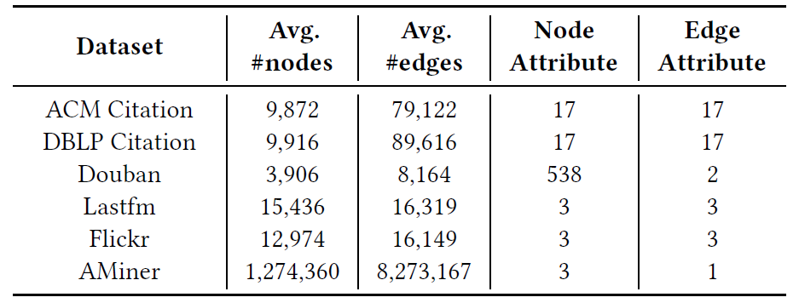
Experimental Evaluation
Research Questions
RQ1 (Effectiveness). How accurate are the proposed methods? How attributes information contribute?
RQ2 (Efficiency). How fast and scalable are the proposed algorithms?
Experimental Setup
Datasets: 6 real-world datasets
18

Slide 19
Experimental Evaluation
Experimental Setting
Parameters: $α=0.6$
Network alignment algorithm
NetAlign [1], IsoRank [2], FINAL[3]
Comparison methods
Matching-based [4], Entropy, Margin, Least confident, Betweenness, Random
Alignment scenario | Query budget (k) | Batch size (b)
ACM-ACM | 200 | $$20$$
ACM-DBLP | $$400$$ | $$40$$
Flickr-Lastfm | 200 | 20
Douban | 100 | 10
[1] Bayati, M. et al. “Message-Passing Algorithms for Sparse Network Alignment.” TKDD.
[2] Singh, R. et al. “Global alignment of multiple protein interaction networks with application to functional orthology detection.” National Academy of Sciences (2008).
[3] Zhang, S., & Tong, H. Final: Fast attributed network alignment. KDD 2016.
[4] Malmi, Eric et al. “Active Network Alignment: A Matching-Based Approach.” CIKM, 2017.
19

Slide 20
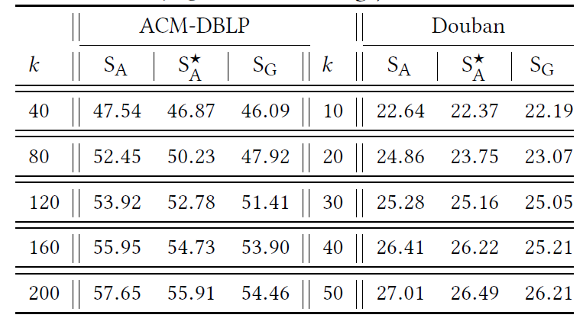
Experimental Evaluation
Our methods
Effectiveness results (FINAL)
Ablation study
Perform experiments on proposed ATTENT-L2 with and without attributes and GibbsMatchings (i.e., $S_{A},S_{A}^{∗}, S_{G}$)
20

Slide 21
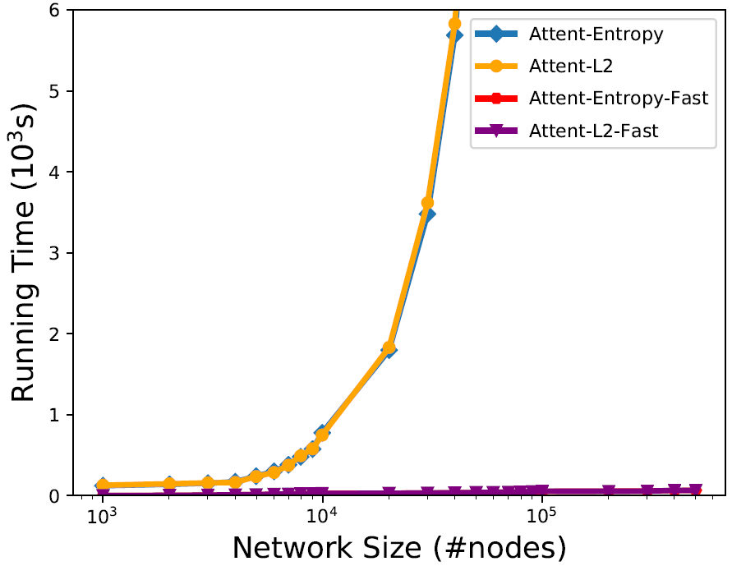
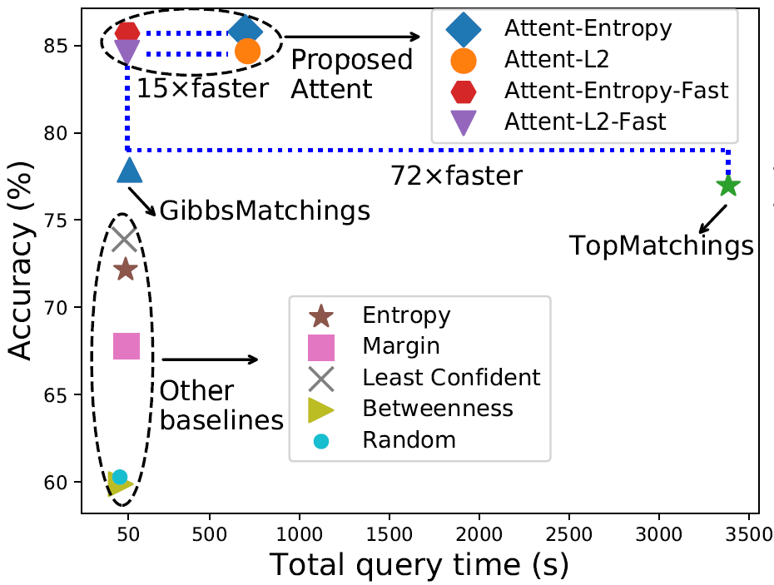
Experimental Evaluation
Efficiency results
Scalability (left)
Balance between quality and running time (right)
Fast solution
Our methods
Our methods
21

Slide 22
Roadmap
Motivations and Background
ATTENT Algorithms
Experimental Evaluation
Conclusions
22

Slide 23
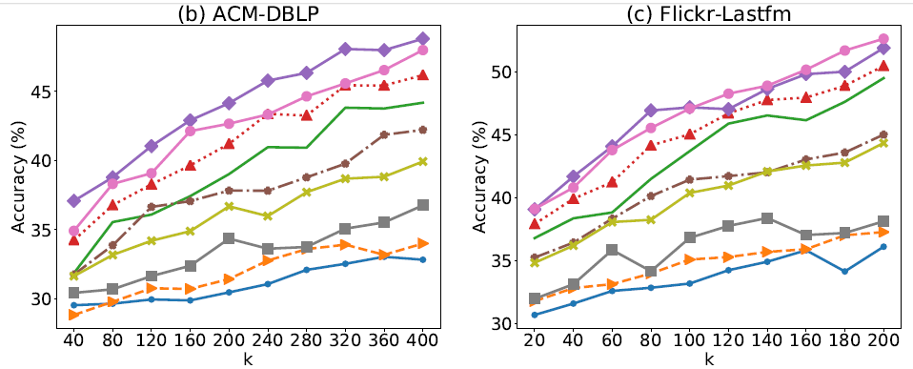
Conclusion
Problem: Active Attributed Network Alignment
Solution:
Quantifying query informativeness
by influence function
Algorithms with fast solution
work for existing network alignment methods
Results: Outperform alternative strategies
Improving network alignment accuracy
Efficient in computation
23

Slide 24
Thank you!

